Slide 1

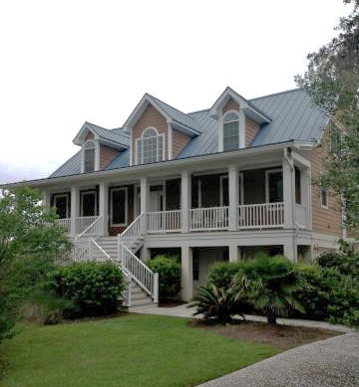



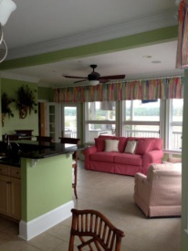

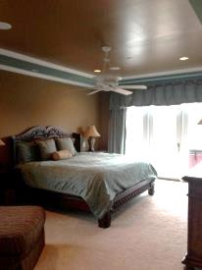

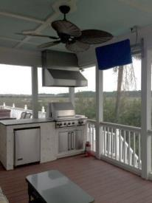
Furnished Waterfront Executive Rental
1202 Finley Rd
Pinefield
Charleston, SC
MLS# 14029871
$3,800/mo
Incredible opportunity to rent this waterfront home with amazing views. This custom built home has everything you would want including Viking and Wolf appliances, a huge family room, oversized kitchen with sunroom and eat-in area. Master bedroom with jacuzzi tub and a huge steam shower! The back side of this home is great for relaxing on the screened porch or taking a dip in the hot tub while overlooking the water. Hardwood Floors found throughout home, gas fireplace, custom built-ins, and an elevator! Call today, this won't last long. Home can be rented fully furnished.
Wendy Delaney | wendydelaneyhomes@comcast.net | 843-670-6889

