Slide 1
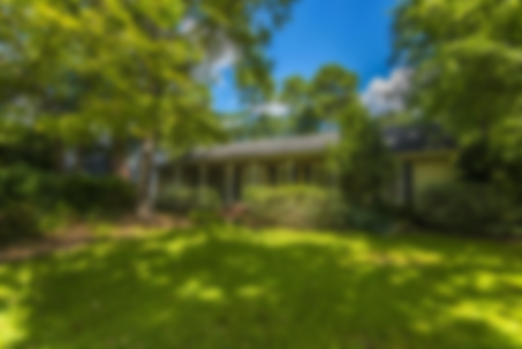
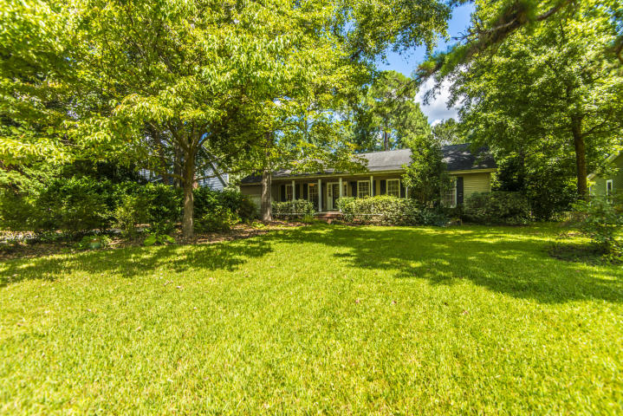
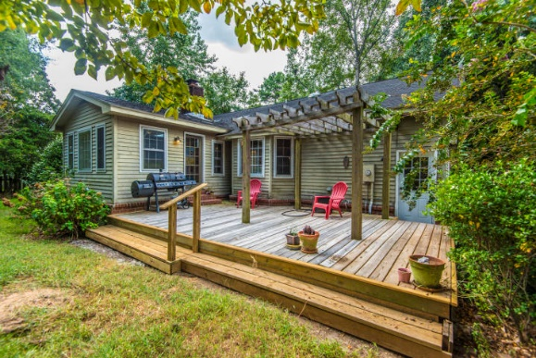
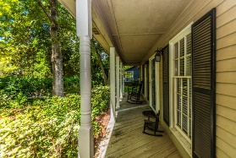
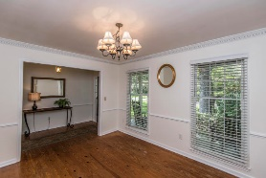
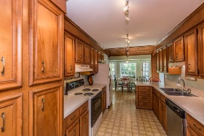
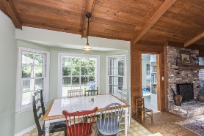
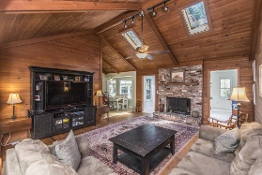
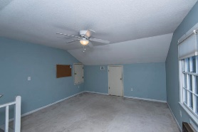
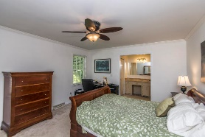
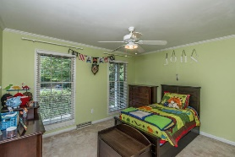
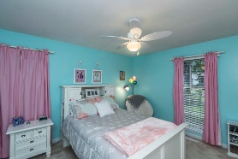
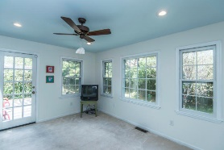


Just Listed in Snee Farm
1203 Ambling Way
Mount Pleasant, SC 29464 | MLS# 18024372 | $414,500
Situated in the heart of Mount Pleasant, this charming home is a great opportunity to move into well established Snee Farm.
This home features 4 bedrooms & 2 bathrooms. The large living room has vaulted ceilings as well as a wood burning fireplace. The kitchen has an eat in area along with a separate dining room perfect for entertaining.
The fenced in backyard with deck will provide plenty of space for outdoor fun! Sit back and relax on the front porch overlooking the beautiful large front yard.
This home is ready for you!
Lauren Courcoux
Mobile - (843) 224-8613
lauren.courcoux@carolinaone.com
www.laurendelucacourcoux.com
Carolina One Real Estate | 2713 Highway 17 North | Mt Pleasant, SC 29466

