Slide 1
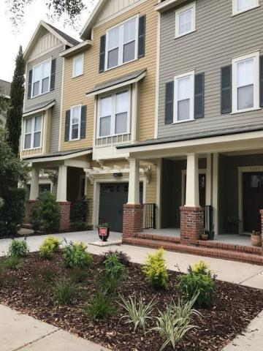
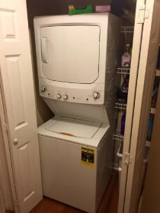
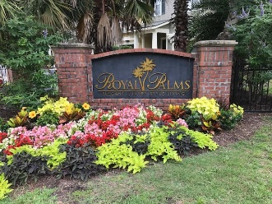
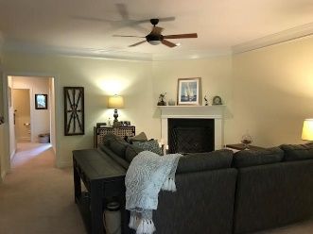
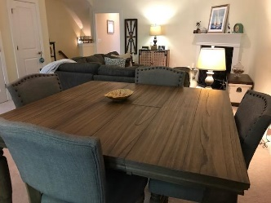
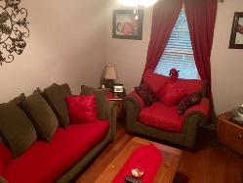
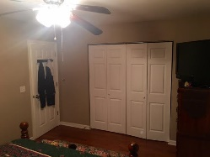
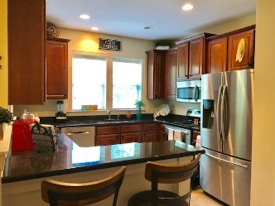
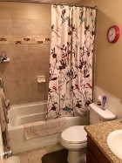
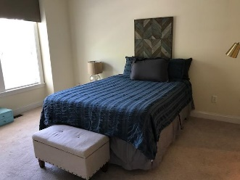
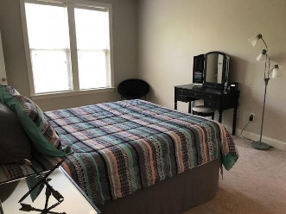
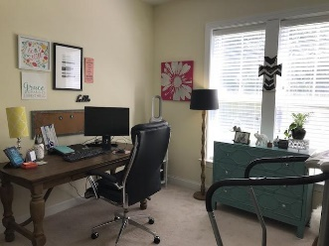
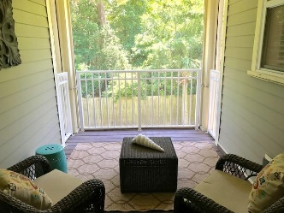

1203 Dingle Road Royal Palms Mount Pleasant, SC 29466 MLS# 17015637 $337,000 4 Bedrooms | 2/2 Baths | 2,512 sf
Open House This Weekend!
Saturday 11-1 & Sunday 11-2
Motivated Seller!
This beautiful townhouse has 4 nice sized bedrooms, 2 full baths, 2 half baths, and 2449 square feet of comfortable living in the northern end of town. This Sovereign model is the largest floor plan in Royal Palms. Upon entering the home you’ll be welcomed into a large foyer. Down the hallway you can decided if that fourth bedroom is an office or a bedroom! There is a half bath on the first floor. This home has a fairly private backyard waiting for your creative touch! The second level features an open living, dining and kitchen area with double doors to a screened in porch. This living area also has a corner gas-fired fireplace and it really warms the room for those colder Charleston winters. The kitchen has 42-inch cabinets, crown molding, stainless steel appliances, granite counters and a raised island with seating for two. The master bedroom has a large walk-in closet, two sinks, tiled shower, soaking tub, and separate toilet area. The third floor has two full bedrooms, one with a walk-in closet, the other with an extra sitting space, that share a Jack and Jill bath with separate sinks and extra cabinets. This area offers privacy for the children or can be a great guest room for friends visiting your new home!
Susan & Greg Day
843-900-0477 | 732-757-2904 charlestonbyday@gmail.com
www.charlestonbyday.com
AgentOwned Realty Co. Premier Group, Inc. | 824 Johnnie Dodds Blvd | Mt Pleasant, SC 29464

