Slide 1
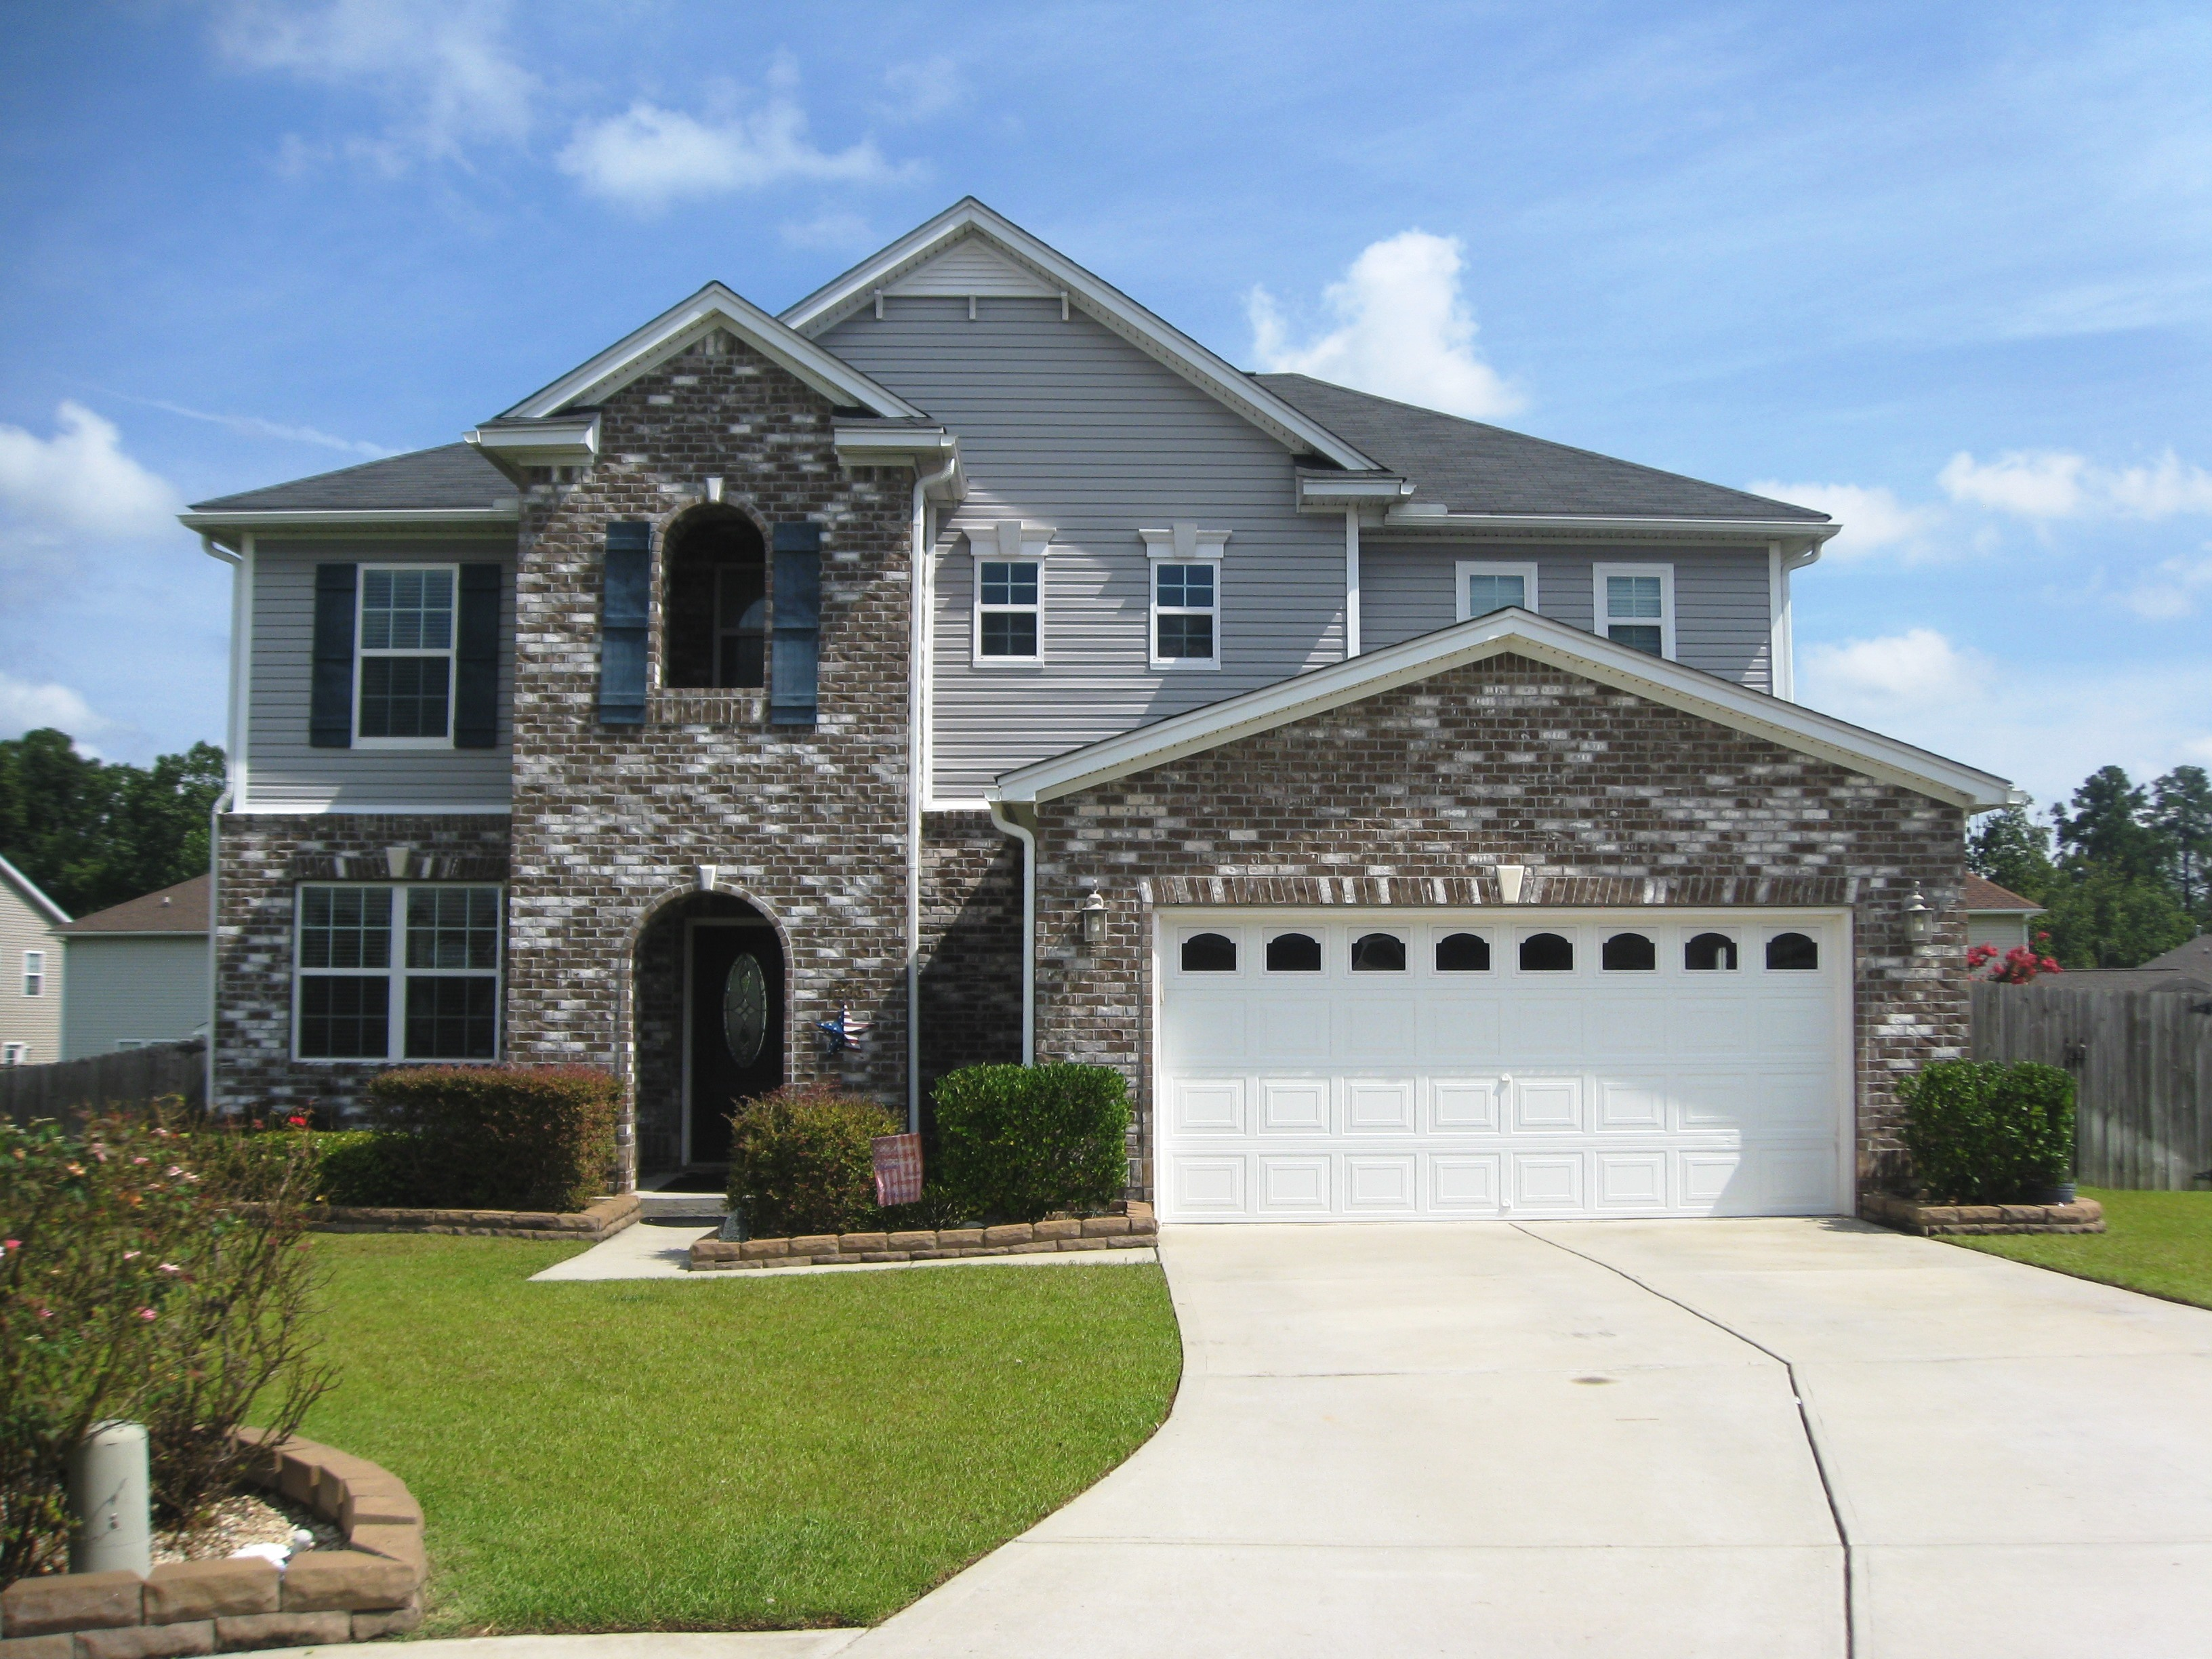
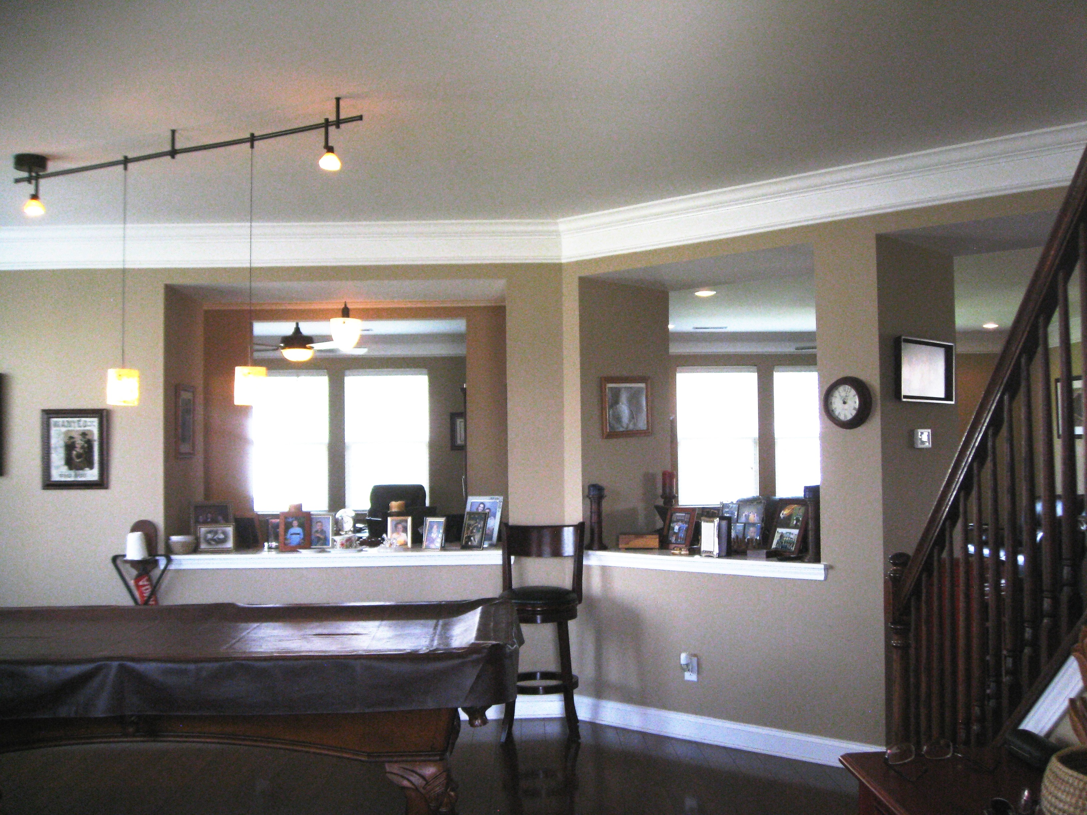
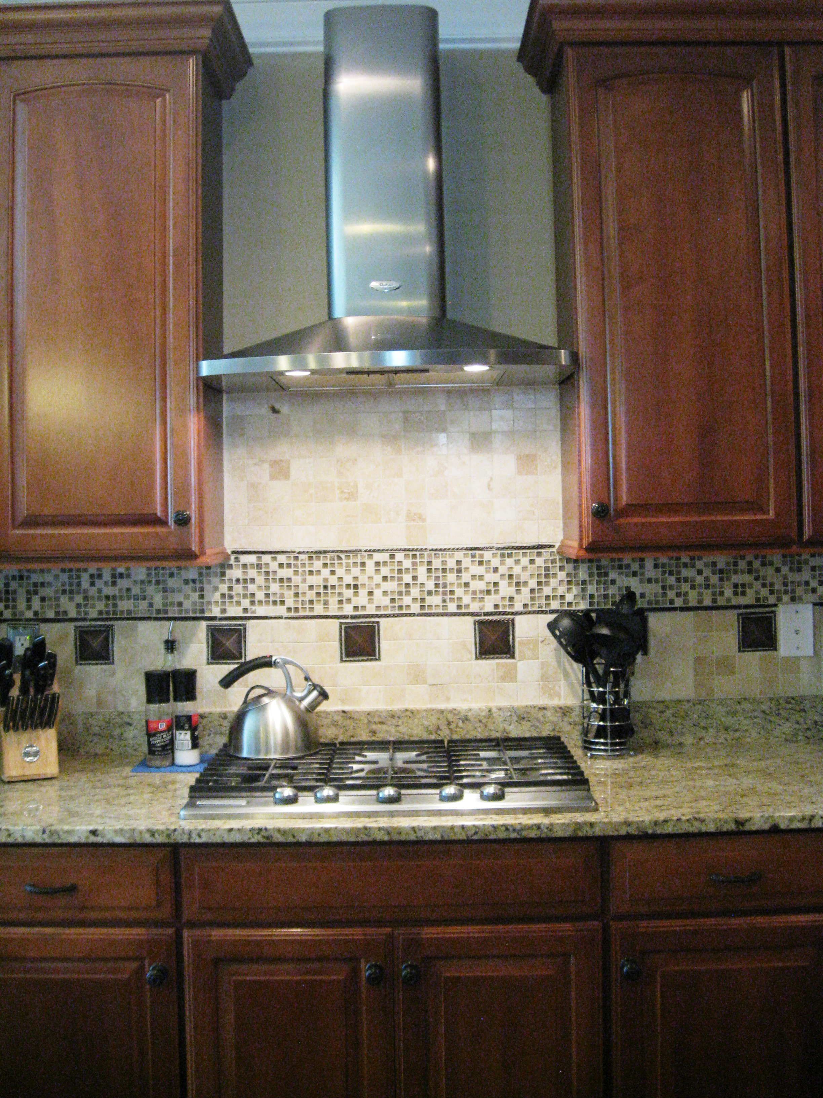
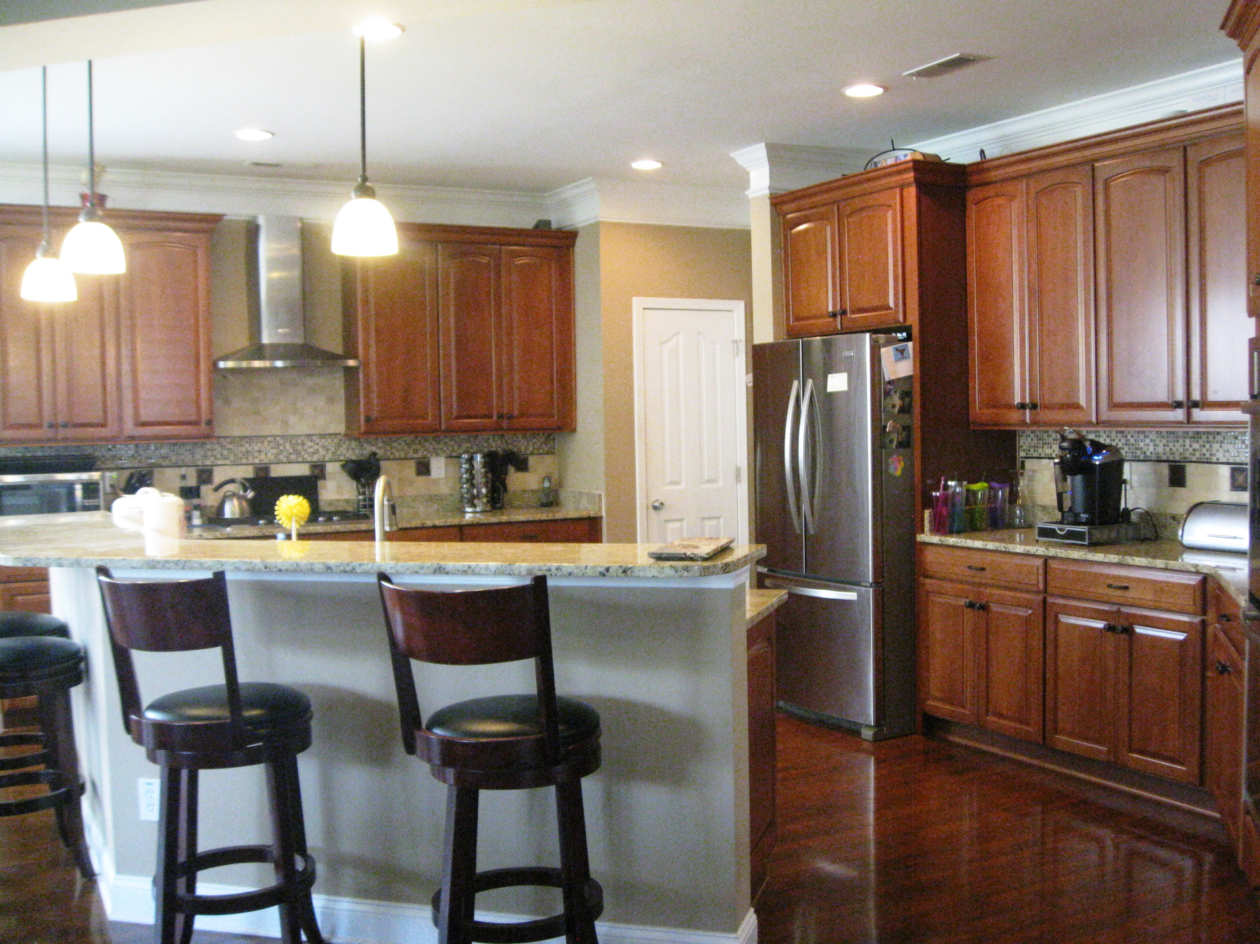
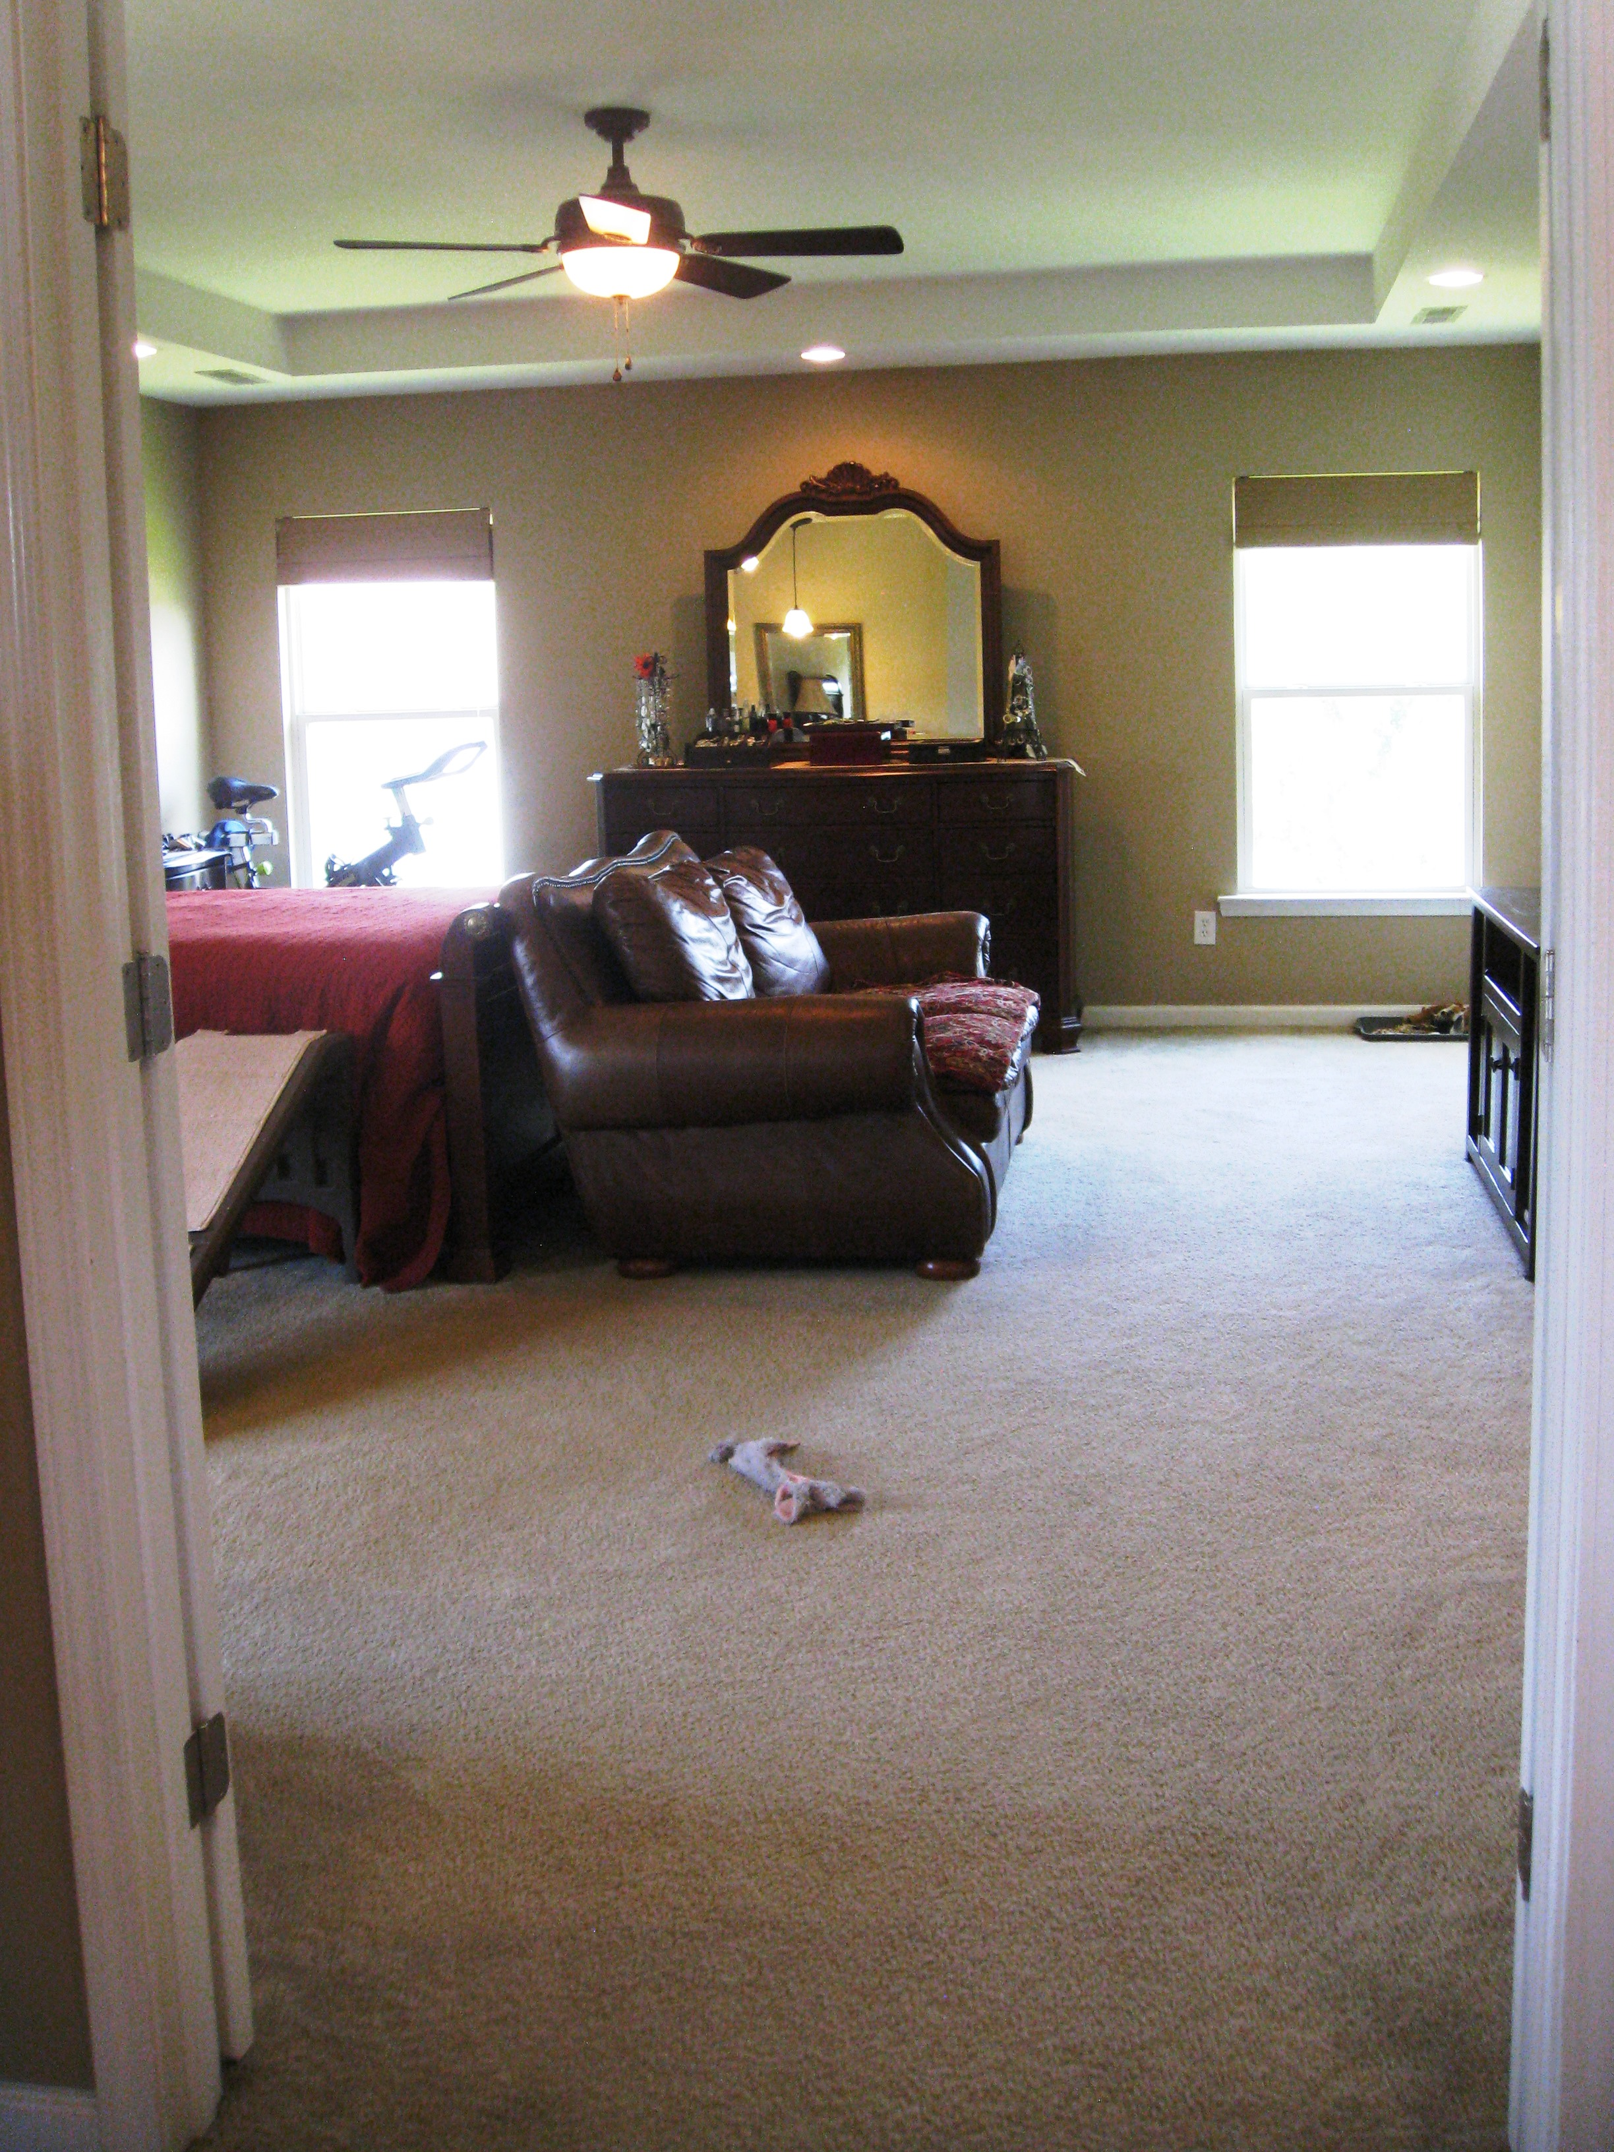
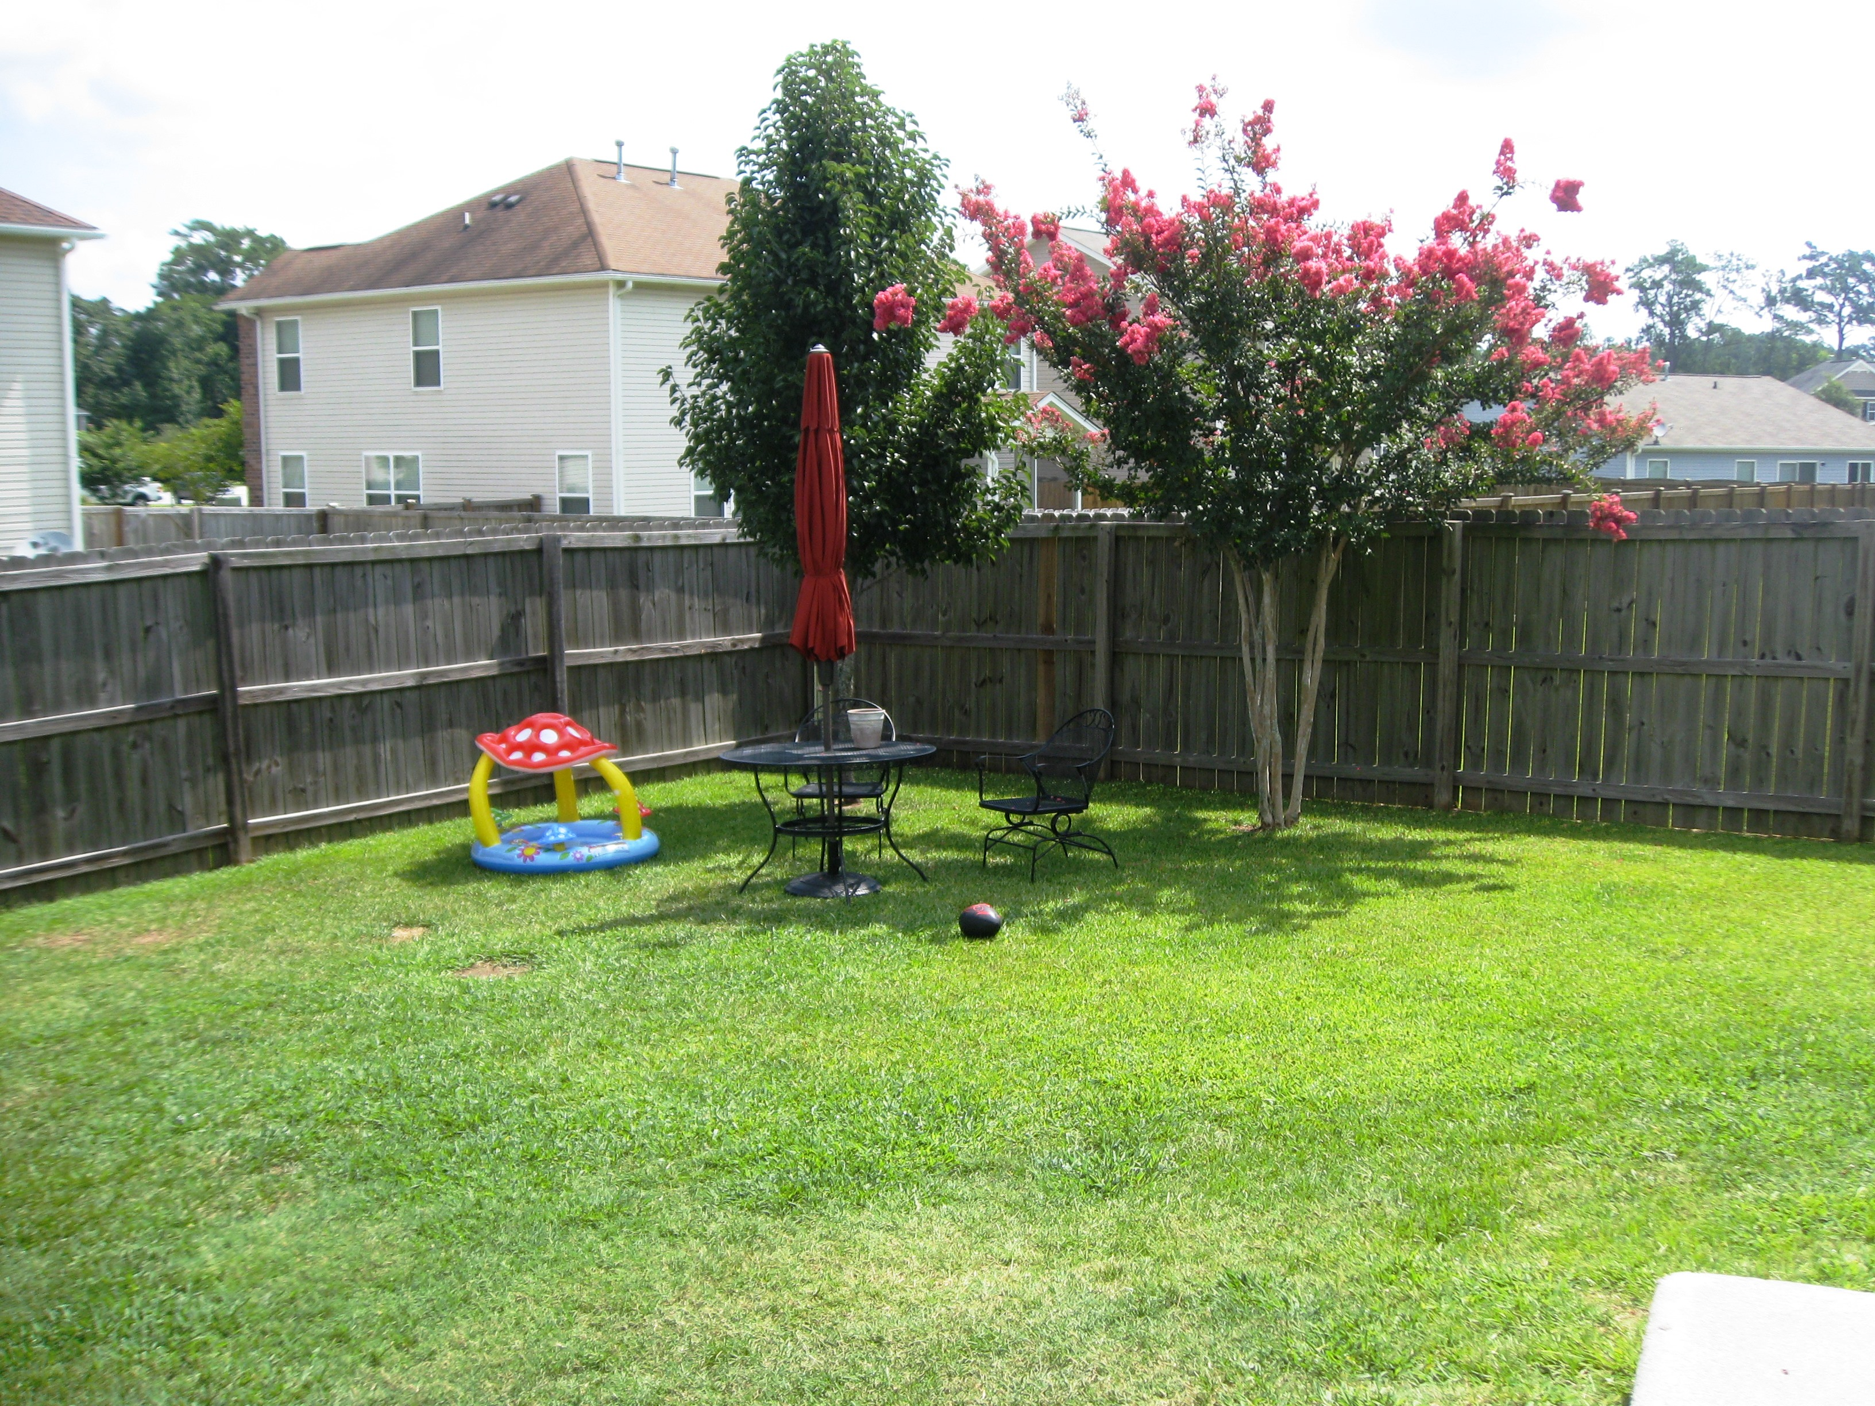


Ready To Sell!!
Price Reduced!
1203 Saffron Lane
Tanner Plantation ~ Hanahan ~ MLS# 15019256 ~ $342,900
Unbelievable space in this lovely, well maintained home!! Gorgeous yard, the awesome open floor plan & the beautiful Laminate floors, will pull you in! Great home for family or the opportunity for some fun entertaining! Home offers Gourmet Chef's Kitchen w/Maple Cabinets, Granite, Tile backsplash,5 Burner Gas Range w/ hood, Double wall oven, SS appliances. Exterior offers: screened in porch, lawn irrigation,220 outlet out back for sauna, lovely landscaping. Home is wired for alarm system including window break sensors & door sensors. This is a 3 bdrm home but if you need 4, the loft or downstairs study can be easily converted. Upstairs you will find the largest Master Bedroom ever...with tray ceilings & a huge walk in closet! Both extra bedrooms also have large walk in closets & in hall there are 2 very nice sized linen closets. Also upstairs is the laundry room with plenty of space & a utility sink. The 2 car garage also offers a utility sink. Owners have a transferable termite bond & there is 5 years left on the Builders Warranty. This Energy Star Home has so many upgrades....list available if you are interested! This lovely home is located in the Blue Ribbon Hanahan School District and convenient to SPAWR, Air Force Base & Boeing. Neighborhood offers shopping center for your convenience.
Jeanne Weekley, Realtor
843-442-3364
jeanne.weekley07@comcast.net
ERA Wilder Realty, 125-F Wappoo Creek Dr, Charleston, SC 29412

