Slide 1
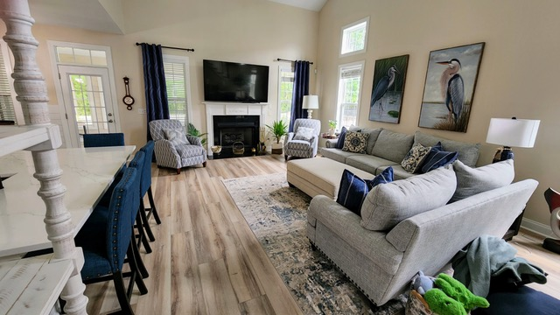
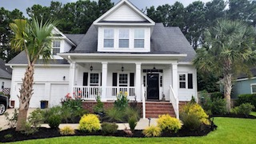
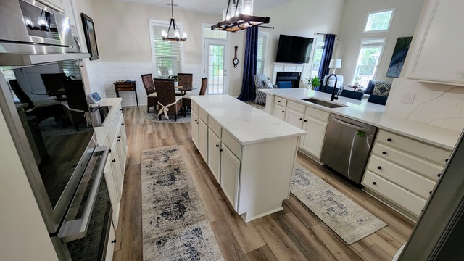
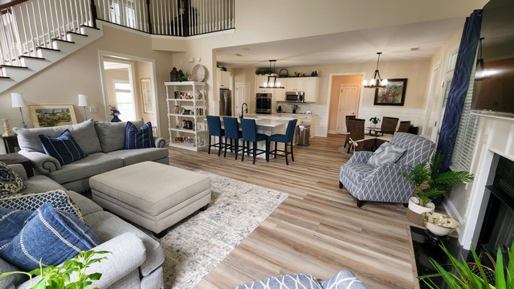
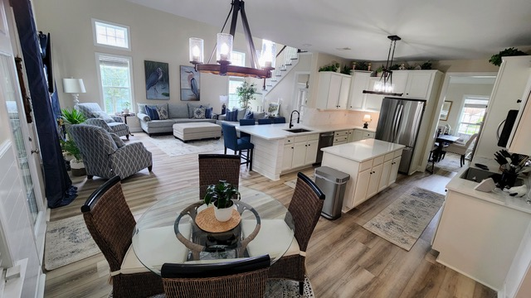
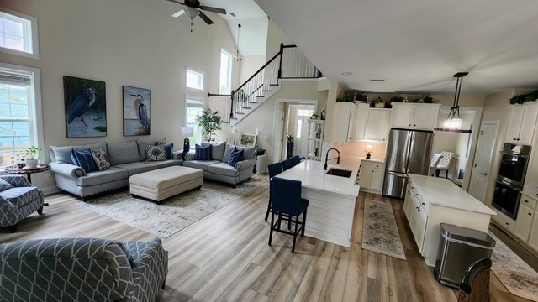
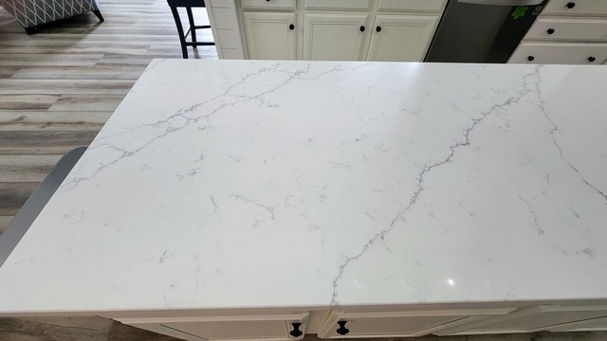


Coming Soon and OPEN HOUSE
Saturday 8/20 10am-2pm
1203 Rivers Reach Drive
River Reach Pointe
Wando, SC 29492
MLS# 22021931 | $784,900
This is a fully renovated stunner of a home! Time to gather up those, “All I want to do is unpack my boxes!” buyer clients and schedule your tour! Or send them Saturday between 10 and 2 to check out the Open House.
This home has been completely transformed! Painted inside and out, all new flooring, completely renovated and updated kitchen, reconstructed gorgeous sunroom overlooking a private wooded yard. Just steps away from the community dock in River Reach Pointe on the Wando River. This home is a WINNER!!!!
Ellen O'Neil
Broker/Owner, ABR, e-PRO, CNE
Charleston Realtor of Distinction
(843) 300-8530
www.EllenONeilProperties.com

