Slide 1
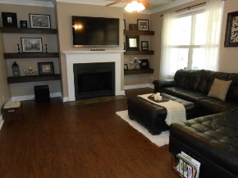
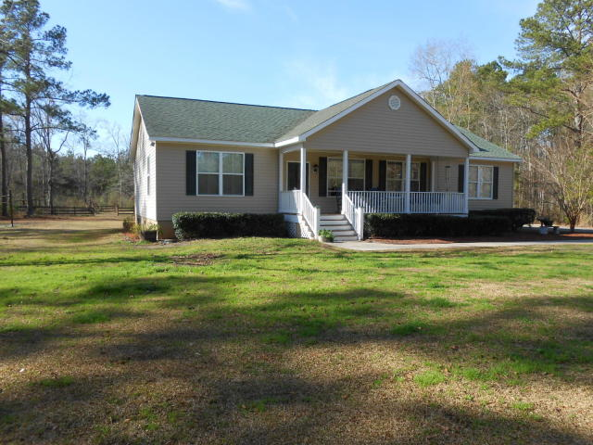
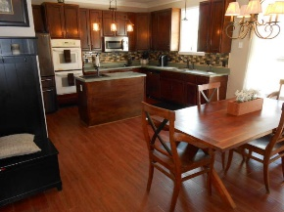
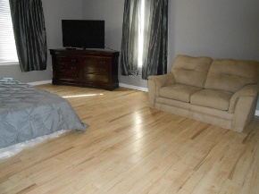
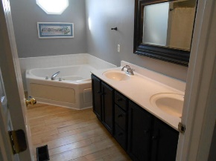
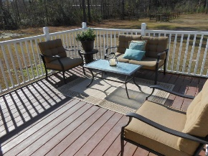
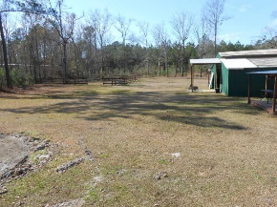
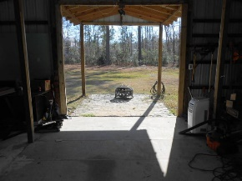
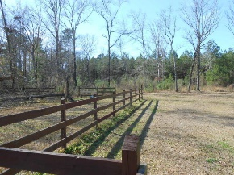

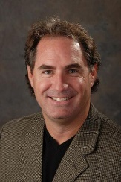
1204 Saddlehorn Road Eagle Harbor ~ Summerville MLS# 17001574 ~ $300,000
Bring Your Horses!
Over 4 acres so bring your horses, four wheelers, and all of your toys because there's room to enjoy them! There's also an herb garden, and a great sand volleyball court for your crew! This property is located a short distance past Cane Bay High School and is in a very low tax district of Berkeley County. One level of easy living with large bedrooms. The owners previously had horses so there is some fencing still in place. There is also a metal building that was previously used as a barn. The stall dividers have been removed but it can easily be made back into a barn.
Gregg Fesler GRI, CRS, REALTOR
Office (843) 856-3983 | Mobile (843) 797-0000
gregg@greggfesler.com
Carolina One Real Estate | 628 Long Point Rd. | Mt Pleasant, SC 29464-3032

