Slide 1
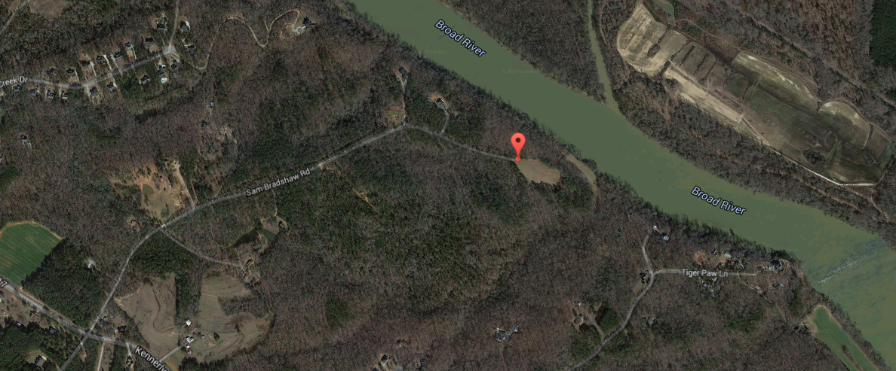

1204 Sam Bradshaw
Irmo, SC 29063
MLS# 14029922
$780,000
55 Gorgeous Acres!
This is a gorgeous wooded lot with babbling brook located in Richland County, recently named ''best new bedroom community.''
Walking distance to the Broad River!
This is an opportunity to enjoy private, rural living that is close to excellent schools - the elementary and middle schools both score a 9 out of 10 in the Great Schools Rating.
The 55 acres has many possible uses; private farm, shared mini-farms, or a fantastic equestrian estate.
Possibility for residential development.
Zoning is RU - Rural Residential
Liisa Sewell
Office - (843) 416-3037
Mobile - (843) 693-6027
lsewell@carolinaone.com
Carolina One Real Estate
195 W Coleman Blvd
Mt Pleasant, SC 29464

