Slide 1

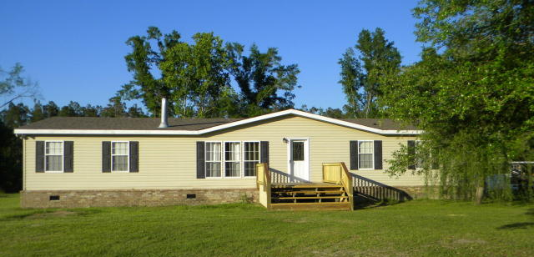
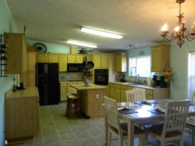
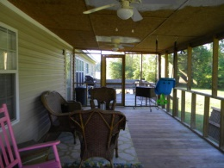
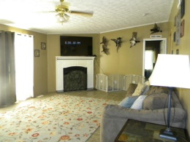
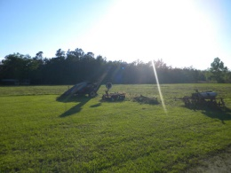
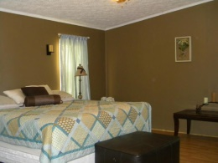
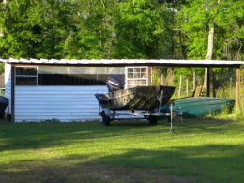
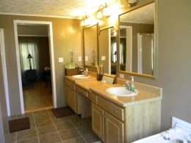
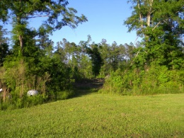
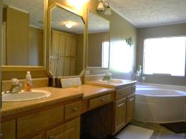
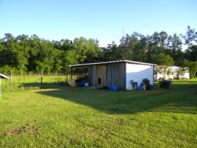


This is a must see Over 10 acres! Perfect for farming or horses
1204 Thomas Road Ruffin, SC 29475 • MLS# 15010946 • $161,800
Love the outdoors? Then you will love this property! This is a must see for anyone that loves the great outdoors! Over 10 acres perfect for farming or horses. Home features Large open kitchen with lots of cabinets and storage, breakfast island, wall oven and dining area. Great room has wood burning fireplace and ample space to spread out and relax. King sized Master bedroom with enormous walk-in closet and master bath has separate soaker tub and large walk-in shower and dual sink vanity. The other 2 bedrooms are very spacious with large closets. Spacious laundry and storage room. Large screened in back porch to enjoy the peaceful serenity of country living! There are several outbuildings you can use for storage, chicken coop, horse stable and plenty more room to add what you like!
Christina Garvin
(843) 270-7667 | cgarvin63@gmail.com
Elaine Brabham and Associates, LLC • 1890 Sam Rittenberg Boulevard, Suite 217 • Charleston, SC 29407

