Slide 1
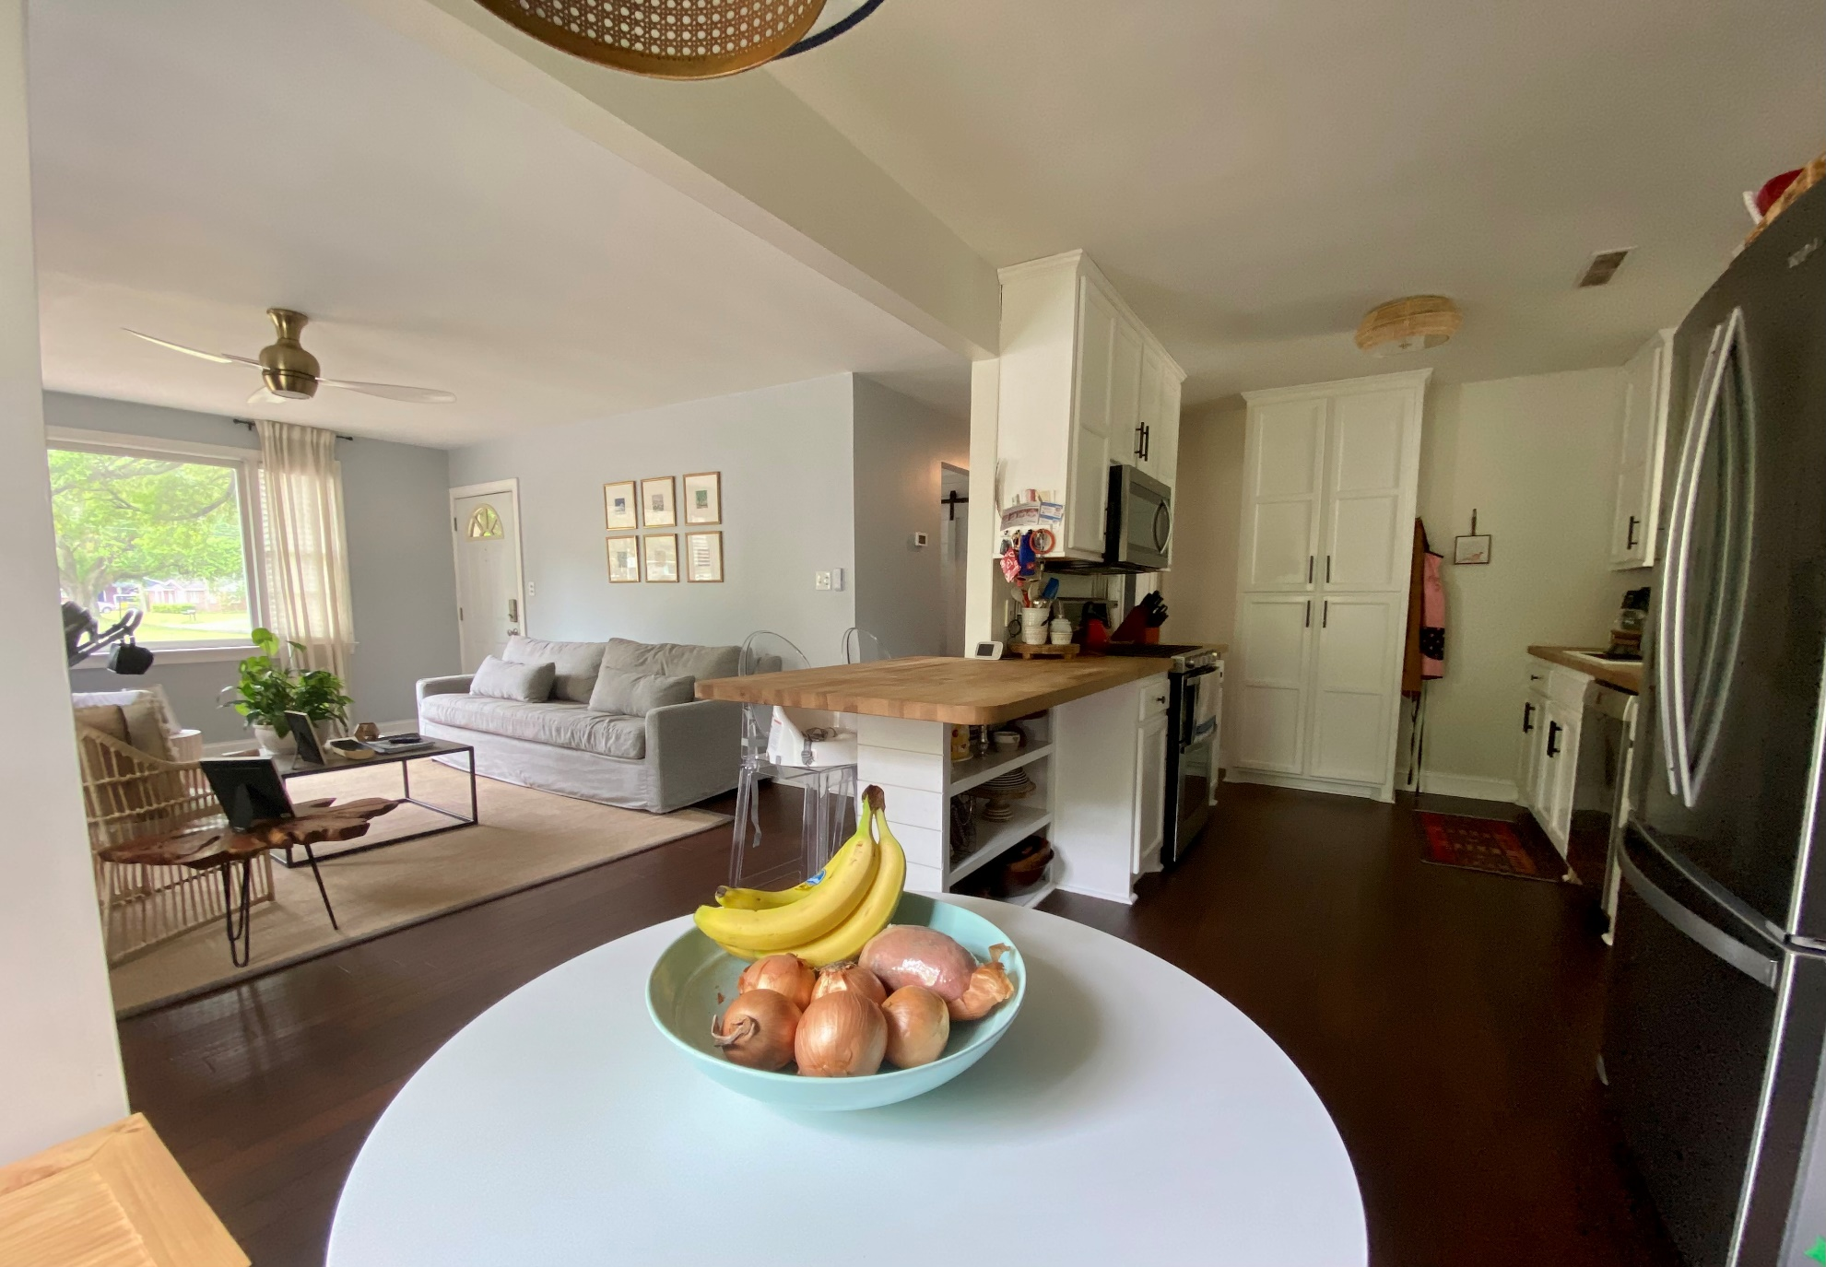
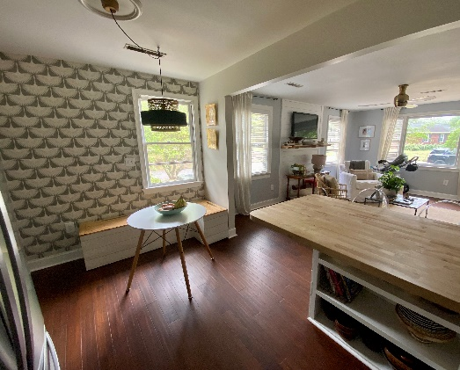
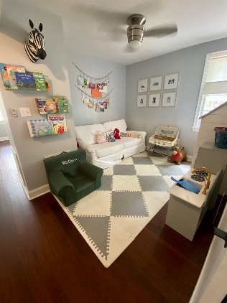
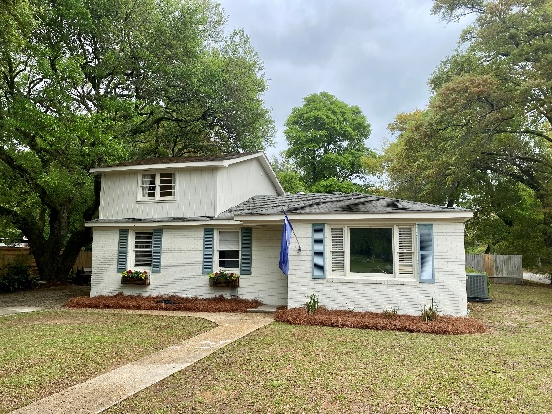


Great Value on James Island
1204 Julian Clark Road
Clarks Point | Charleston, SC 29412 | Offering at $550,000
Huge lot, 1700 sq ft, 3/2/0
Goes live tomorrow! Contact list agent for showing info, easy to see. Very few updated homes at this price on James Island.
Justin Natale
843-437-9739 | jnatale1982@gmail.com
www.theblvdcompany.com
The Boulevard Company, LLC | 806 Johnnie Dodds Blvd Ste 100 | Mt Pleasant, SC 29464

