Slide 1
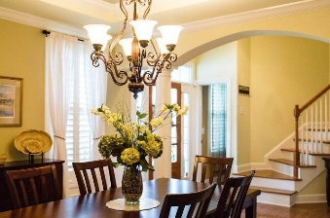
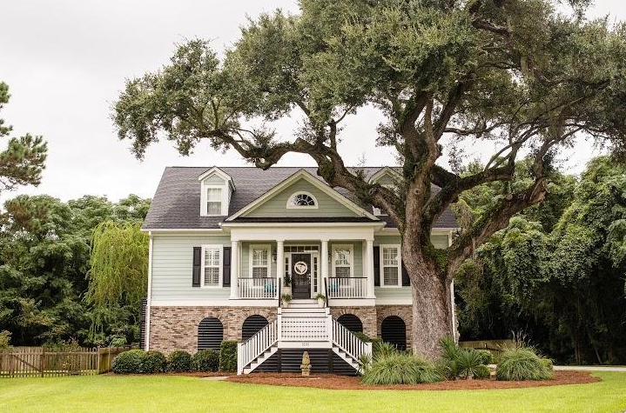
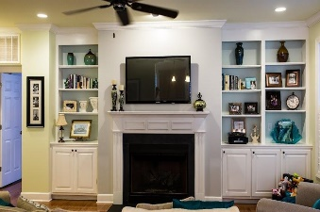
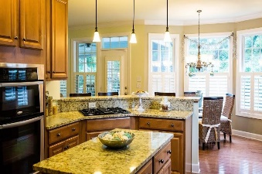

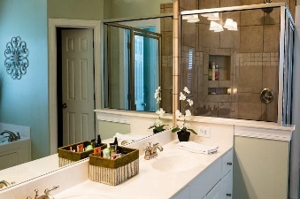
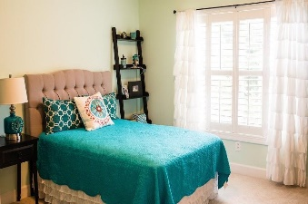
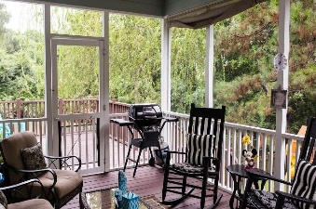
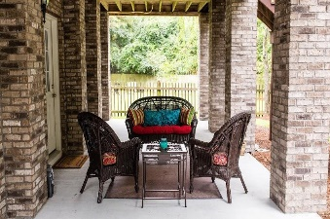
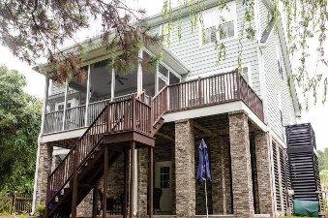


1205 Flowering Oak Way
Hamlin Plantation ~ Mount Pleasant
MLS# 15021823 ~ $595,000
Motivated Seller!
Beautiful Southern charm home for the Lowcountry style lifestyle in The Village subsection of Hamlin Plantation. Close to the new Jennie Moore and Laing Schools. As you pull up you will enjoy the large front yard with a gorgeous grand oak. Enjoy sitting on your front porch overlooking your large front yard with gas lanterns that flank the entry. This true 5 bedroom, 3 1/2 bath elevated construction with rear covered patio, deck, screened porch overlooking your private fenced back yard.Open floor plan with separate dining room perfect for family gatherings and dinner parties. The family room has gas fireplace with built-ins open to the kitchen and breakfast area. The chefs kitchen with granite countertops, center island, wall oven/microwave and gas stove top. Hardwood floors throughout the first floor with master on first floor. Master bathroom with two walk-in closets, jetted tub, walk-in tile shower and double vanity. Three bedrooms share hall bath, large media room can be used as a fifth bedroom with a private bathroom. Plantation shutters throughout, Irrigation system , yard lighting and 3+ car garage with plenty of room to keep 3 cars, a boat and a golf cart and a storage room. Hamlin Plantation amenities include a junior Olympic swimming pool with waterslide, clubhouse, play park, workout building, basketball court, beach volleyball court, tennis courts, hiking and biking trails and optional boat storage. Buyer to verify any information deemed important to them.
Steve DeMarco
Cell - 843-442-1520
steve@beresfordappraisals.com
www.beresfordrealty.com
Beresford Realty, LLC | 672 Marina Dr, S-206B | Charleston, SC 29492

