Slide 1
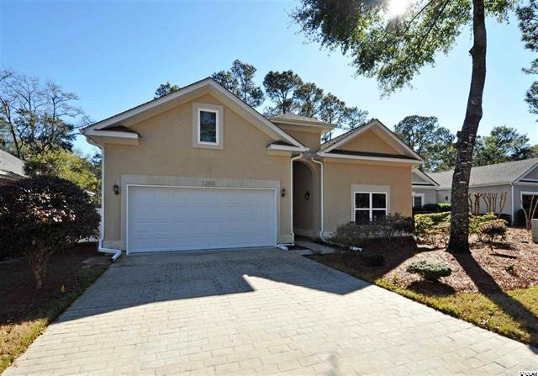
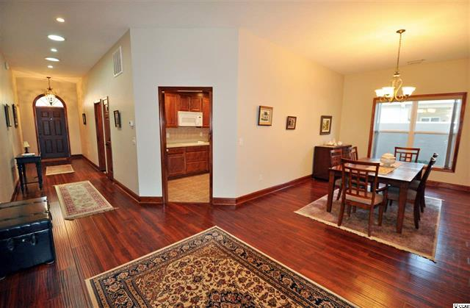
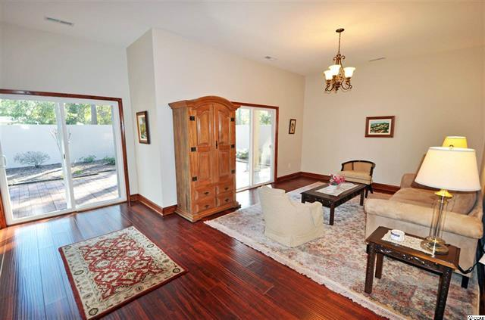
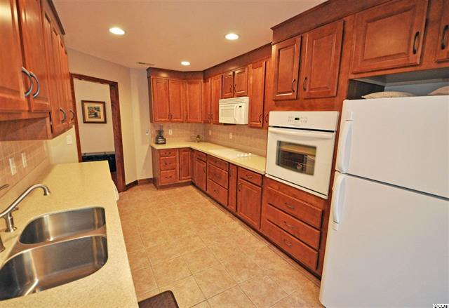
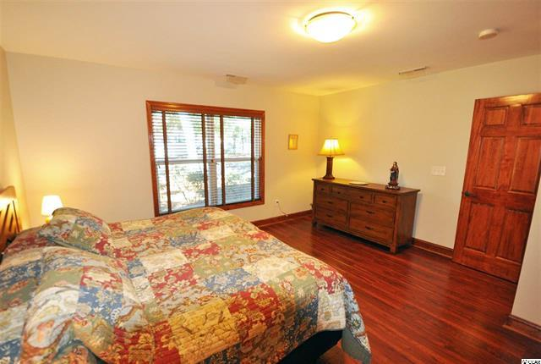
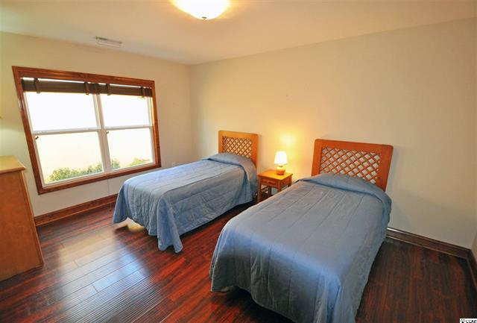
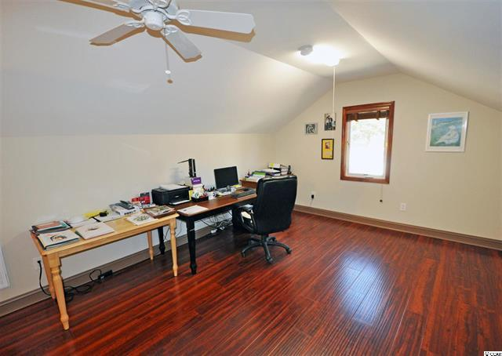
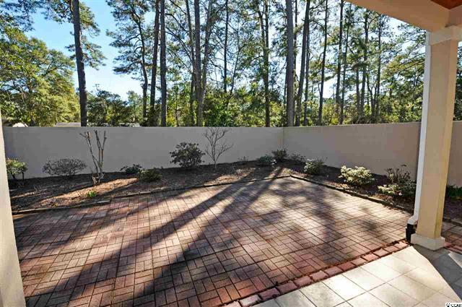


Architectural-Deigned Luxury
but easy-living beach home for the generations!
1205 Trisail Lane
Tidewater Plantation ~ North Myrtle Beach, SC 29582 ~ MLS# 1901996 ~ $349,520
Cash preferred, credit/debit cards accepted, NO checks
Items sold as is, where is.
All sales final.
Rain or shine.
No public restroom.
No food or drink allowed in the house.
Inspect items to your satisfaction before purchase.
Bring help to load large items.
You (or your child) break it, you buy it.
Use caution while on the property: we are not responsible for accidents or injuries.
We reserve the right to open the sale before the posted start time.
First come, first served – the waiting line must monitor itself.
There are no "holds" or pre-sales on items pictured for sale.
No animals please (we love them, but this is a private residence).
Items purchased and left onsite at the conclusion of a sale will be considered abandoned and removed as needed.
Though rare, due to circumstances beyond our control, an item(s) pictured for sale may be removed by our client prior to the doors opening.
By attending, guests understand and agree to allow the recording of their image for security
Or marketing purposes.
If the sale is being conducted in a covenant restricted community, such covenants
Must be followed by all participants.
This is a remarkable, architect-designed masterpiece...timeless and ageless! It took 6 months to build. When you think of a luxury, custom-built home in Europe, do you call to mind a livable, memorable house meant to pass with resplendent, classic architectural features from one generation to the next? These rare houses offer much thought and attention in every fine detail, from conception, managed construction and loving, functional occupancy to families for the ages. Such a unique find now truly exists for sale in the Plantation of Tidewater Resort – and at a fraction of the price to barely even attempt to reproduce today. Enter from a covered front landing through a beautiful dark-stained solid-wood signature door. Simple elegance, but you know immediately that this clean, clutter-free showpiece, with ceilings up to 10', is not going to be ordinary. The center hallway is wide, facilitating handicap access, if desired, and with the ease of notable spaciousness. Surprises await behind several more lovely dark-stained wood corridor doors, matching trim and room entrances; moreover, the hallway view is directly through the entire home to a walled, gated, private courtyard for alfresco dining, the addition of a pool/spa, master gardening or just complete relaxation in this personal outdoor enclave. And the floor throughout is a contiguous stunner of rich gleaming cherry-color – merely vacuum and damp mop. NO CARPET! A nice surprise is the roomy, multi-purpose utility room with sink, extra counter tops, stacked washer/dryer, several storage/closet spaces and multi-purpose entries, including hall, garage, half-bath and kitchen. Convenience x 4! Architect-inspired flex space best describes a home with from 2- to 4- bedrooms, two of which are comfortably big suites with full baths. There are 2-half and 2-full baths with walk-in tiled showers, plus a workable galley kitchen with desk area and great traffic pattern, convenient planned storage with built-in components, the perfect master suite at the front of the home and well separated from other bedrooms which include that second master with en suite, upscale formal dining and living rooms, separate den, and bonus room up a small flight of stairs and with more storage and the second half bath. The bonus room can also be another bedroom. The home boasts more than 2300 sq. ft. of heated, clean, practical yet splendid living space. A list of many impressive upgrades and features is associated to the listing. No need to travel the world; see this little bit of Europe for yourself today. Feel free to linger to remember this ageless, timeless treasure in the Courtyard Neighborhood of Tidewater Plantation Resort. Amenity-rich Tidewater is on a tree-lined road to oceanfront Anne Tilghman Boyce Coastal Reserve, a nature conservancy, including Waties Island, with access for managed recreational use. Tidewater itself is on an elevated peninsula of live oaks and southern pines between the Intracoastal Waterway and the Cherry Grove Inlet to the Atlantic Ocean. The plantation also preserves the singular look of its own historic origins. It is minutes from the beach, shopping, medical services, entertainment and access to major highways. Rich amenities at low, low HOAs include an oceanfront beach cabana for owners' use with open/screened porches, bathrooms, showers and kitchen. Residents enjoy the use of several pools/hot tubs. Other amenities include a driving range, golf shop, clubhouse with bar/dining and event facilities overlooking the 18th hole, clay and hard surface tennis courts, pickle ball court, fitness center overlooking a pool, bocce courts and amenity center for public/private events. Tidewater has a gated storage yard for boats, jet skis, motorcycles & kayaks. Tidewater Plantation, with its full range of things to do and to enjoy, reflects a "way of life" in safe, affordable North Myrtle Beach, which has the lowest tax millage of any such full-service city of its kind in the Carolinas.
Deborah Collins
843-424-9013
dctidewater@yahoo.com
Connie Ross-Karl
702-306-2643
conniesross@aol.com
NEW WAY PROPERTIES MYRTLE BEACH

