Slide 1
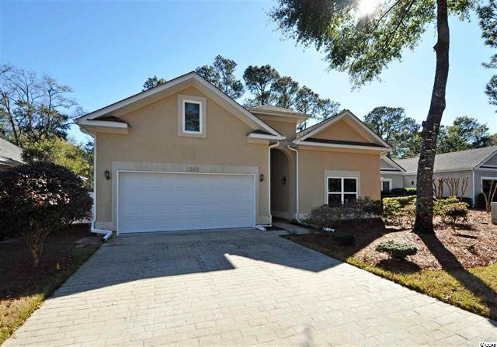
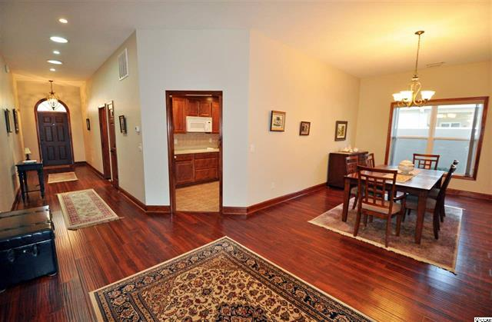
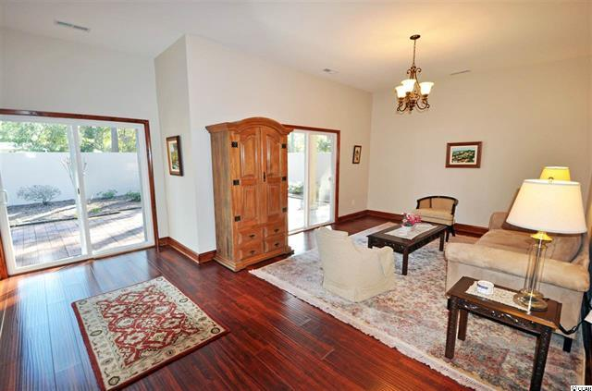
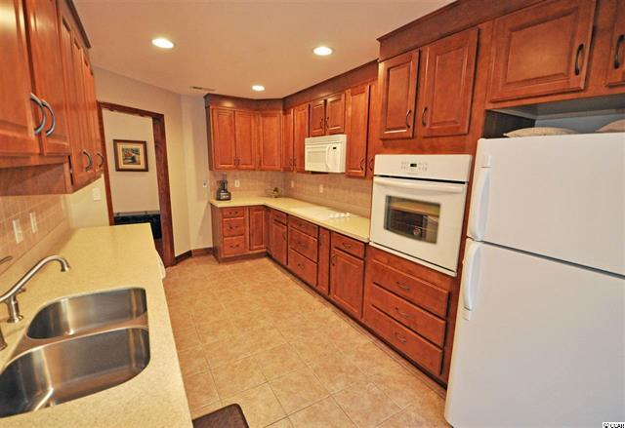
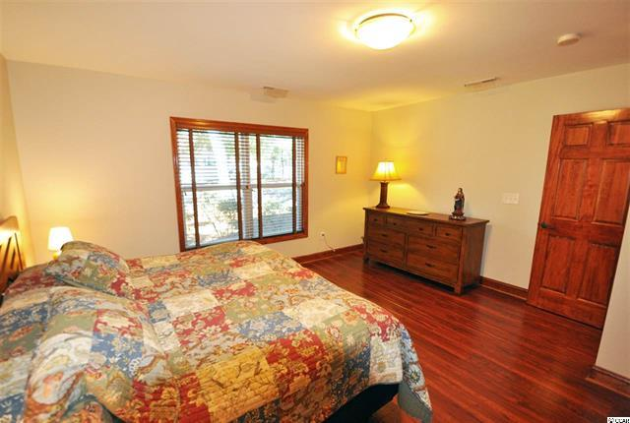
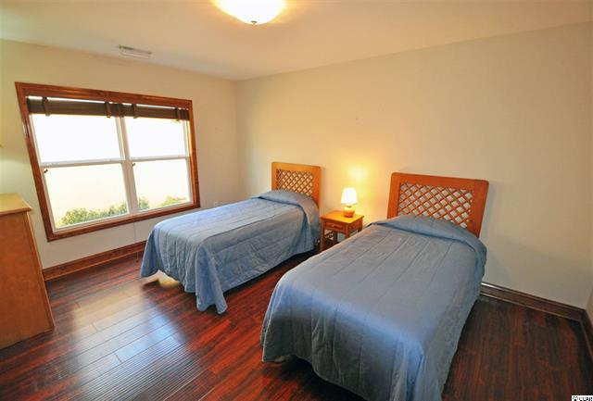
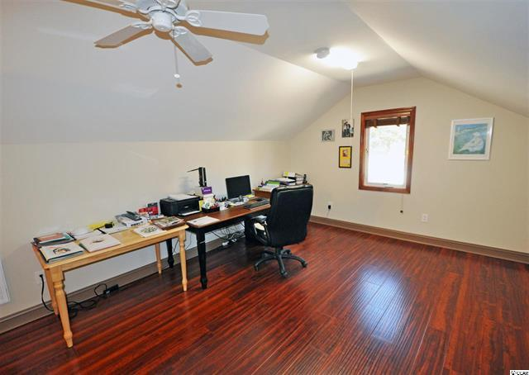
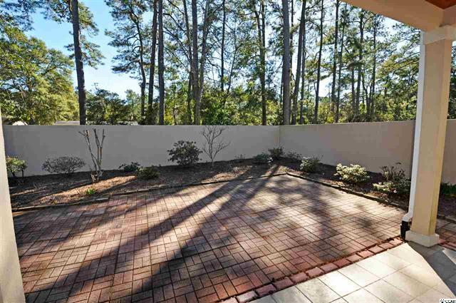


Architectural-Deigned Luxury
but easy-living beach home for the generations!
1205 Trisail Lane
Tidewater Plantation ~ North Myrtle Beach, SC 29582
Features and Upgrades
The construction of this extraordinary home was managed daily by the owner; the home was actually built over a 6-month period by a team of Brazilian workers and artisans, from remarkable specifications put together by the architect and the owners. The owners have lived in several countries and come from European backgrounds; so this home, meant for a lifetime, was a compilation of the best living experiences from their previous residences. Original floor plan available. Please find the impressive list of features and upgrades following:
Interior
Ceiling heights up to 10'
2 solar tubes in entry hall
Coat closet in entry hall
UV film protection on sliding door in kitchen, dining & master bedrooms and flex room
3 large patio doors at back of home for full patio views
Solar energy attic exhaust fan
Large, state-of-the-art Trane heat pump
Special whole-house filter for HVAC, with central filter system, only one filter and changed twice a year
Solid wood doors and trim
Storage areas on both levels
The pipes inside the house are what is called: PEX PIPES
Ceiling fan at rear covered patio
Third bedroom upstairs with half bath or can be used as a bonus room
Flex room on main level is currently used as a den
Hallway lights have dimmers
Dining room light has dimmer
Both showers are reinforced to also act as a refuge from high winds
Kitchen Improvements
New light fixtures with dimmer
DuPont Corian counter tops in popular neutral gray color
Drop-in cook top
Kitchen sink with Moen faucet with sprayer
Heavy duty water filter under sink
Extended warranty on cook top and dishwasher
Strong exhaust fan
Wall oven
Lazy Susan in cabinets
Dedicated space for bags and cookie sheets
En Suite Bedrooms
Large walk-in closets with built-in components
Spacious walk-in tiled showers with safety grab bars
ADA compliant toilets
Laundry
Extra large sink
Pantry
Stacked washer/dryer with extended warranty
Half bath accessible via the garage and laundry room
Entrance directly to laundry room and to kitchen also from the garage
New light fixtures with dimmer
Miscellaneous
Grand Strand Pest control has serviced home since it was built
Builder used additional termite protection on the frame and wood
Weed fabric under pine straw and mulch in backyard
Pine Straw changed twice yearly by HOA at no additional charge
Front yard mowed and driveway blown off every Wednesday
Plants pruned several times a year
Garbage, yard debris and recycles picked up every Tuesday morning
One-year Old Republic Home Warranty for Buyers
Easy, economical housecleaning
Kitchen counter tops clean up with only soap and water, no special cleansers required.
Windows and doors inside are cleaned with water only
Dark floors throughout the entire home are vacuumed and damp mopped, NO CARPET!
Storage upstairs in bonus room as well as in a large floored attic area off bonus room
The courtyard is walled, and there is room for a pool/spa; the wall that goes to the backyard patio is reinforced with additional metal brackets and more wood to withstand high winds
Two exterior patios, one covered
Fine, handmade stucco exterior
Deborah Collins
843-424-9013
dctidewater@yahoo.com
Connie Ross-Karl
702-306-2643
conniesross@aol.com
NEW WAY PROPERTIES MYRTLE BEACH

