Slide 1
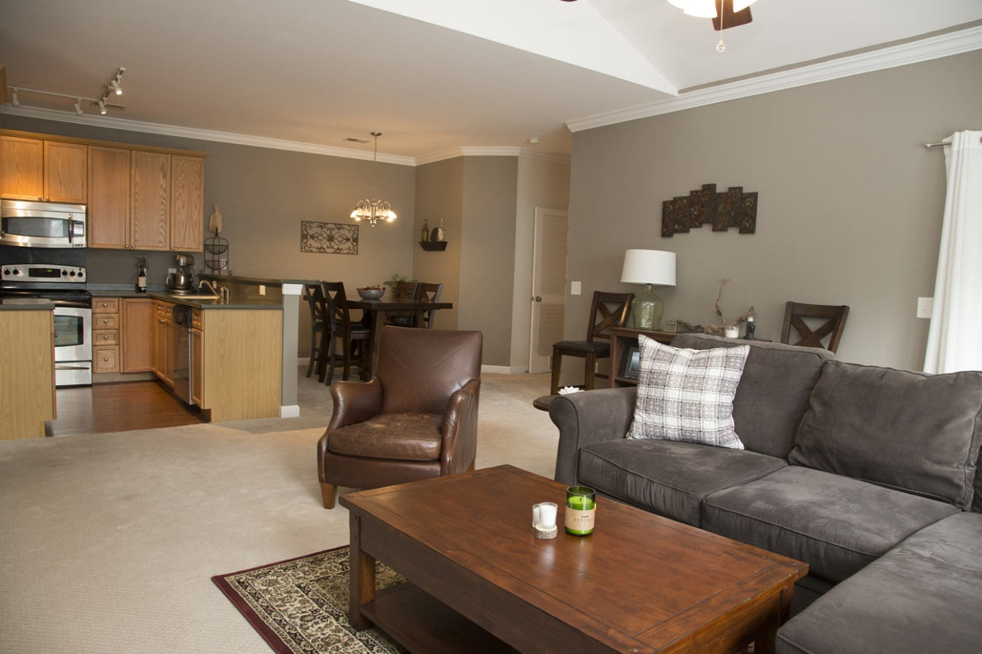
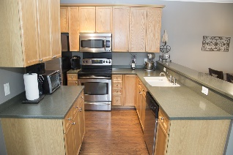
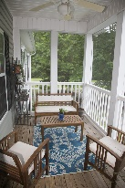
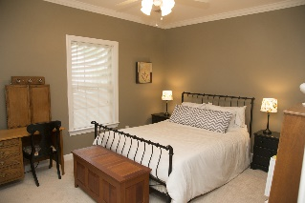
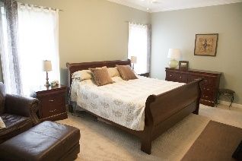
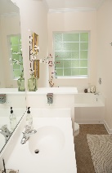
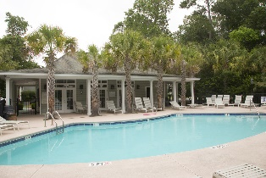


1206 Grove Park Drive
Grand Oaks Townhomes ~ Charleston
MLS# 16014149 ~ $155,000
Just Reduced $4k! Ready to sell!
Open House This Weekend
Join me Saturday or Sunday 1-2:30
MUST SEE beautiful meticulously maintained 2nd floor unit in highly sought after Grand Oaks Plantation. As you walk in you are greeted by vaulted ceilings and a big picture window letting in lots of natural light. The owners didn't miss any details. New carpet, beautiful paint colors, crown molding throughout, and an updated kitchen. There are 2 bedrooms each with their own baths. Expansive master bedroom has his and her closets and dual sinks in the large master bath! To top it all off, there is a peaceful screen porch overlooking a private wooded space and your own storage closet right outside your front door! You can't beat the location and privacy! This unit is like new and move in ready! Come see it today! Priced and ready to sell!
Sarah Ellen Lacke
(843) 607-4330
sarahellen@bhhssun.com
www.sarahellen.myhomecharleston.com
BHHS Carolina Sun Real Estate | 313 East Bay St | Charleston, SC 29401

