Slide 1

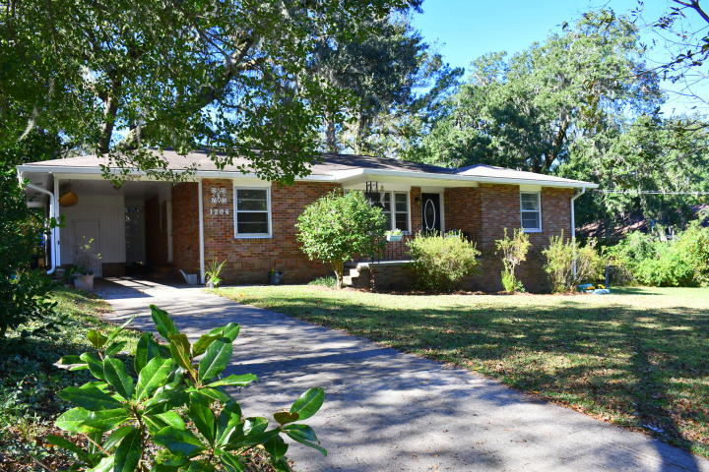
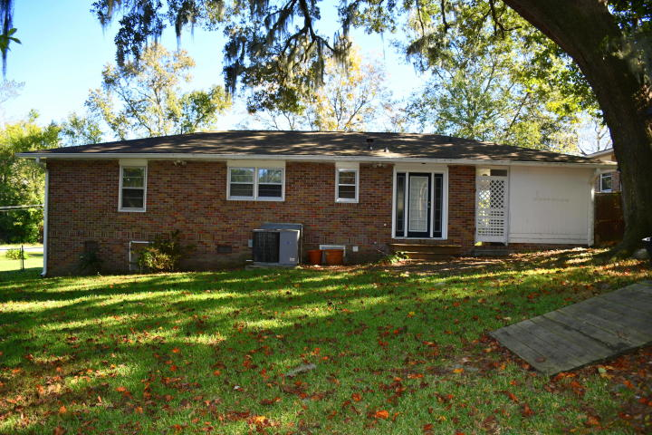
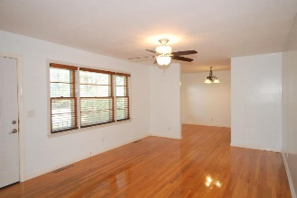
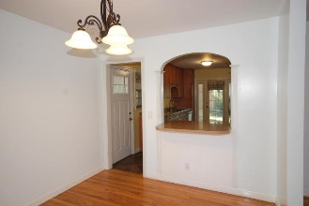
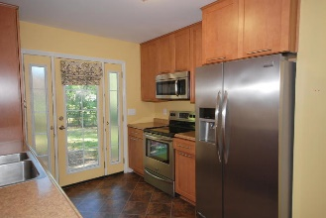
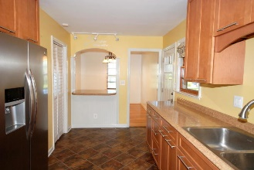
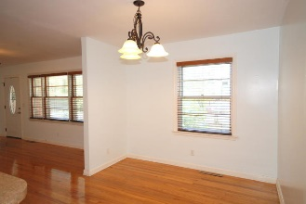

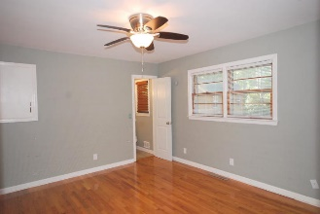
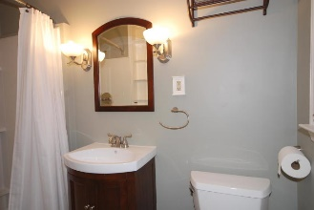
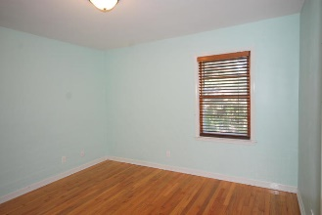
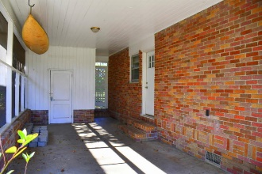
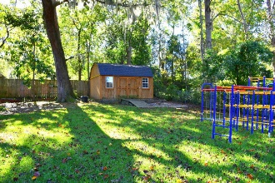
Debbie Cromer
ABR, RSPS, REALTOR, CRS
(843) 437-6342
debbie@debbiecromer.com
www.mylowcountryhomes.com
Beautifully Renovated Brick
Ranch with Huge Fenced Yard!
1206 Redeemer Drive
Berkeley Hills | Hanahan, SC 29410 | MLS# 19030598 | $235,000
Renovation completed in 2015. New Electric and Plumbing including fixtures! New kitchen featuring custom all wood cabinets with soft close hinges and drawers! Newer stainless kitchen appliances! New interior doors throughout! The original hardwood floors have been refinished.
Mature landscaping with pecan tree in front yard and live oak in your fenced back yard. Extremely reasonable flood insurance available! Right house, right price. Make your private viewing appointment today!
Century 21 Properties Plus | 1090 Park West Blvd; Ste 3 | Mount Pleasant, SC 29466

