Slide 1
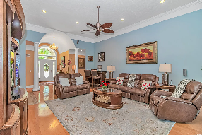
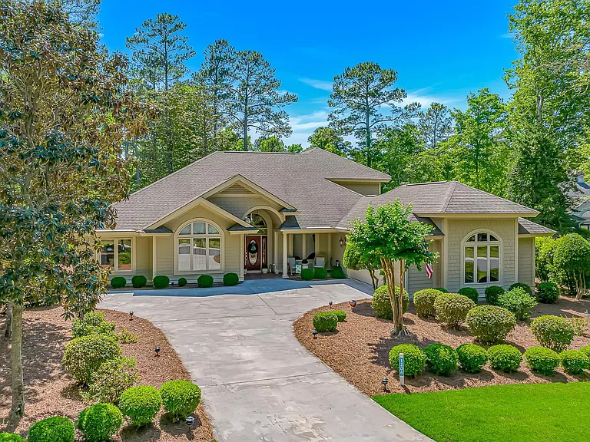
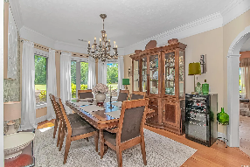
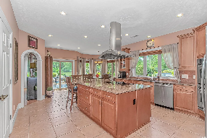
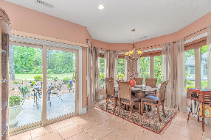
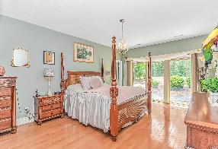
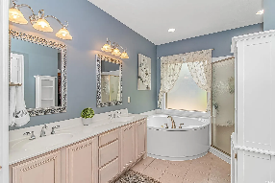
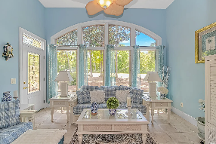
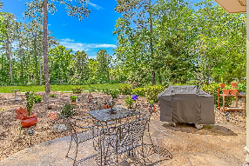
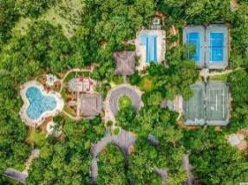
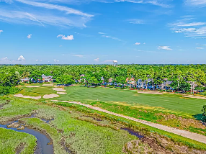
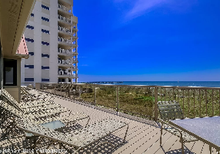


Prime Tidewater Property
1206 Spinnaker Drive
Tidewater Plantation
North Myrtle Beach, SC 29582
MLS# 2511714 | $969,000
Welcome to 1206 Spinnaker Drive, a stunning residence located in the prestigious Tidewater Plantation community of North Myrtle Beach located on #6 fairway. This elegant home offers the perfect blend of comfort and sophistication, featuring 4 bedrooms, 4.5 bathrooms, and over 3,800 square feet of beautifully designed living space. The gourmet, eat-in kitchen is a chef’s dream, complete with a vented hood over the stove on the large center island, ample seating, and high-end appliances that make cooking and entertaining a pleasure. The formal dining room includes a built-in wet bar, ideal for hosting gatherings with style. A bright Carolina room offers a seamless walkout to a brand-new stamped concrete patio, perfect for enjoying the outdoors and tranquil golf course views. The home also features a dedicated office, providing a quiet and comfortable space to work from home. The spacious master suite serves as a private retreat, complete with a luxurious en-suite bath, dual vanities, and a large walk-in closet. A versatile bonus room includes an additional bedroom and private bath, ideal for guests or extended stays. You’ll appreciate the oversized two-car garage with a dedicated work area, as well as the extra-large laundry room outfitted with cabinets and workspace for added convenience. Ample walk-in storage throughout the home ensures you have room for everything. Nestled on the fairways of the Tidewater Golf Club, this home offers scenic views and access to premier community amenities, including a private beach cabana, clubhouse, dining, fitness center, pools, and 24-hour gated security. This is coastal living at its finest.
Virtual Tour
Donna Fortney
703-624-3517
dofortney@aol.com
Robert Jacoby
843-455-7075
rcjacoby@aol.com
NEW WAY PROPERTIES MYRTLE BEACH

