Slide 1
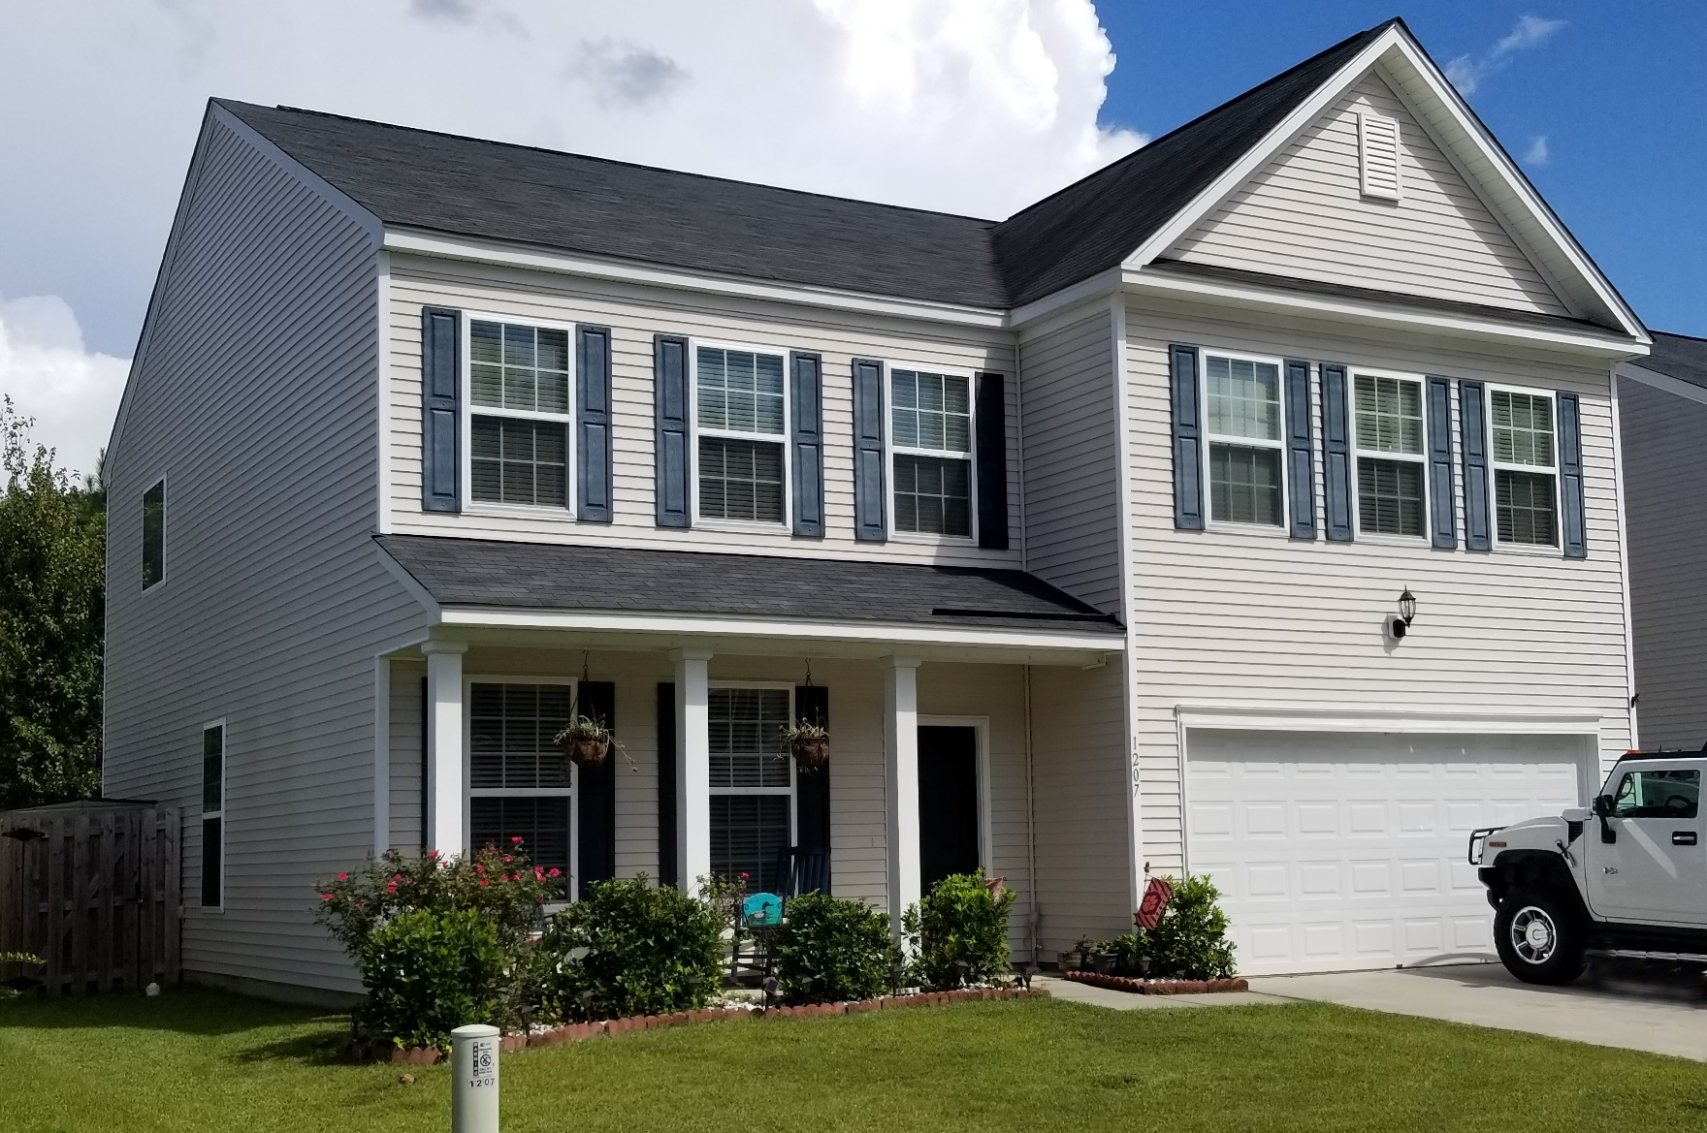
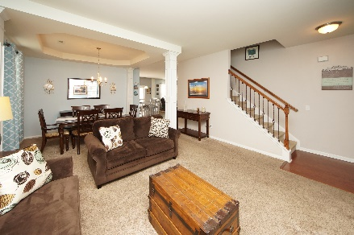
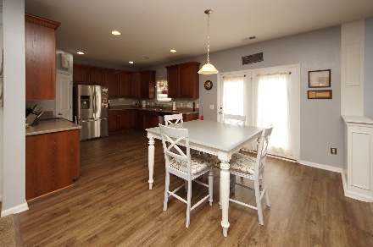
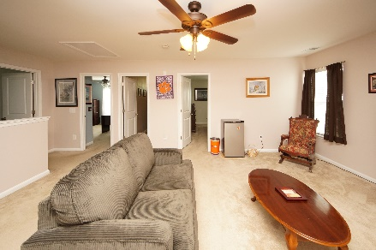


1207 Cosmos Road Myers Mill :: Summerville, SC 29483 MLS# 18020181 :: $259,000 4 Bed / 2½ Bath
Just Reduced!
Now $259,000
Welcome home to The Augusta! This open floor plan show cases upgrades by the builder and the sellers stylish flare! Enter the house to a well designed formal living and dining room which flows perfectly into the kitchen with 42'' cabinets, back splash, granite counter tops, and stainless appliances. Family room has a gas fire place with stone detail making this the perfect floor plan for entertaining. Upstairs you will find an oversized bonus room, bedrooms and a dreamy master fit for a California King! Each room has an abundance of space for your furniture and family living. Outside is privacy fenced yard and extended patio for your out door furniture and grill. Pictures are with a thousand words! Myers Mill has a neighborhood swimming pool!
Connie White, Broker
843-532-3356
connie@chrepros.com · conniewhiterealestate.com
Charleston Homes · 597 Old Mt. Holly Road · Suite 301 · Goose Creek, SC 29445

