Slide 1
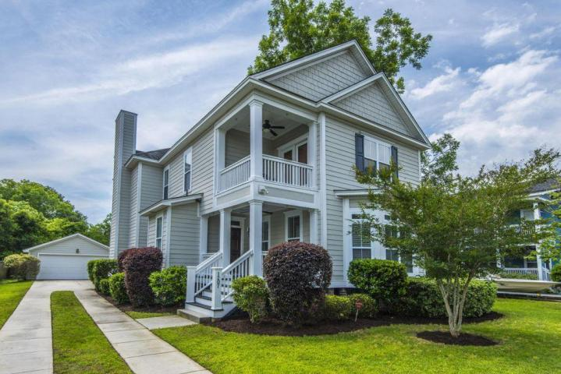
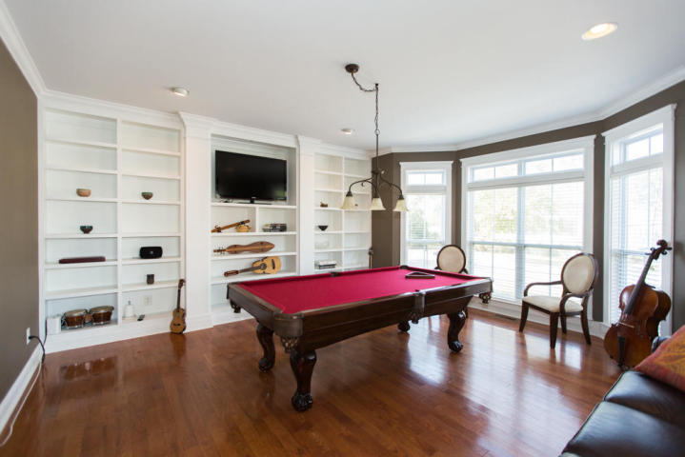
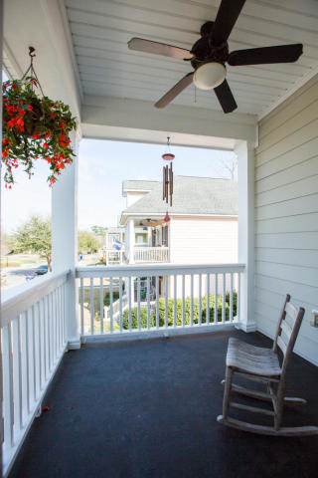
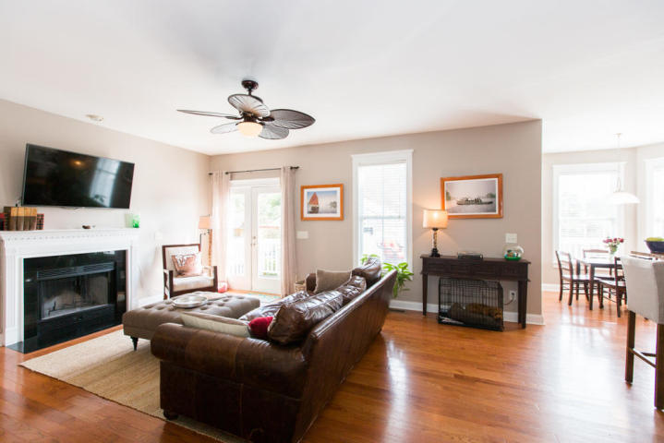
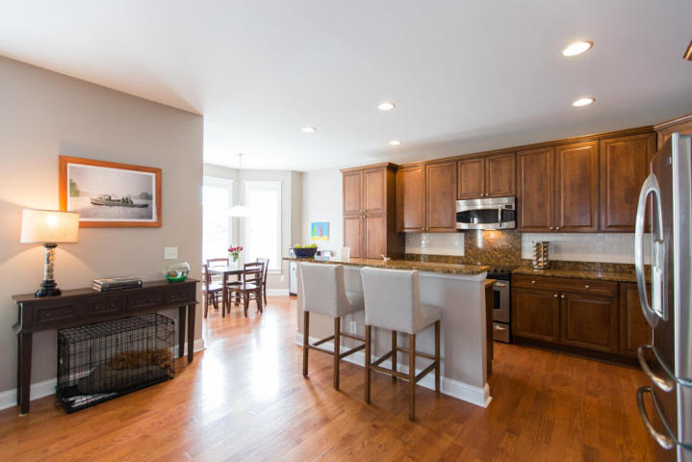
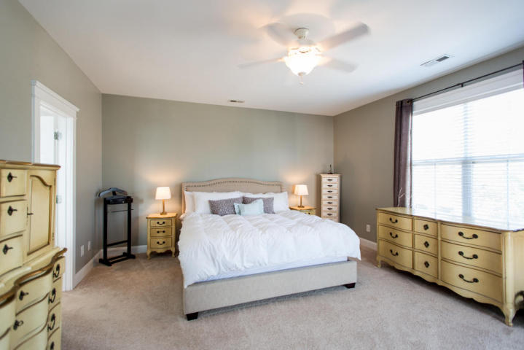
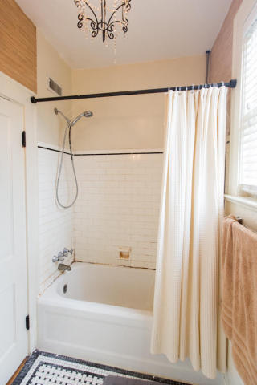
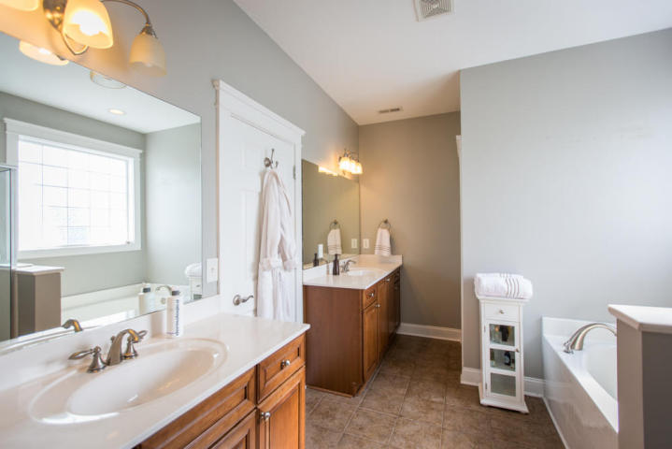
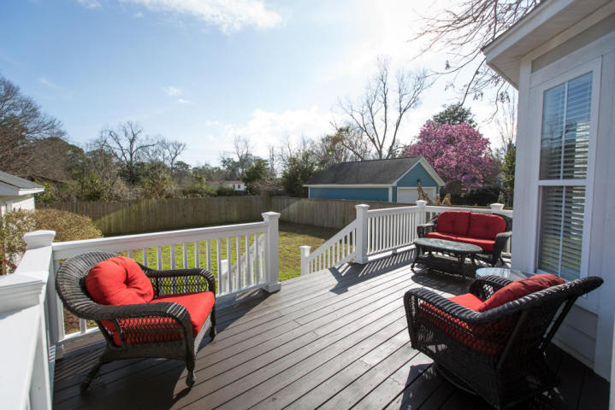
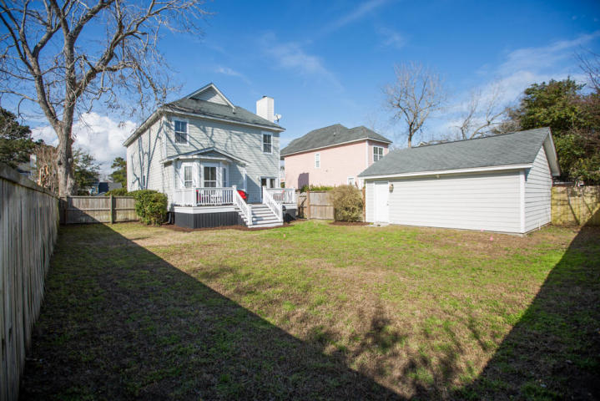
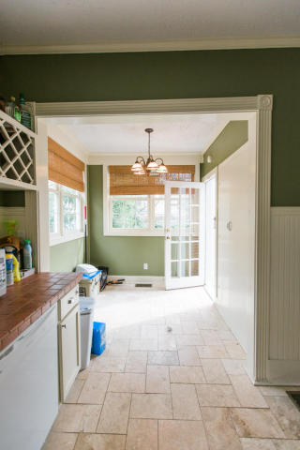

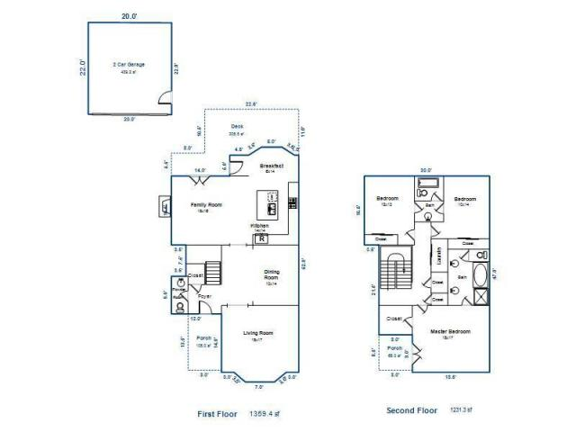
1207 Hepburn
Westfield Place ~ Charleston, SC 29412
MLS# 18004559 ~ $479,000
Spacious home in small, friendly neighborhood with central play area, perfect for families!
Great mix of formal and informal spaces, including large, light-filled living room with built ins, dining room, and an open flow between kitchen and family room. Large master with private porch, upstairs laundry, and fenced in backyard.
House is eligible for fiber optic internet for your home office! Zoned for Harborview Elementary too!
Marion Jackson
Mobile - (843) 442-4404
marionjacksonrealtor@gmail.com
Charleston Property Brokers | 151 St. Philip St. Apt A | Charleston, SC 29403

