Slide 1


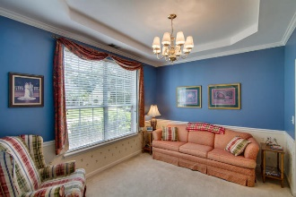
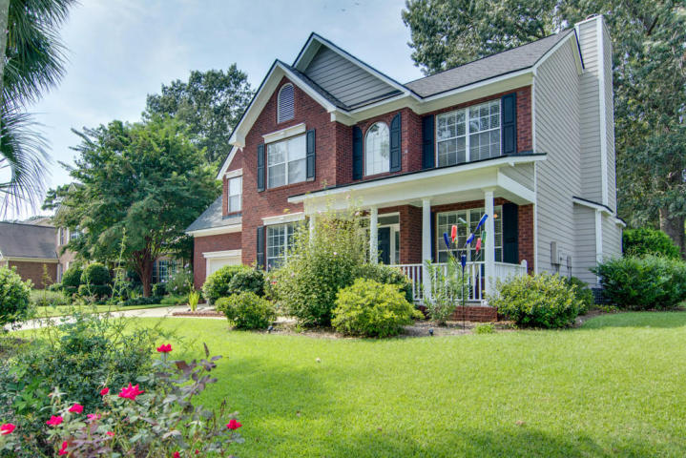
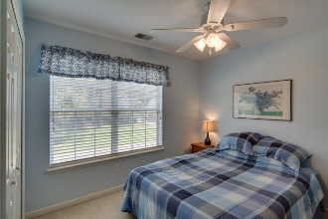
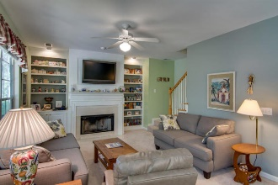
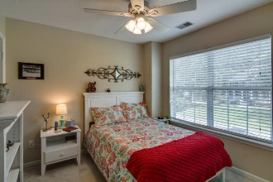
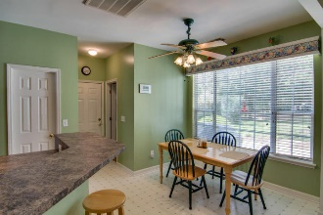
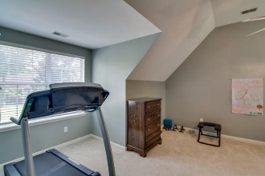
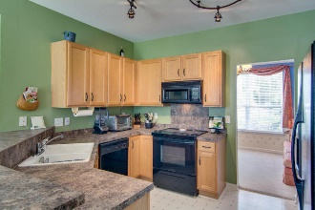
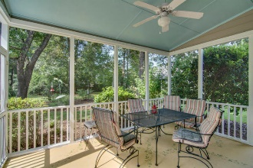
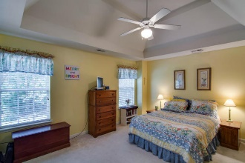
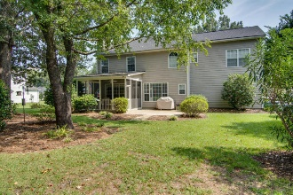
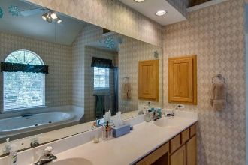
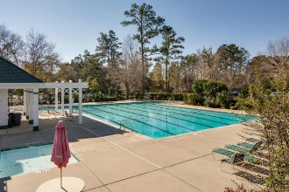

New listing in Legend Oaks Plantation!!
1208 Out Of Bounds Drive
Legend Oaks Plantation ~ Summerville
MLS# 16024434 ~ $272,500
Just Reduced!
Legend Oaks Plantation! 4 bedroom, 2.5 bath, John Wieland built, cement plank w/brick front, trees in the yard, under $275,000, what a find! Palm trees and magnolia in front. Tankless hot water. Semi private backyard. New roof. Front porch welcomes you to enjoy a glass of sweet tea. Enter to spacious foyer with office to the right and formal dining to the left. Kitchen is open to the family room and has eat-in space as well. Pantry and half bath are located off kitchen. Large screened porch is off family room to extend your entertaining area. Backyard has trees and bushes and feels very private. Upstairs find all the bedrooms. Master is really big, with his and her closets, separate shower and garden tub, dual sinks, water closet: great space! Two secondary bedrooms are spacious, one with large walk in closet. Fourth bedroom, is also the bonus room, has a closet. Laundry is conveniently located upstairs. Legend Oaks is in the Dorchester II schools, including the Palmetto's Finest award winning Beech Hill Elementary and Ashley Ridge high school. Call to view this beautiful home today!
Laurie A Loparo, ABR laurieloparo@gmail.com
lauriesellscharleston.com
Golden Bear Realty | 654 Coleman Blvd, Suite 100 | Mt Pleasant , SC 29464
Cell (843) 442-1290 | Office (855) 352-9088 | Fax (561) 721-3311

