Slide 1
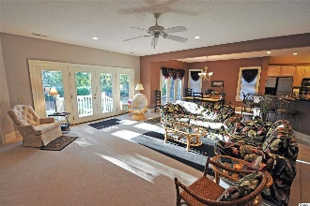
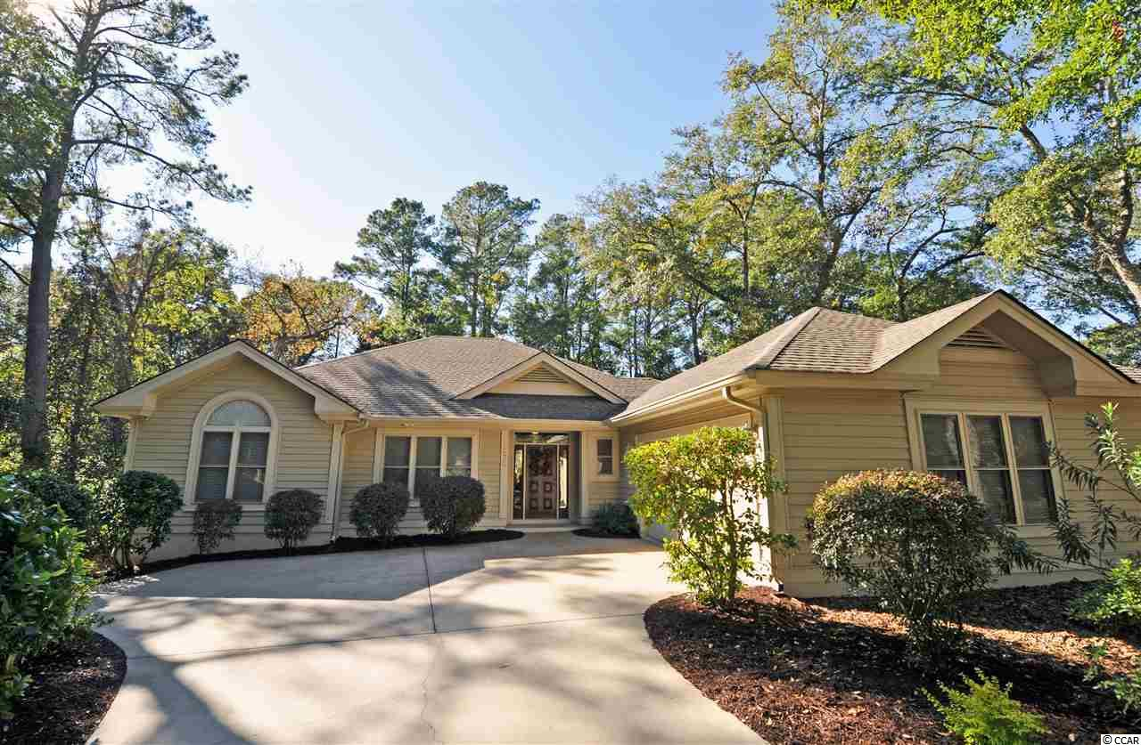
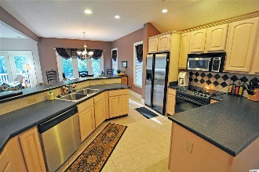
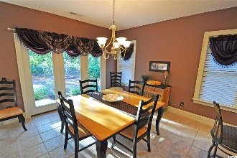
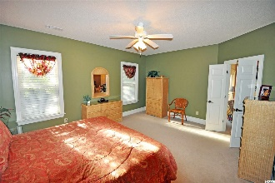
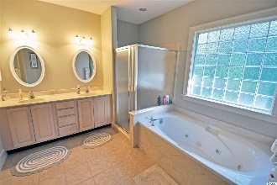
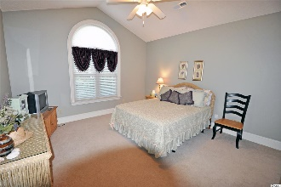
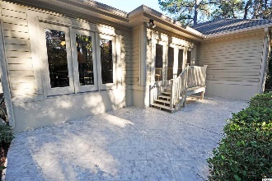
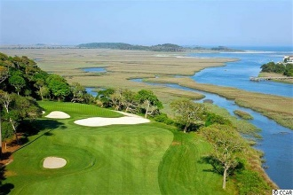
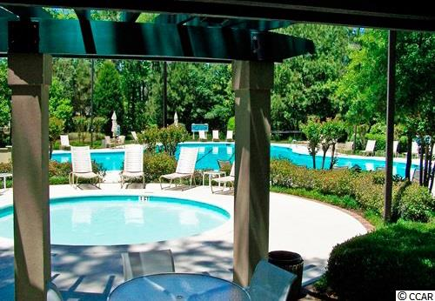
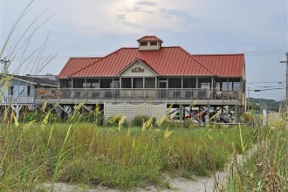


1208 Pine Valley Rd
Tidewater Plantation Resort ~ North Myrtle Beach ~ MLS# 1823528 ~ $389,900
Prefer being in a beach, Intracoastal Waterway & world-class-golf-resort community yet desire the privacy of a secluded, fenced backyard? This large, level, rare almost half-acre lot is a tranquil, mostly fenced retreat which backs up to a secluded wooded enclave -- perfect for pets, active families or peaceful relaxation on the rear porch and patio. The house itself is well set back on a beautifully landscaped space with the signature look and feel of the popular Plantation of Tidewater Resort. This beautiful Pine Valley location is one of the communities' unique preferred historic neighborhoods...still highly desirable today. The home is nicely appointed and impeccable, too! There's MORE...furniture and decor are negotiable, and an Old Republic Platinum-level Warranty is effective at closing! This custom-build traditional offers an appealing, luxurious lay-out and lives like a charming, casual beach house. It has only been lightly used as a second home but includes all the must-haves for a full-time residence or investment property: over-sized 2-car side-load garage, newer upgraded major and gleaming stainless-steel kitchen appliances, 3 spacious bedrooms in a split-bedroom floor plan and 3 full baths. All bath vanities and commodes and other counter tops are raised. Lots of closets and thoughtful storage space; there is a pull-down staircase to the floored storage space in the garage, and an 80-gallon hot water heater was installed in the garage for ease of access. No running out of hot water for visiting family and friends. Upgraded HVAC system installed in 2018; home has cedar siding, so new HVAC enclosure is also cedar. There is a great traffic pattern also from both the garage and the decorative front-entry hall to the BIG GREAT ROOM adjoining the entertaining-sized dining area and wonderful, warm kitchen. The upscale, workable kitchen features a really super-sized walk-in pantry and convenient nearby utility room with sink as well. This main living area is the heart of the home and inviting for a family or a foursome! The master bedroom is likewise larger and has double walk-in closets, en suite with linen and water closets, double sink vanity, walk-in shower and separate whirlpool tub. It is a true master retreat with views of that private backyard. Charm, comfort and convenience abound. Everything has been well planned for simple living and maximum enjoyment. Amenity-rich Tidewater is on a tree-lined road to oceanfront Anne Tilghman Boyce Coastal Reserve, a nature conservancy, including Waties Island, with access for managed recreational use. Tidewater itself is on an elevated peninsula of live oaks and southern pines between the Intracoatal Waterway and the Cherry Grove Inlet to the Atlantic Ocean. The plantation also preserves the singular look of its own historic origins. It is minutes from the beach, shopping, medical services, entertainment and access to major highways. Rich amenities at low, low HOAs include an oceanfront beach cabana for owners' use with open/screened porches, bathrooms, showers and kitchen. Residents enjoy the use of several pools/hot tubs. Other amenities include a driving range, golf shop, clubhouse with bar/dining and event facilities overlooking the 18th hole, clay and hard surface tennis courts, pickle ball court, fitness center overlooking a pool, bocce courts and amenity center for public/private events. Tidewater has a gated storage yard for boats, jet skis, motorcycles & kayaks. Tidewater Plantation, with its full range of things to do and to enjoy, reflects a "way of life" in safe, affordable North Myrtle Beach. North Myrtle Beach enjoys the lowest tax millage of any such full-service city of its kind the Carolinas. Both Tidewater and North Myrtle Beach are well run and have healthy financial resources, along with the most uncrowded, wide, white sand beaches in the area. It is, after all, ALL about the BEACH!
Deborah Collins
843-424-9013
dctidewater@yahoo.com
Connie Ross-Karl
702-306-2643
conniesross@aol.com
NEW WAY PROPERTIES MYRTLE BEACH

