Slide 1
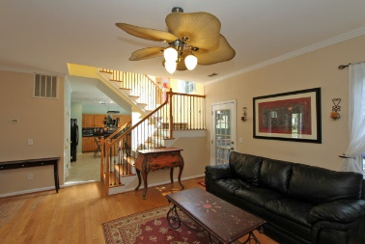
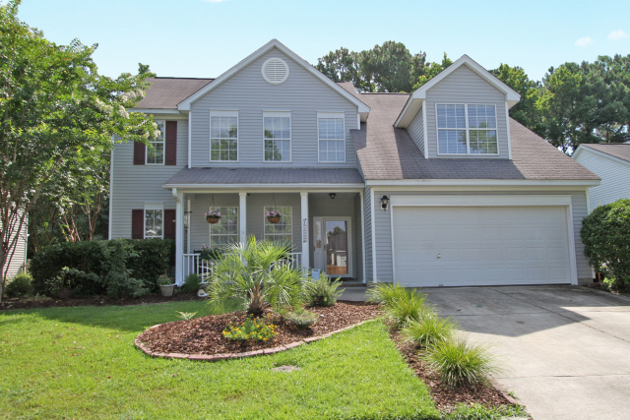
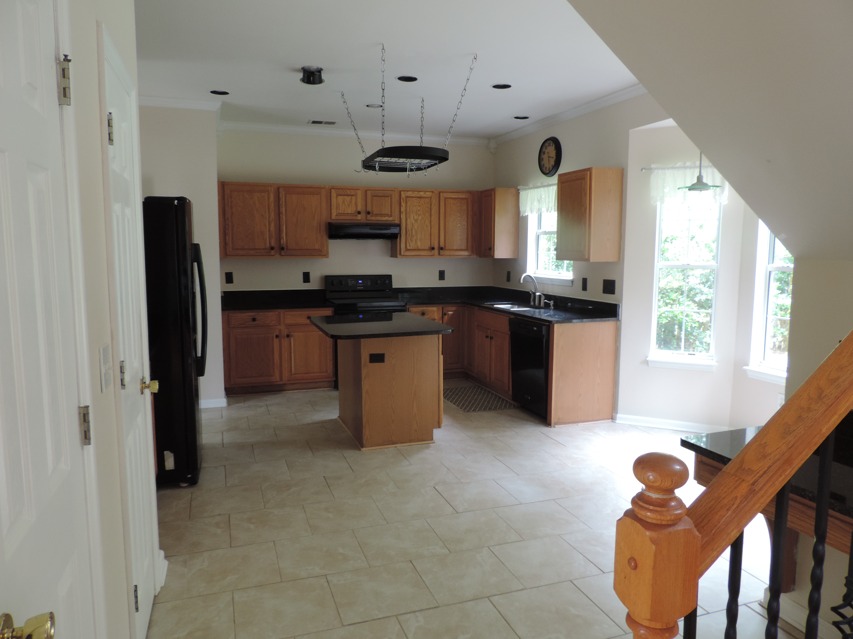
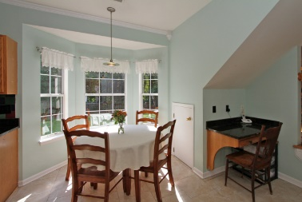
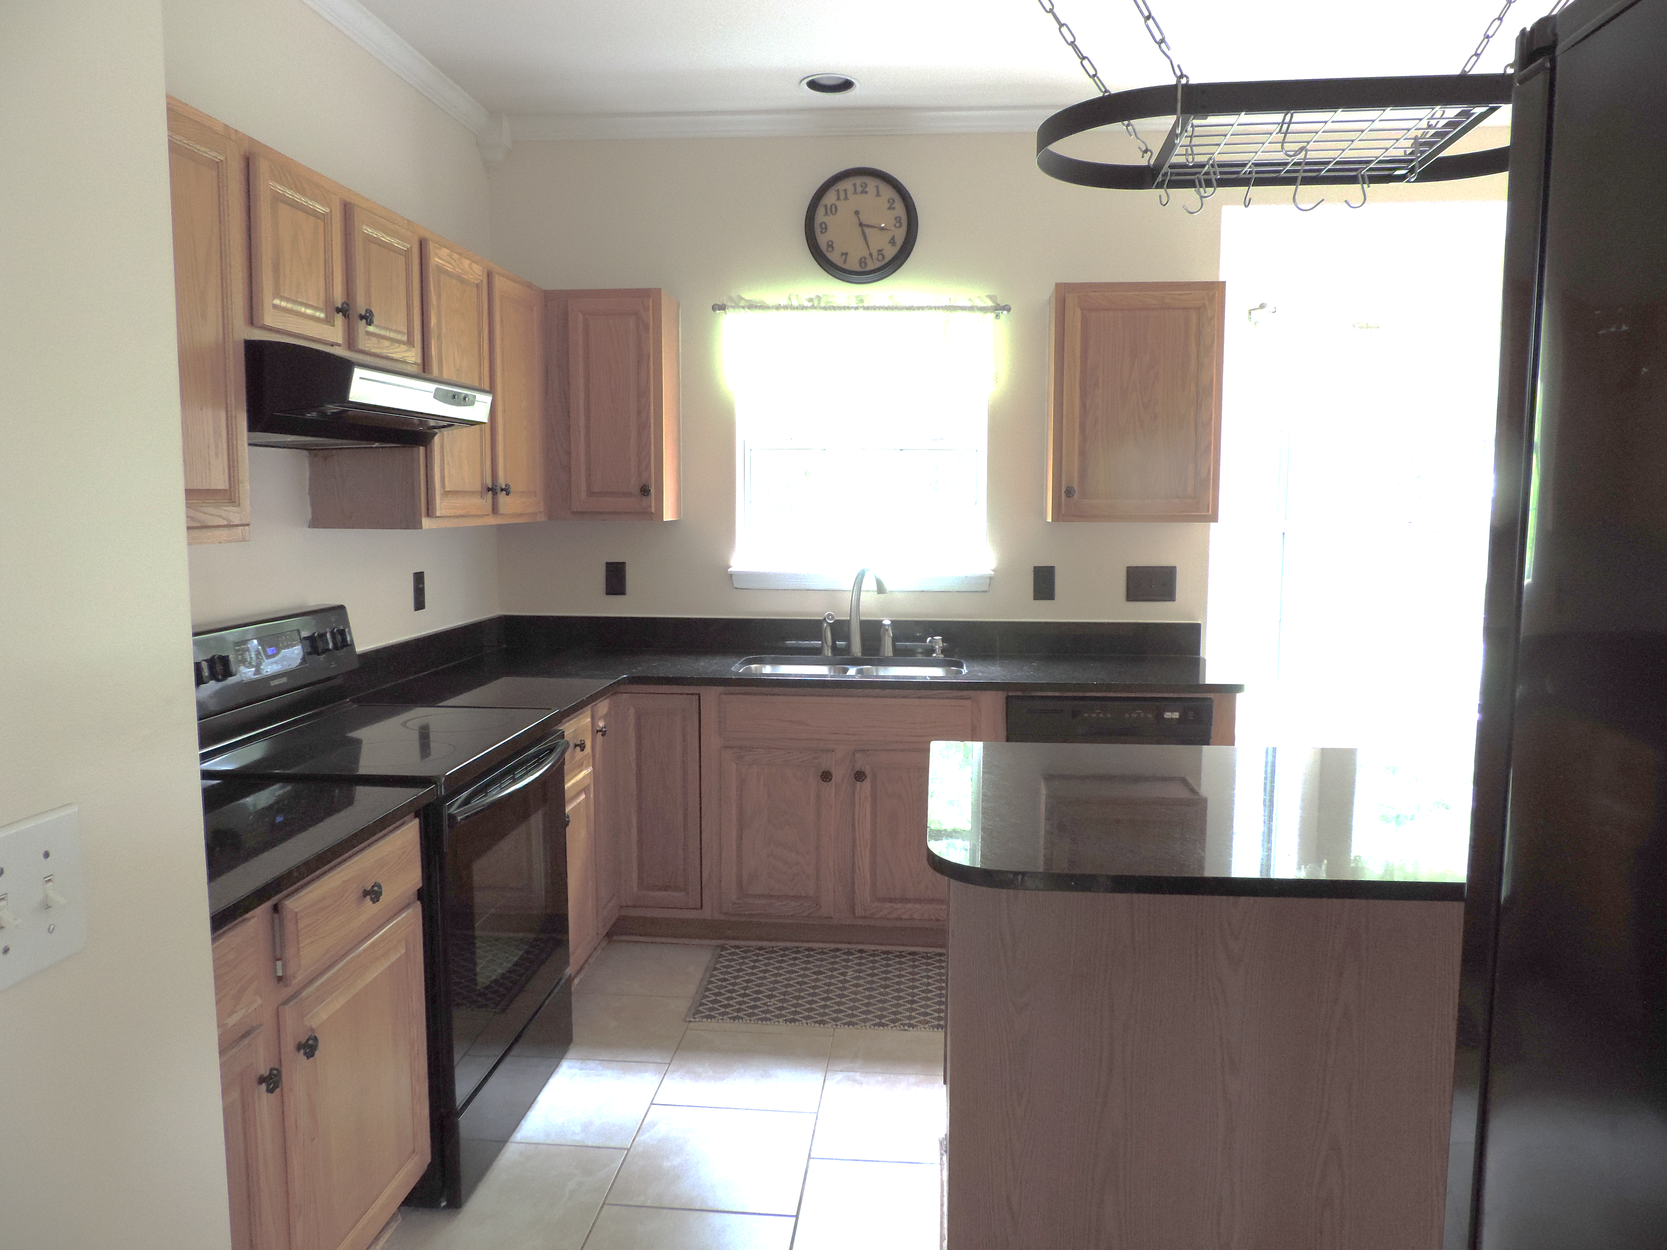
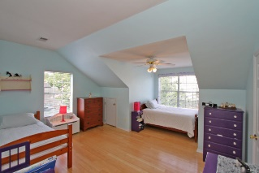
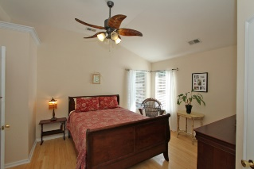
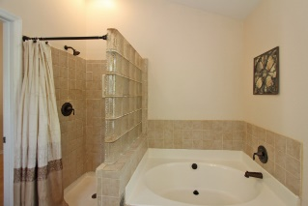
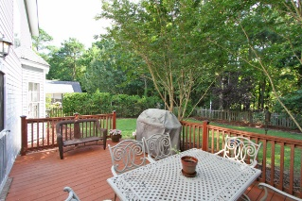
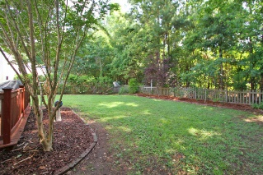


1208 Willoughby Lane Park West ~ Mount Pleasant ~ MLS# 15017425 ~ $350,000
Move-in Ready Home That Can Close Quickly!
Park West home that is move-in ready. Well appointed rooms that are spacious and public parks nearby. Hardwood floor throughout main floor and tile in kitchen. Beautiful upgraded granite countertops in the kitchen.
A lovely arched doorway leads to a separate, bright dining room. Master has walk-in closet and recently upgraded shower and tub with dual sinks. Roomy upstairs bedrooms have bamboo floors and share a hall bath. Fourth bedroom can be used as a bonus room.
Large deck off the living room and fenced backyard are perfect for entertaining friends and family. Mount Pleasant Parks and Rec in walking distance with ball fields, soccer fields, indoor pool and the new Laurel Park walking trails. Close proximity to beaches, shopping, restaurants, schools and hospital.
Kimberly Ritter ABR, CRS, REALTOR
Office - (843) 216-2356
Fax - (843) 202-2923
Mobile - (843) 693-8802
kritter@carolinaone.com
www.SearchForCharlestonHomes.com
Carolina One Real Estate
628 Long Point Rd
Mt Pleasant, SC 29464

