Slide 1
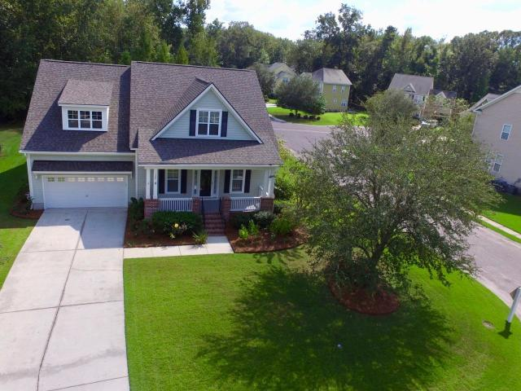
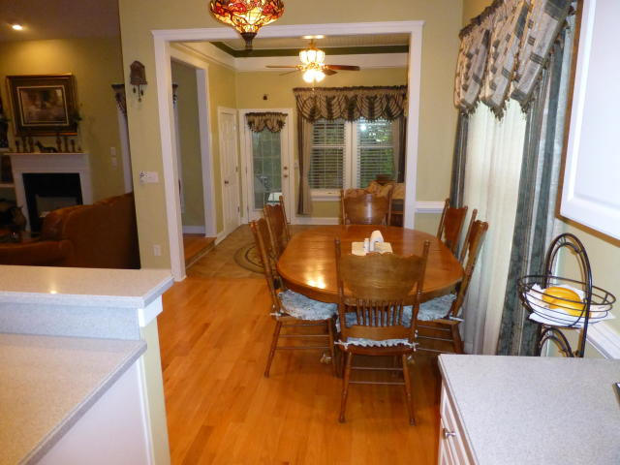
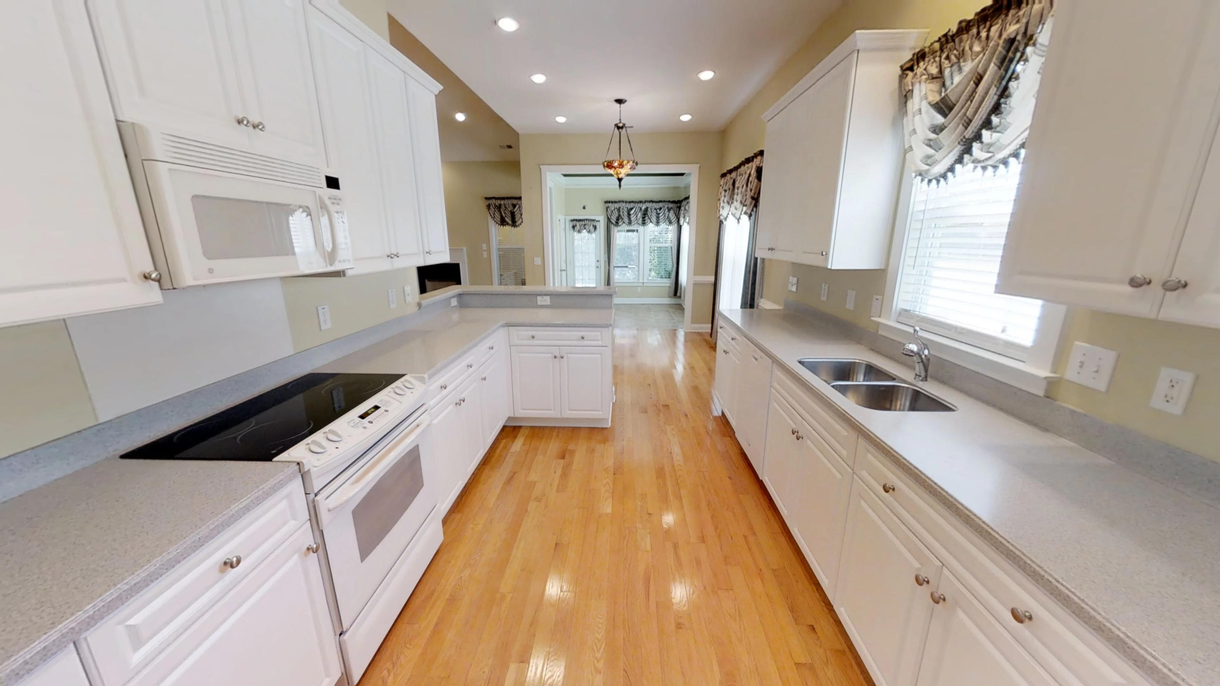
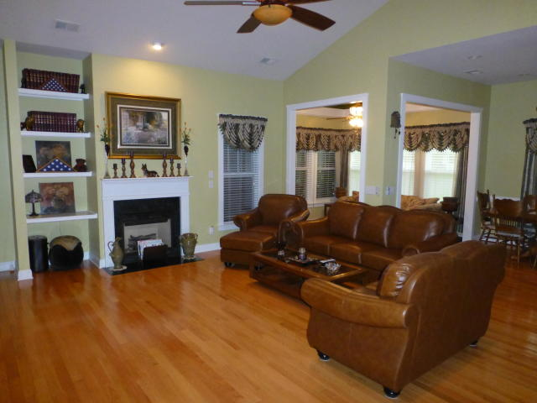
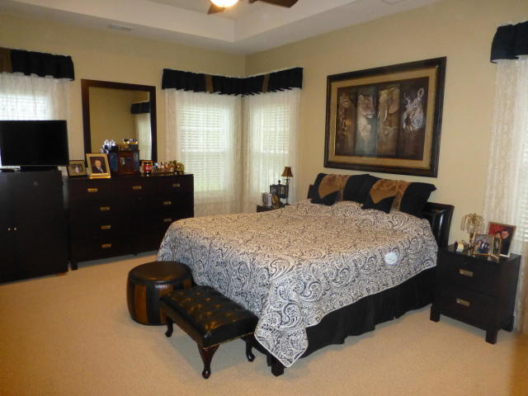
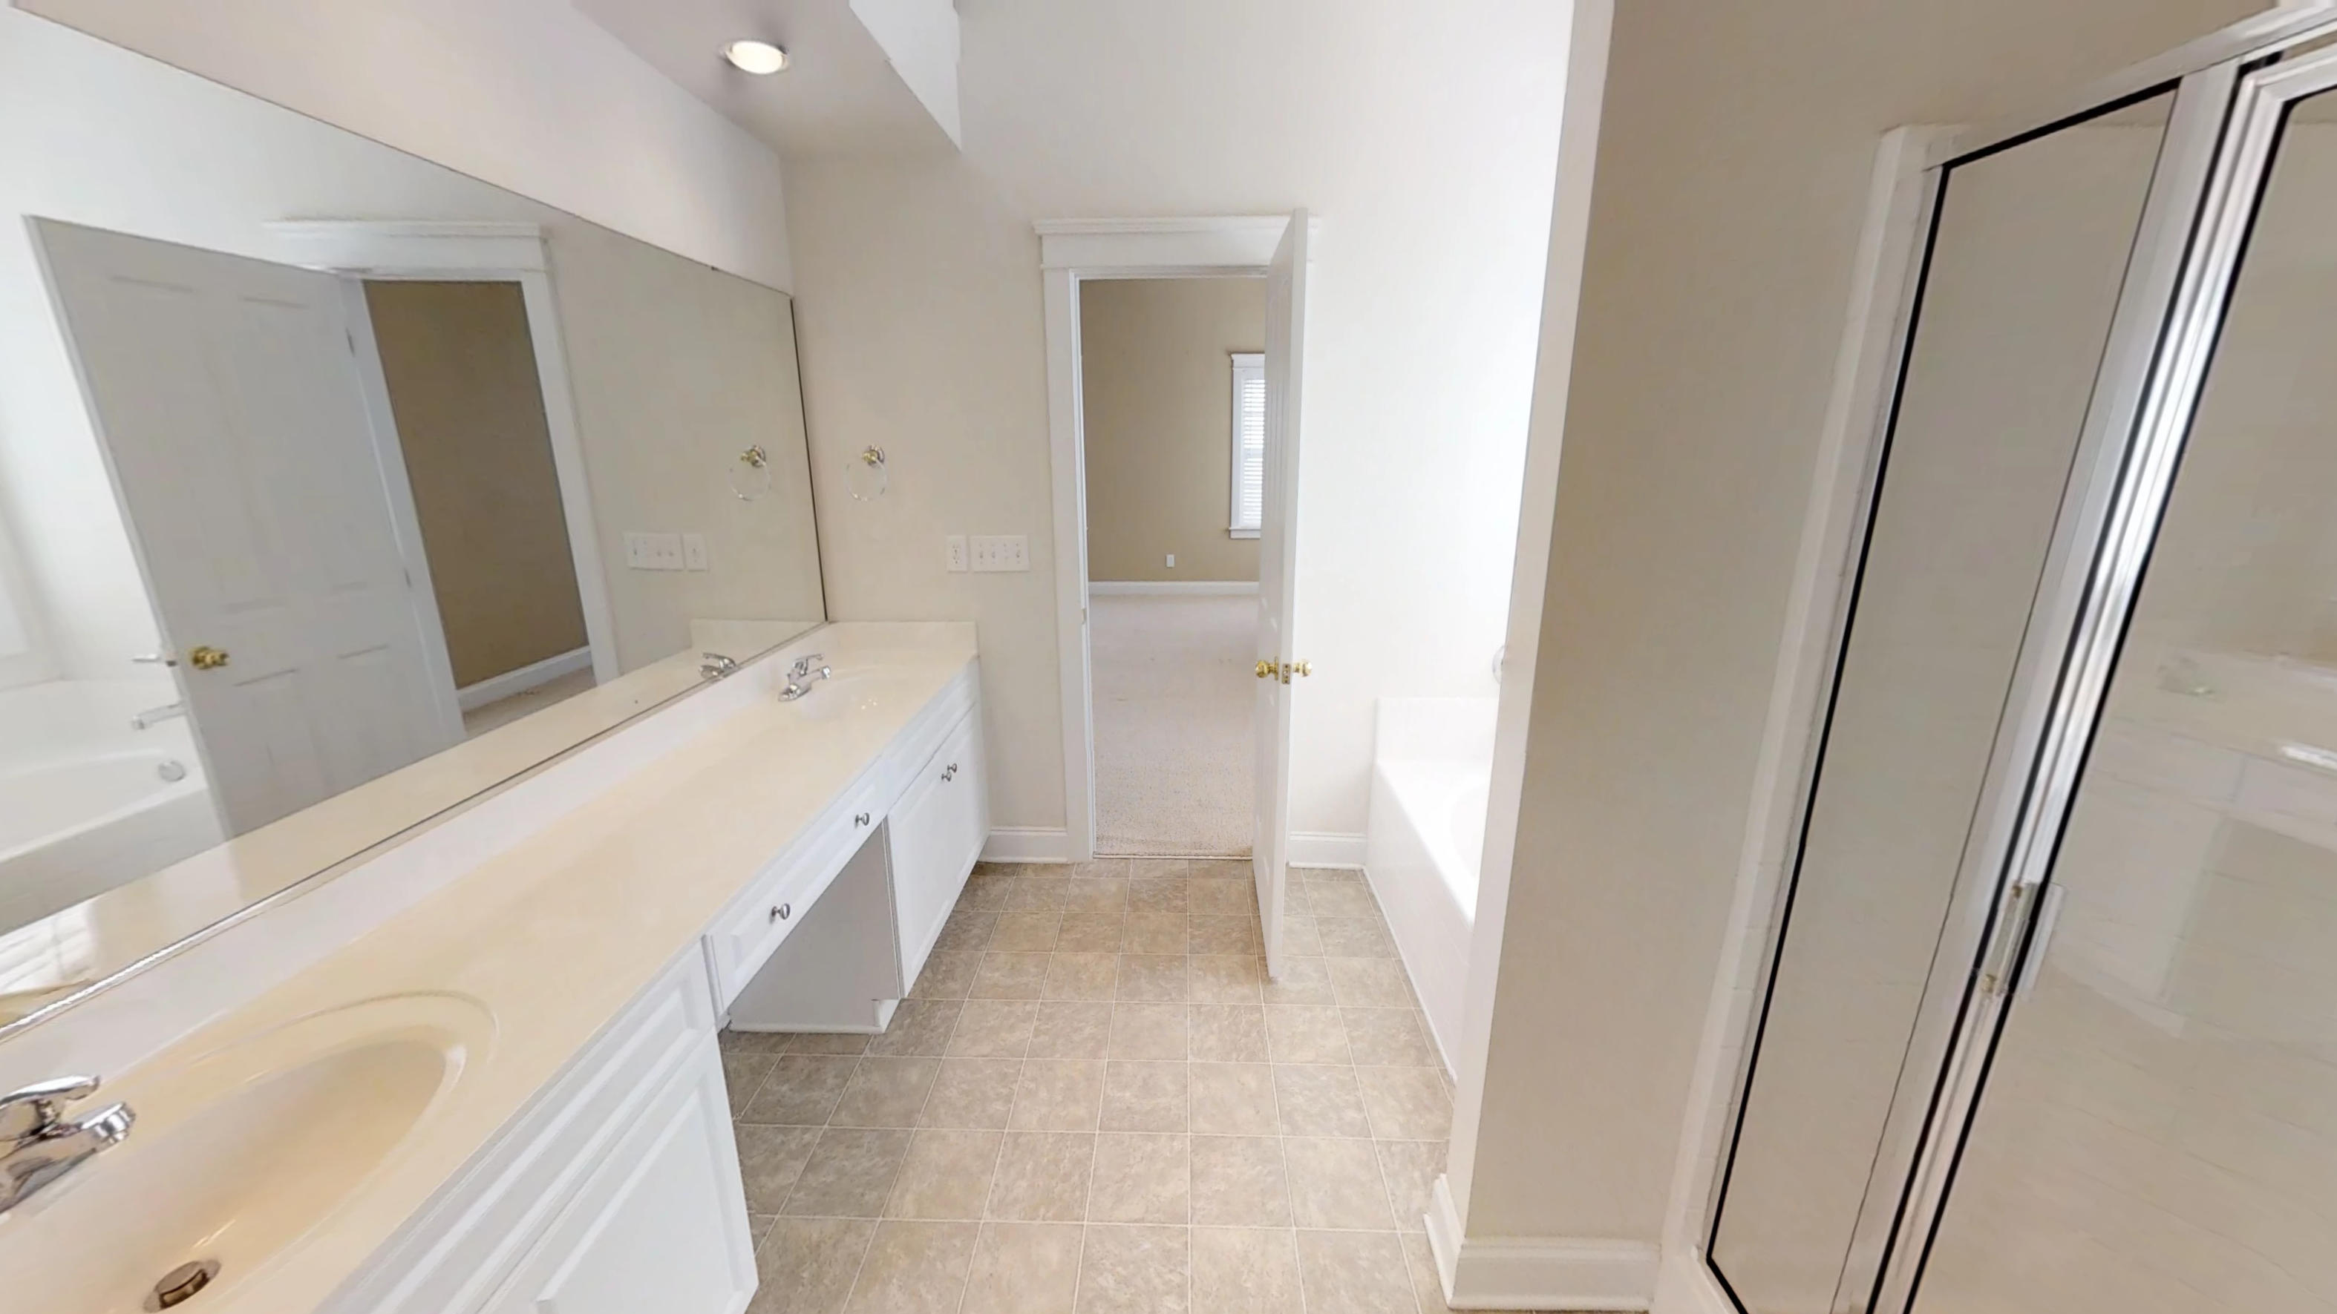
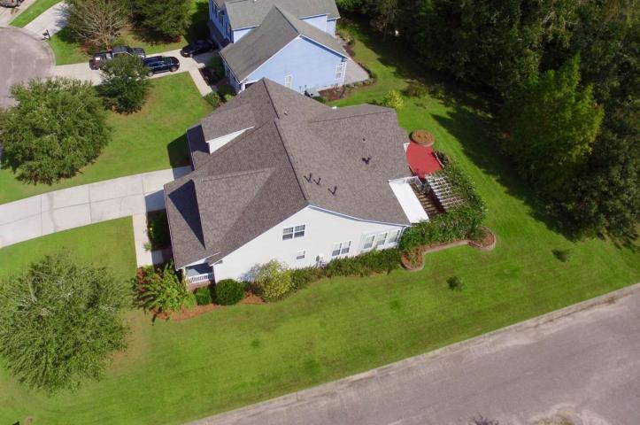
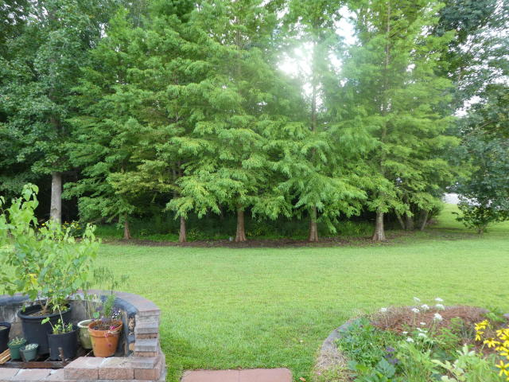
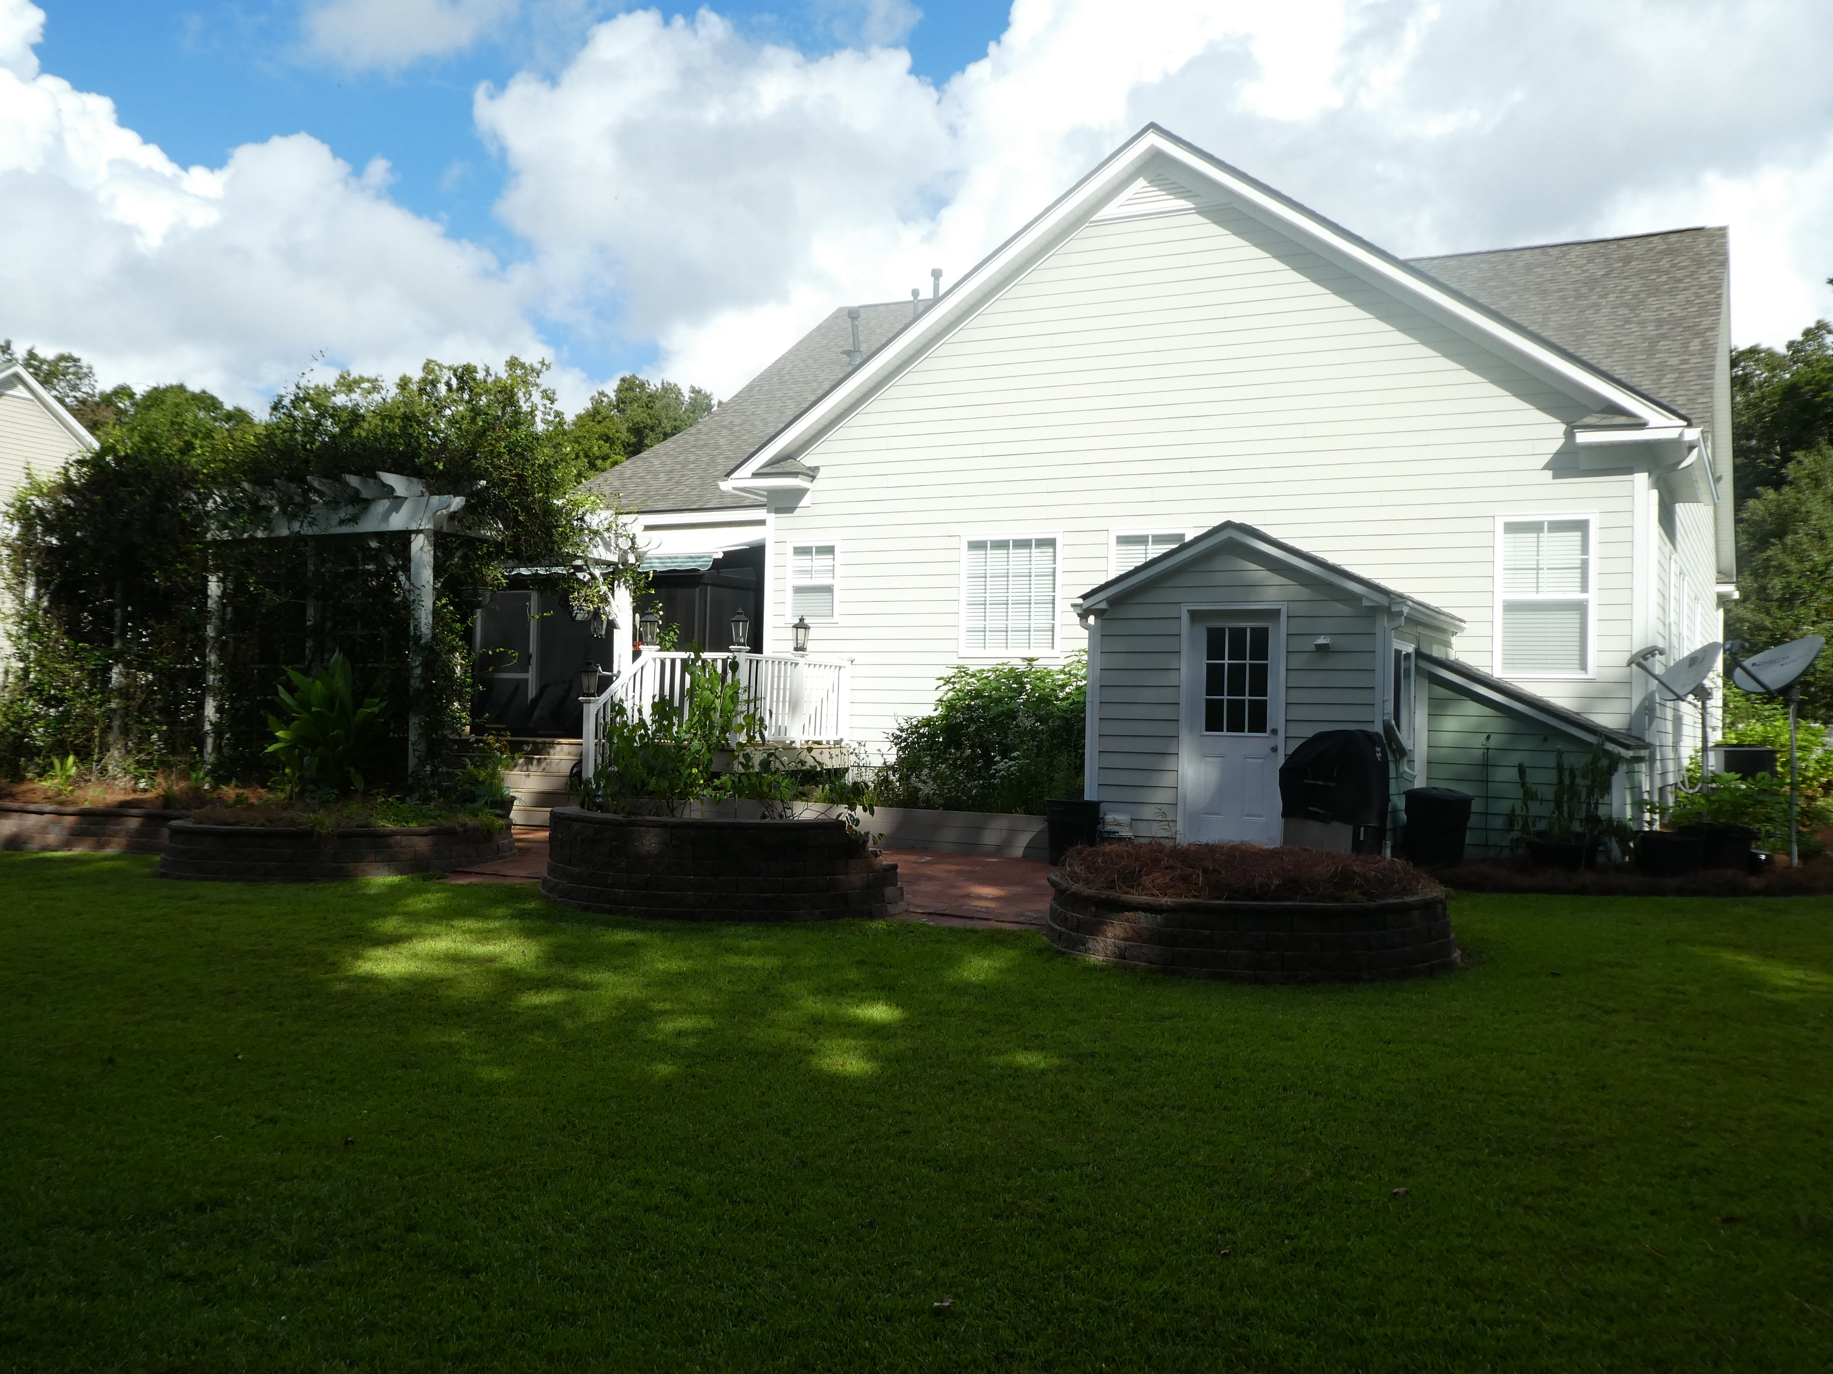
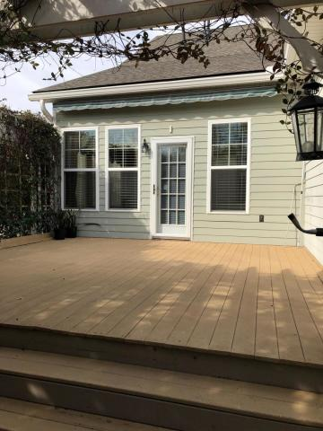
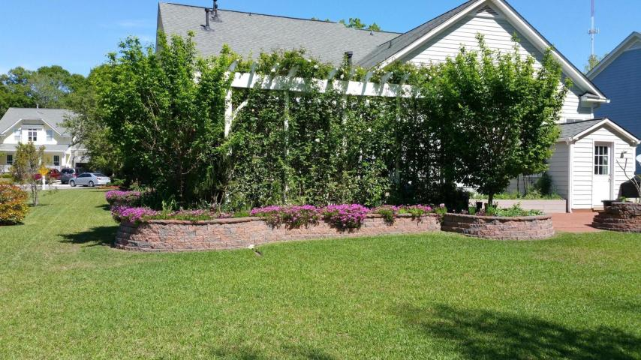
Recent Price Adjustment in Legend Oaks Plantation
120 Blackwater Drive
Summerville, SC 29485 ~ MLS# 19001601 ~ $354,500
You’ll LOVE this stunning Saussy Burbank Executive Home with lots of Custom Features on a large .32 acre lot backing to trees! The home features a Full Front Porch, 10’ ceilings, formal living and dining, and a huge vaulted-ceiling family room where you can cuddle up to a cozy fireplace with a good book. There are beautiful Hardwoods throughout much of the first floor. Living is easy with an open floor plan, which includes a lovely Sunroom off the eat-in-kitchen, leading to a large deck and red paver patio. New Roof in August 2018, and new HVAC on main floor in 2017. Tankless water heater, and separate gas heat and electric cooling make for efficient and cost-effective utilities. This Home is only available to the first Buyer who acts NOW!!!
Randy Espeseth
843-743-1025 | Randy@RandyEHomes.com | Carolina Elite Real Estate

