Slide 1
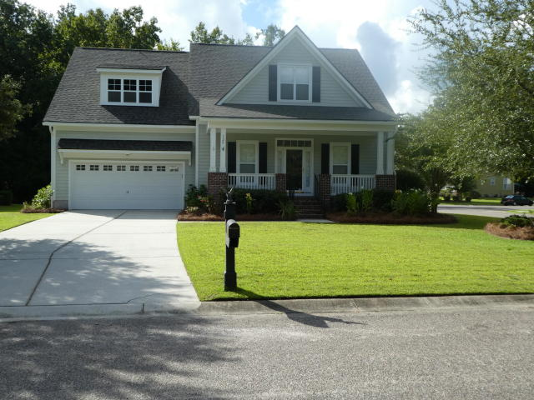
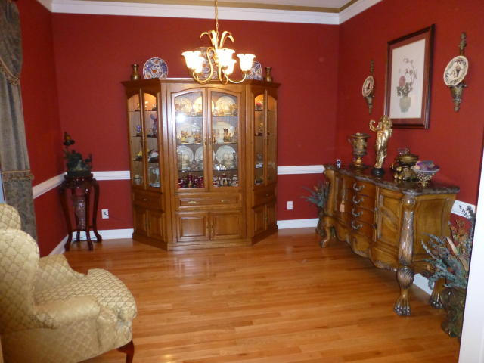
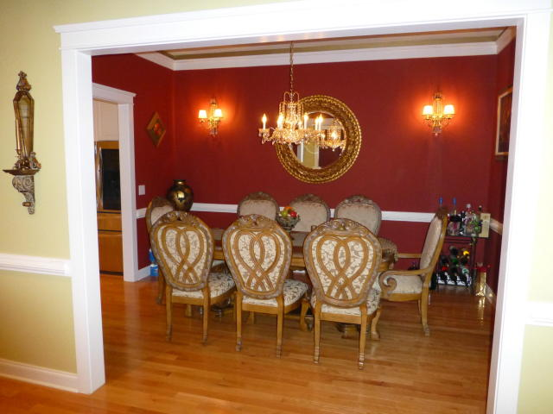
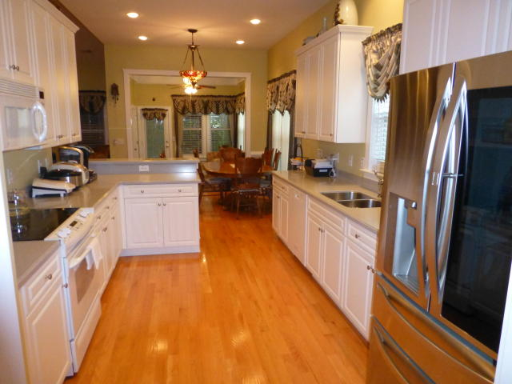
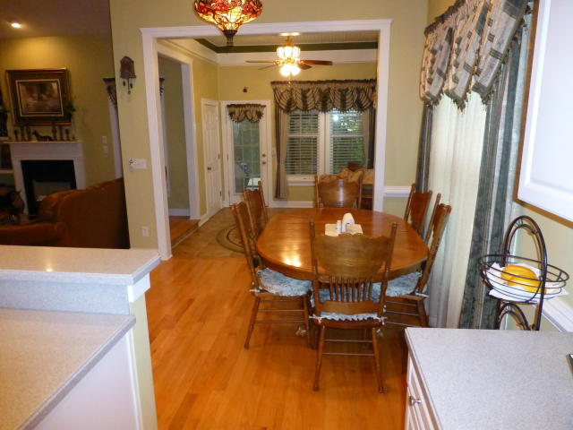
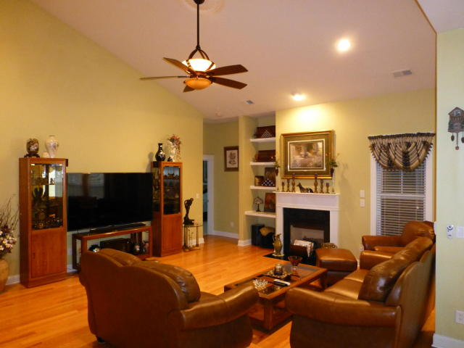
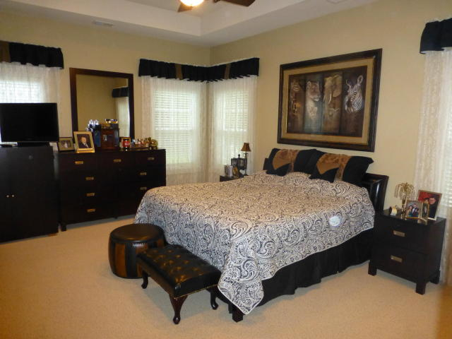
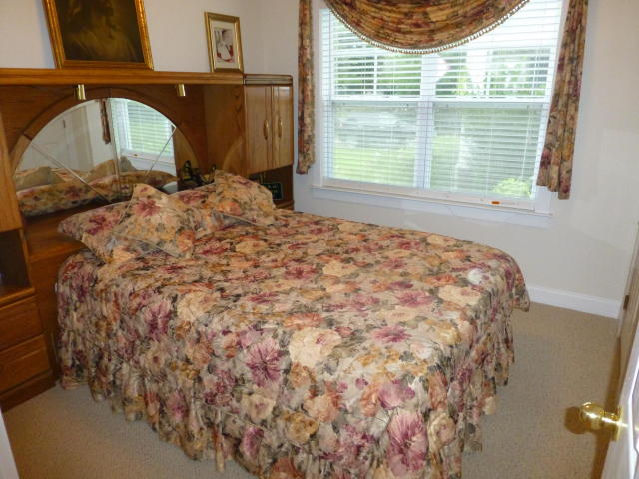
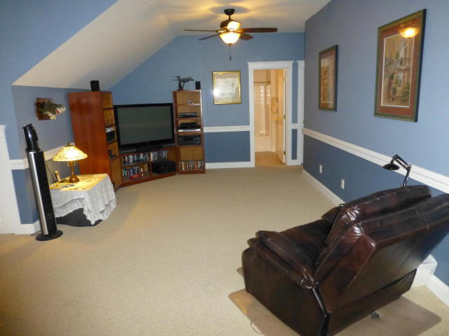
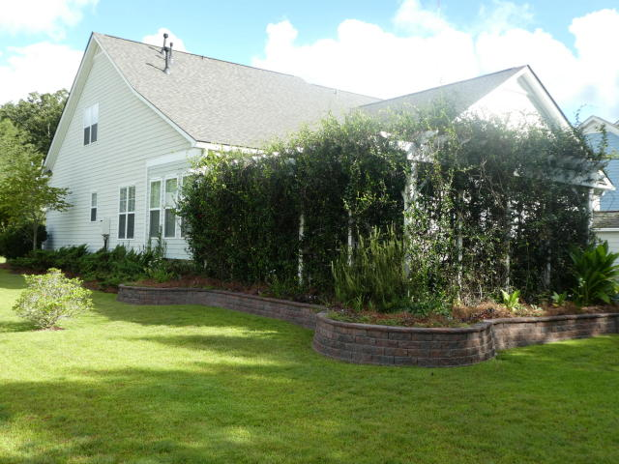
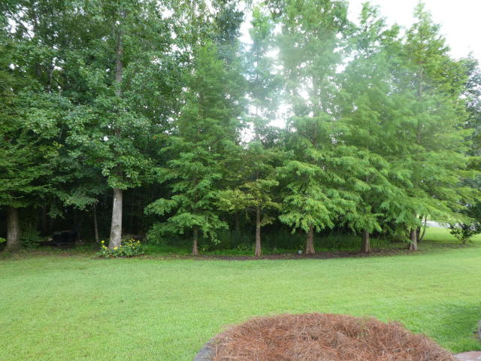
Just Listed in Legend Oaks Plantation
120 Blackwater Drive
Summerville, SC 29485 ~ MLS# 18024721 ~ $385,000
Beautiful Saussy Burbank Home with lots of Custom Features on large .32 acre lot backing to trees! Full Front Porch, 22' long foyer/hallway w/ 10'ceilings, separate formal living and dining, huge vaulted-ceiling family room with fireplace. Kitchen has raised panel 42'' cabinets w/ crown molding, built-in pantry, Corian counters, and stainless steel appliances. Generous 2-piece chair rails in several room. Large master is down as are two other bedrooms and 2 1/2 baths. Lovely Sunroom off of eat-in kitchen which leads to Screened porch and large deck area and 12x16 remotely powered Sunsetter awning. Red pavers for the patio, and a large Pergola made with 6x6 treated lumber that sports lovely rose bushes. New roof in August 2018, and new HVAC on main floor in 2017. Separate dedicated HVAC systems for downstairs and upstairs! Tankless water heater, and separate gas heat and electric cooling. Irrigation System throughout yard! The Fourth Bedroom is used as a sitting room. Very large FROG area upstairs that has a large family room, separate bedroom and bath, and could be used as a Mother-in-Law Suite. Beautiful Hardwood throughout much of the first floor. This home is very close to Beech Hill Eementary, which is an award winning school, and just a few minutes away from the newest High School - Ashley Ridge. Legend Oaks Country Club offers tennis, golf, clubhouse and swimming pool! This home has been meticulously maintained by the only owner, and is ready for a new family to fall in love with and enjoy!!!
Randy Espeseth
843-743-1025 | Randy@RandyEHomes.com | Carolina Elite Real Estate

