Slide 1
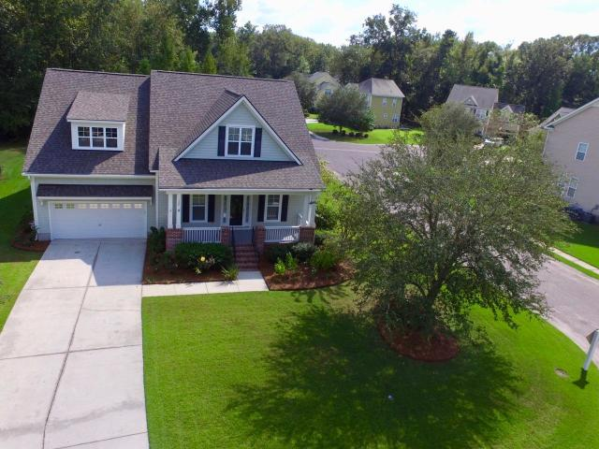
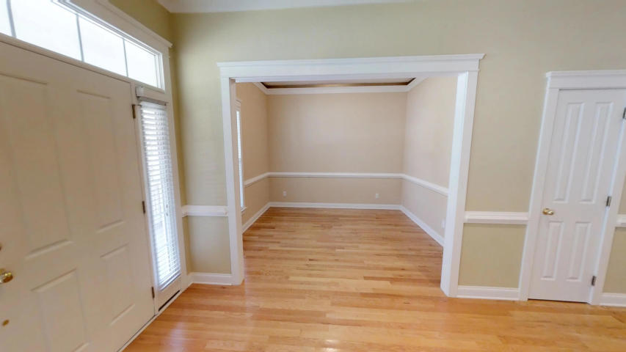
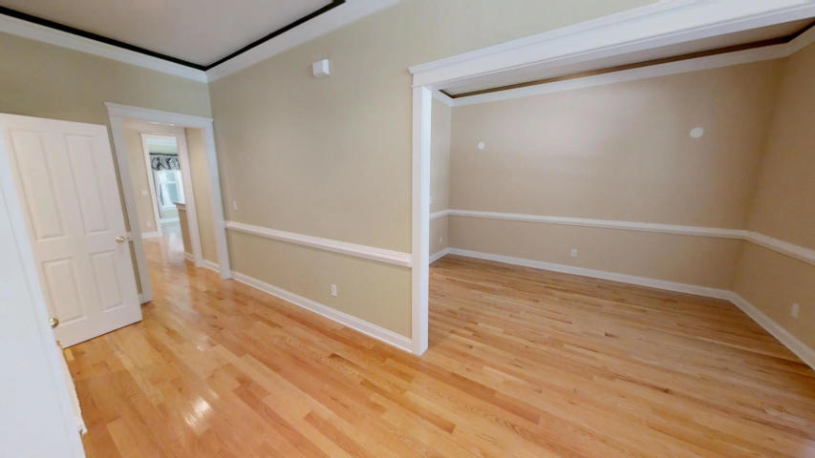
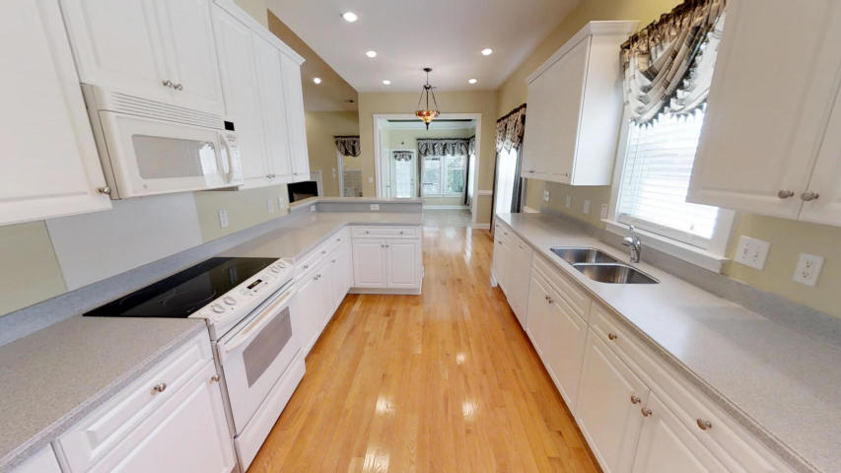
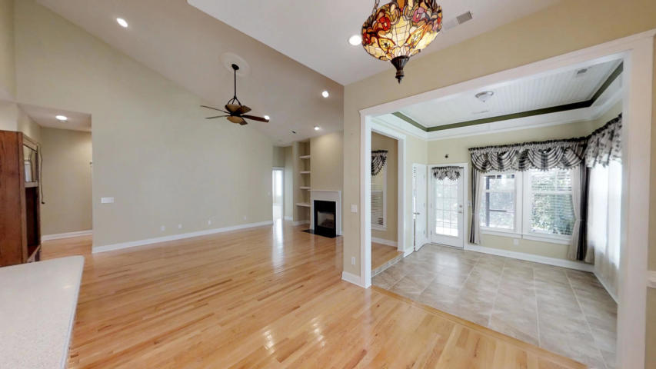
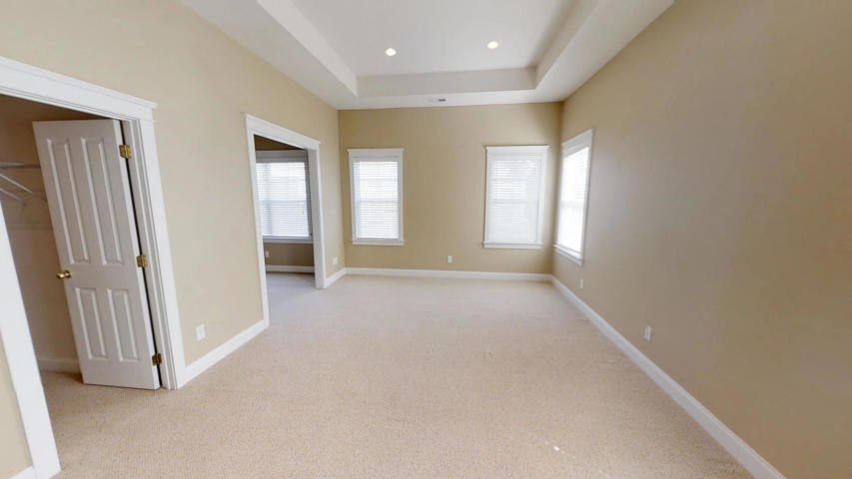
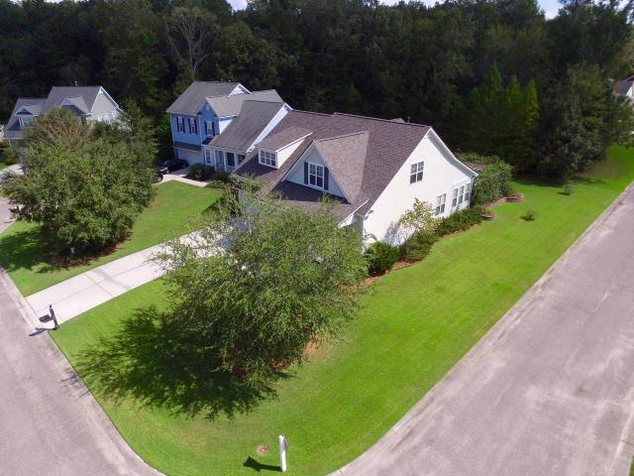
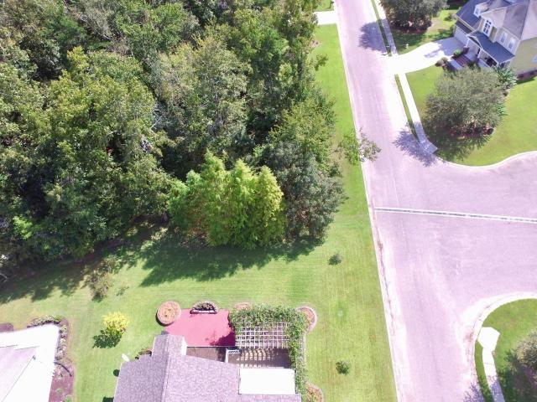
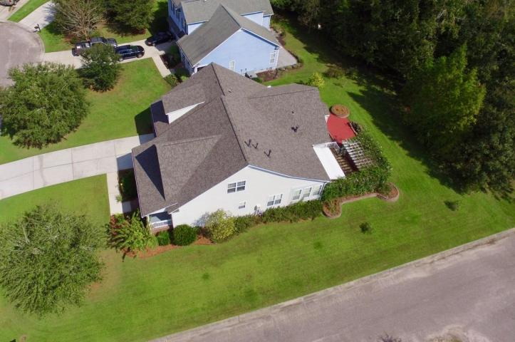
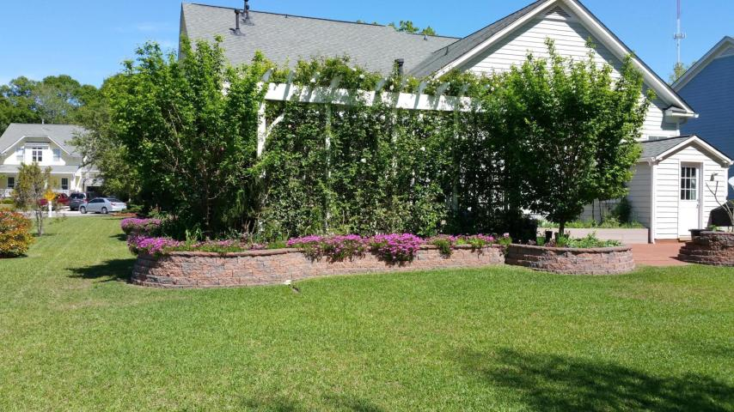
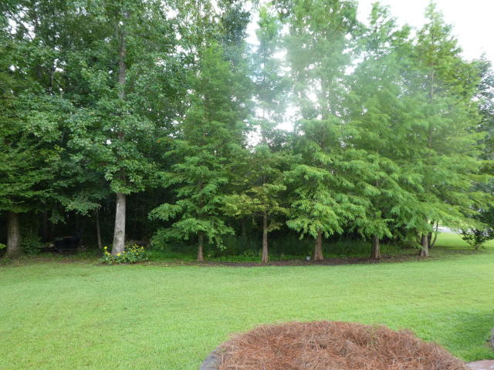
OPEN HOUSE ON EXECUTIVE HOME IN LEGEND OAKS
SUNDAY DECEMBER 2ND FROM 1-4 PM
120 Blackwater Drive Summerville, SC 29485 ~ MLS# 18024721 ~ $370,000
Price Adjustment of $15,000 on a beautiful Saussy Burbank Executive Home in Legend Oaks!!! Sellers has moved to their new home, and are motivated to sell! Sellers will also offer $2500 of Seller paid Buyer closing costs if home is closed by December 31, 2018! This 4 bedroom/3.5 bath/3263 sqft home has lots of Custom Features and is on a large .32 acre lot backing to trees – where no one can build! Full Front Porch, 22' long foyer/hallway w/ 10'ceilings, separate formal living and dining, huge vaulted-ceiling family room with fireplace. Kitchen has raised panel 42'' cabinets w/ crown molding, built-in pantry, Corian counters. Generous 2-piece chair rails in several room. Large master is down as are two other bedrooms and 2 1/2 baths. Lovely Sunroom off of eat-in kitchen which leads to Screened porch and large deck area and 12x16 remotely powered Sunsetter awning. New roof in August 2018, and new HVAC on main floor in 2017. Separate dedicated HVAC systems for downstairs and upstairs! Tankless water heater, and separate gas heat and electric cooling. Irrigation System throughout yard! The Fourth Bedroom is used as a sitting room. Very large FROG area upstairs that has a large family room, separate bedroom and Full bath, and could be used as a Mother-in-Law Suite. Beautiful Hardwood throughout much of the first floor.
Randy Espeseth
843-743-1025 | Randy@RandyEHomes.com | Carolina Elite Real Estate

