Slide 1
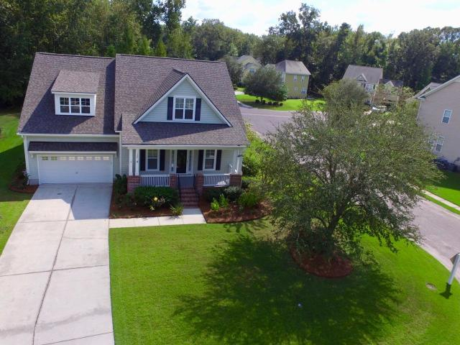
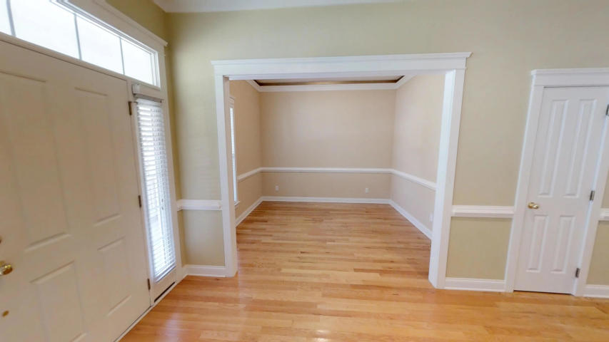
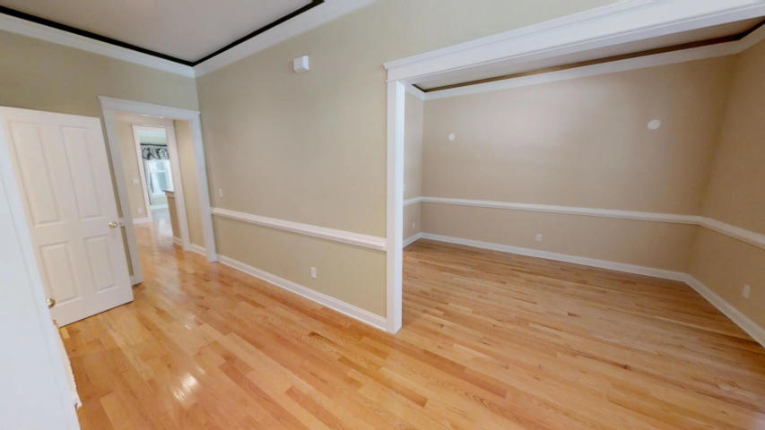
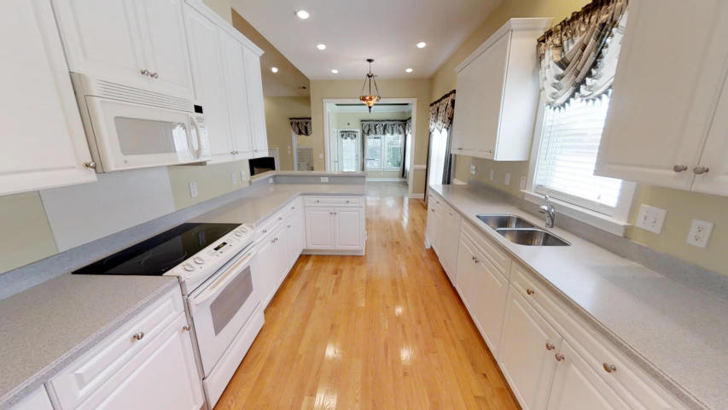
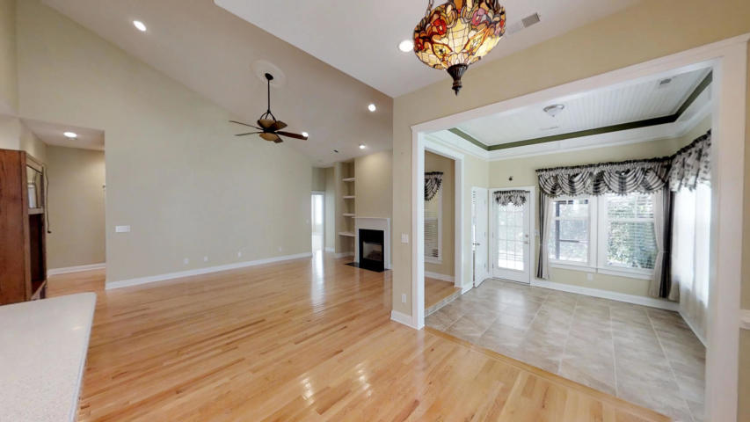
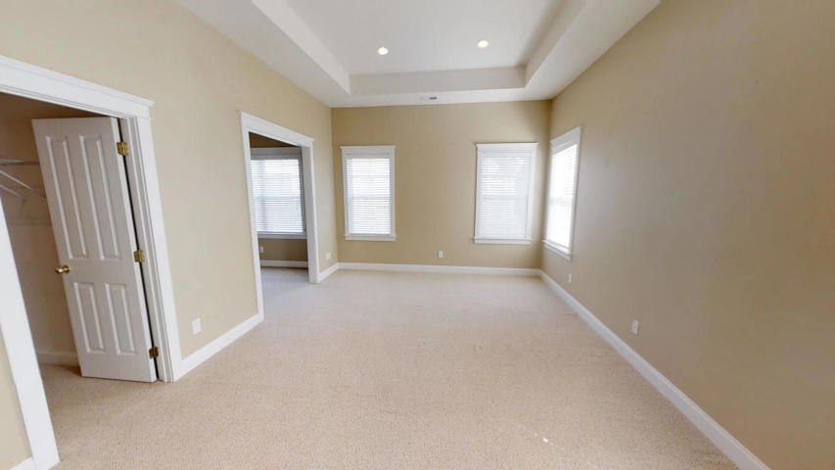
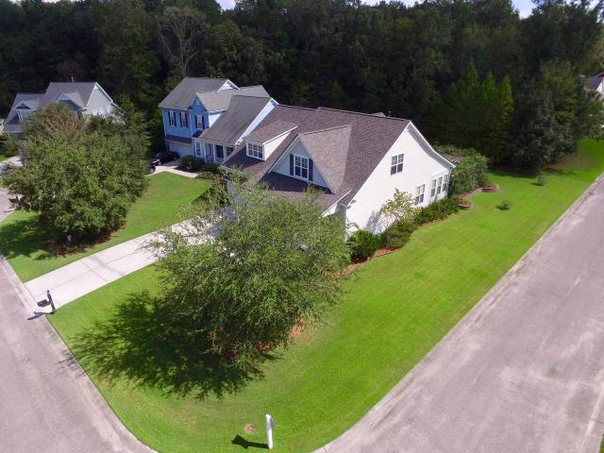
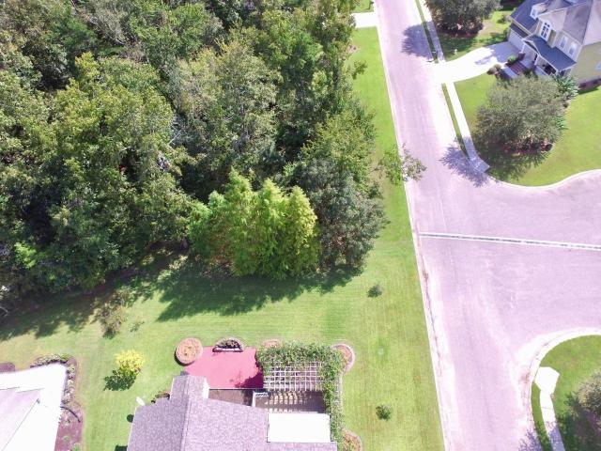
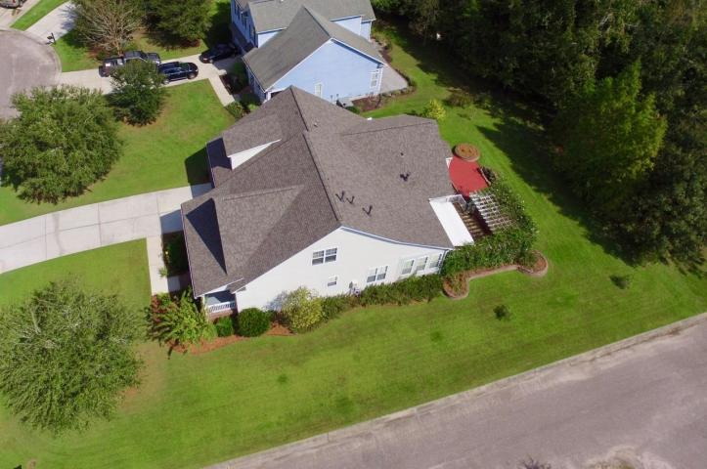
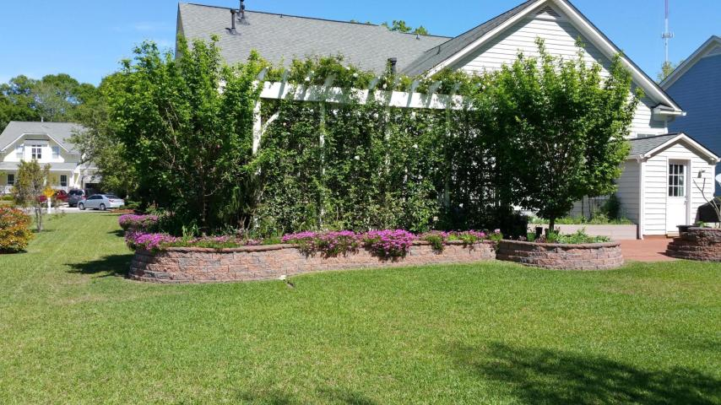
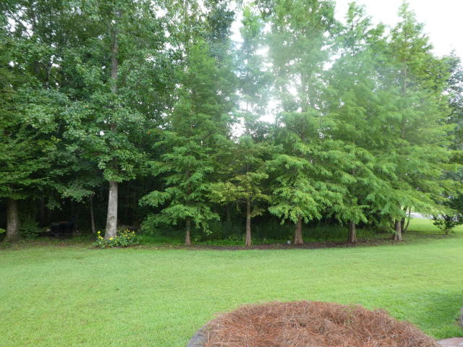
MOTIVATED SELLER - LEGEND OAKS EXECUTIVE HOME
120 Blackwater Drive Summerville, SC 29485 ~ MLS# 18024721 ~ $370,000
Recent Price Adjustment of $15,000 on a beautiful Saussy Burbank Executive Home at 120 Blackwater Drive in Legend Oaks!!! Sellers have moved to their new home, and are very motivated to sell! This 4 bedroom/3.5 bath/3263 sqft home has lots of Custom Features and is on a large .32 acre lot backing to trees - where no one can build! Full Front Porch,10'ceilings, separate formal living and dining rooms, huge vaulted-ceiling family room with fireplace. Kitchen has raised panel 42'' cabinets w/ crown molding, built-in pantry, and Corian counters. Large master is down as are two other bedrooms and 2 1/2 baths. Lovely Sunroom off of eat-in kitchen which leads to Screened porch and large deck area. New roof in August 2018, and new HVAC on main floor in 2017. Separate dedicated HVAC systems for downstairs and upstairs! Tankless water heater, and separate gas heat and electric cooling. Irrigation System throughout yard! The Fourth Bedroom is used as a sitting room. Very large FROG area upstairs that has a large family room, separate bedroom and Full bath, and could be used as a Mother-in-Law Suite. Beautiful Hardwood floors throughout much of the first floor. This home is a MUST SEE; and, as the lowest price per square foot Executive Home in Legend Oaks, A GREAT BUY!!!
Randy Espeseth
843-743-1025 | Randy@RandyEHomes.com | Carolina Elite Real Estate

