Slide 1
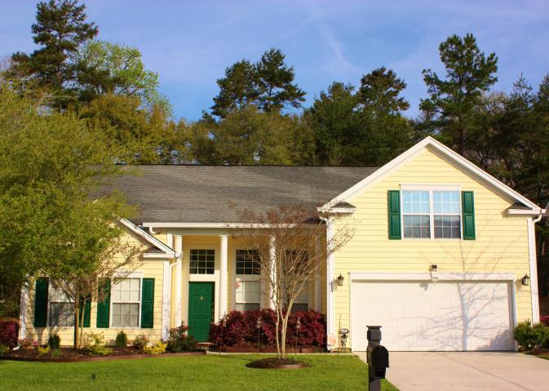
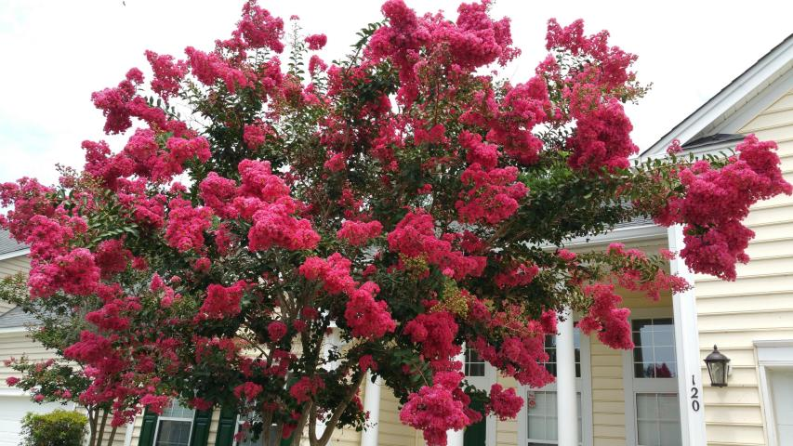
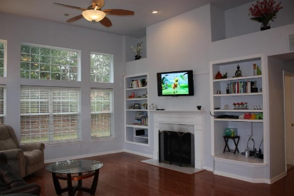
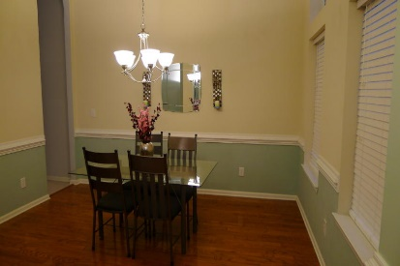
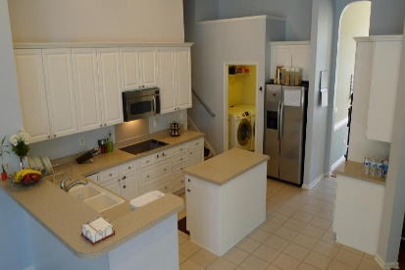
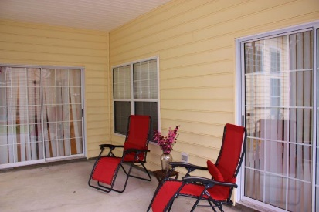
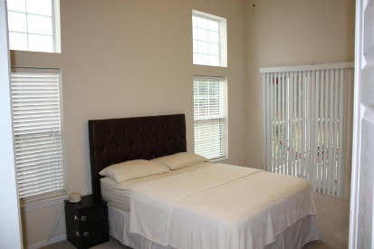
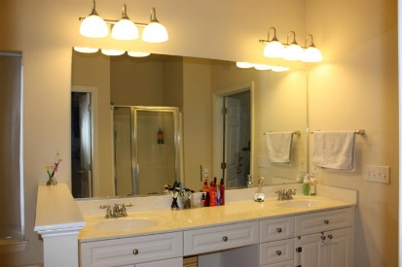
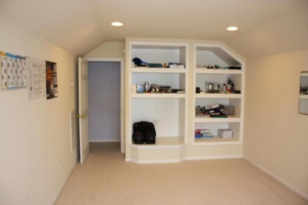
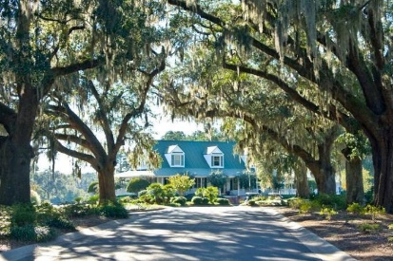


Beautiful Single-Story in Legend Oaks Plantation!
120 Carolinian Drive
Legend Oaks Plantation | Summerville, SC 29485 | MLS# 16001210 | $249,900
Welcome to Legend Oaks Plantation! This well kept 1-story home features 12 ft ceilings and a spacious, open floor plan. Transom windows illuminate this home with natural light. 2-piece crown molding with chair rail accent the Foyer, Living room and Dining room. Gleaming hardwood floors are present in the Foyer, Dining Room, Living Room and Family Room. The eat-in kitchen is fully equipped with dual wall ovens, stainless appliances, ceramic tile floors, center island tons of 42'' cabinets. This popular split floor plan features a large master suite with sliding glass doors opening to the HUGE screen porch, master bath with dual vanities, separate garden tub and shower, water closet and spacious closet. Two additional bedrooms and full bath are off the main living room. The FROG features built-in bookcases and could be used as a 4th bedroom. Don't miss the private wooded back yard and extra shelving and storage in the 2 car garage. Award winning DD2 Schools, Legend Oaks Clubhouse and Golf Membership available.
Marie Hamilton
Mobile - (843) 324-4774
mariehamiltonsc@gmail.com
Keller Williams Realty Charleston West Ashley
1180 Sam Rittenberg Ste 105
Charleston, SC 29407

