Slide 1
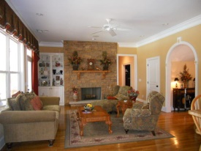
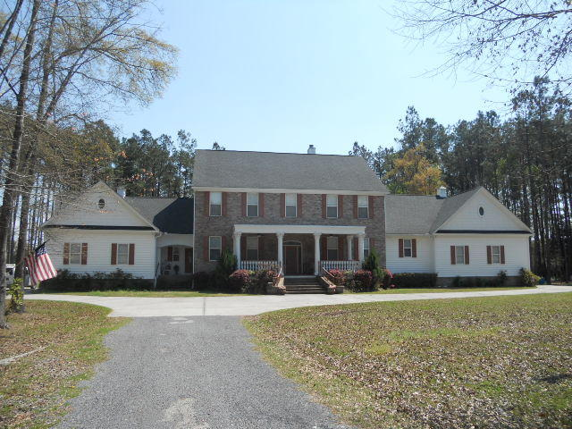
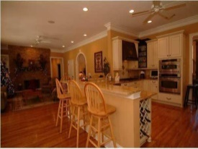
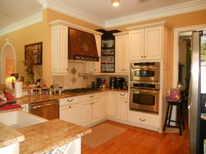
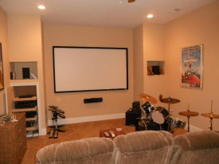
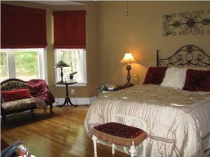
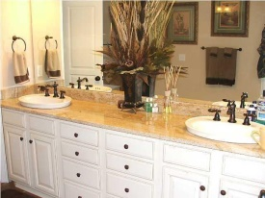
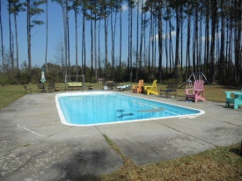

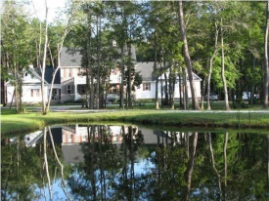
Gorgeous Country Estate!
120 Cotton Creek Ln
Cross Area (East)
Ridgeville, SC 29472
MLS# 15007974 | $775,000
6 Bed / 7 Full Bath (2 Half)
Two Beautiful ponds greet you on both sides of the driveway as you come upon this Georgian Masterpiece. The large Corinthian pillars on the front porch reflect the impeccable scale and beauty that awaits inside. As you enter the home, the gracious archways, exquisite moldings and 10 ft. ceilings through out set the tone for this magnificent residence. The intricate black wrought iron spindled staircase rises to meet a beautiful hand crafted wrought iron chandelier. The Library greets you on the right as you enter, with custom built cabinetry and the exquisite marble fireplace truly makes a statement. Finished apartment over garage provides $700 monthly income. Professional landscaped yard and in ground pool are all surrounded by the tranquility of 10 acres of land.
Connie White, Broker
C: 843-532-3356
conniesyouragent@gmail.com
Charleston Homes
111 Spring Hall Dr
Goose Creek, SC 29445

