Slide 1
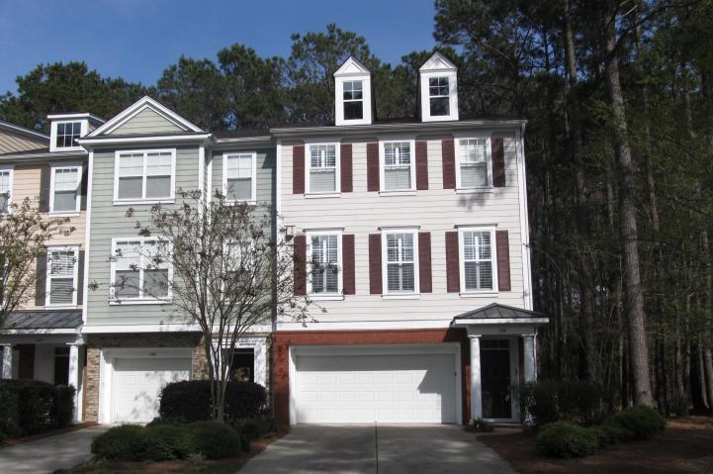
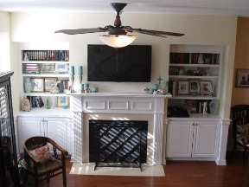
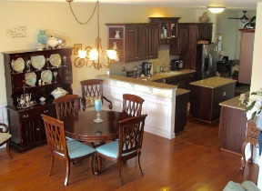
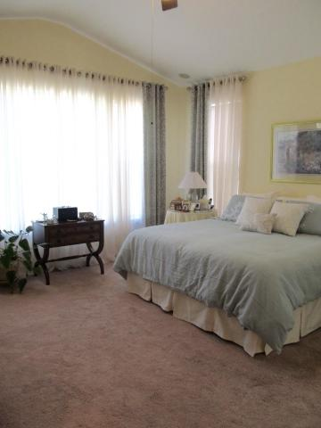
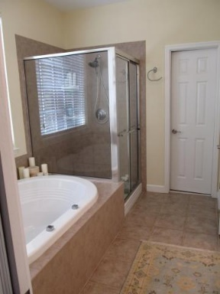
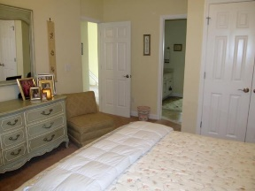
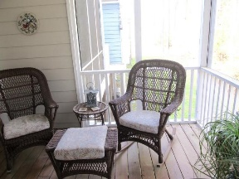
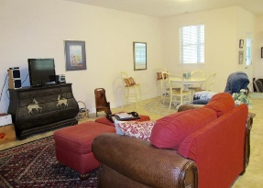
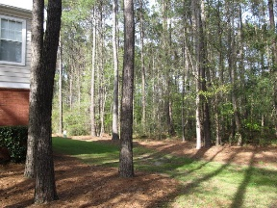
120 Fair Sailing Road
Dunes West ~ Mount Pleasant ~ MLS# 16008745 ~ $399,000
Open House Thurs 10-12
Gate Passes Available
$5,000 toward buyer's closing cost.
$5000 agent bonus w/ BIC approval.
This stunning, end unit town home in gated Dunes West is a gem. It is buffered by woods in the back and side, and is in a very small subsection called Egrets Walk. Many owner upgrades, including most lighting fixtures, wainscoting throughout main floor, plantation shutters, hardwoods, 10' ceilings, surround sound in four rooms. In the kitchen, there are granite counter tops, a dual fuel Kitchen Aid stove/oven, tumbled stone tile backsplash, and custom cabinetry. On the ground floor there is a spacious 2 car garage with extra storage areas, and a 700 sf bonus living area. This space would be a wonderful rec room, office, craft room, etc. Regime fee covers Homeowner and Flood insurance, landscape watering and maintenance. Once you see this one, it won't compare to others on the market.
Deborah A Hulett
(843) 814-0255
debby@hbrtwn.com
Harbourtowne Real Estate | 672 Marina Drive, Ste 110 | Daniel Island, SC 29492

