Slide 1
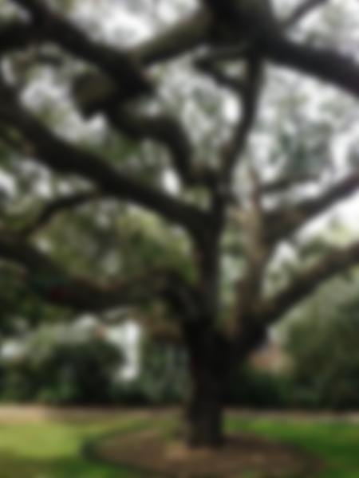
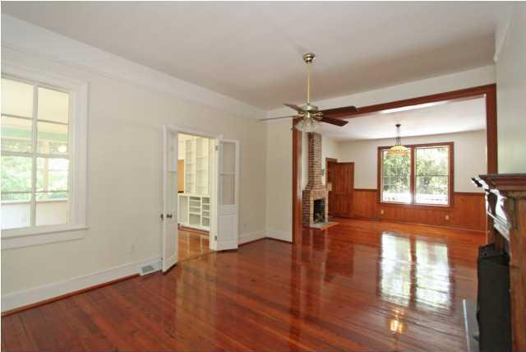
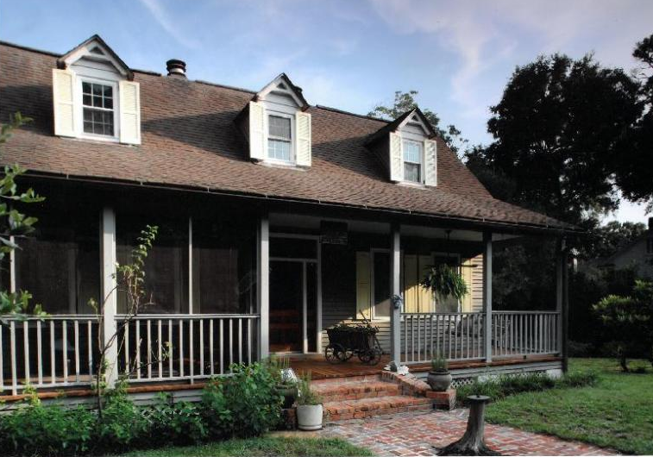
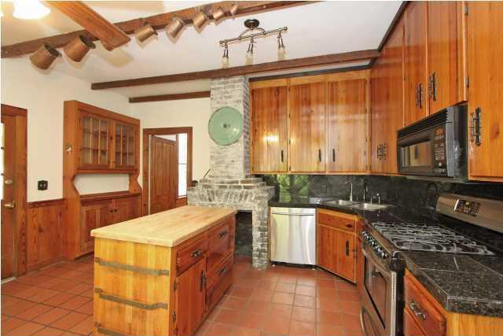
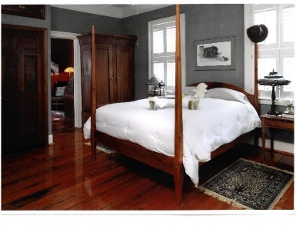
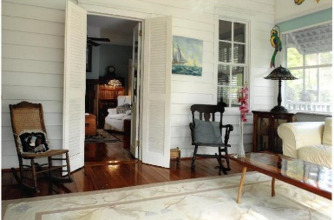
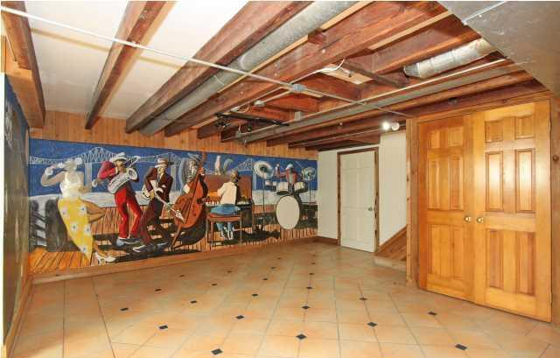
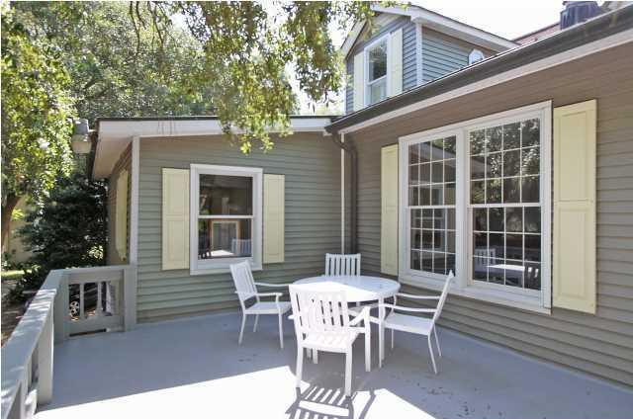


120 Mary Street
MLS# 17009062 ~ $1,779,500
Old Village Open House Aug 27th 1-4pm
Another Price Reduction Of $5,000!
ACORN HILL built in 1850 started as a dairy farm. Owner took great care to preserve it's original heritage. Sitting on a double lot surrounded by majestic Oak Trees, this historic Old Village home has 4 bedrooms, 3 full baths, 5 fireplaces, dining room, living room, library with built-ins, sun room, eat-in kitchen, screened front porch & roomy elevated deck on the back. Possibilities in finished basement area could be a spacious mother-in- law or guest suite, Man Cave, Teenager's retreat, music room/bar area with hand painted wall mural by local artist Shaws Defesaur. This is a true family friendly neighborhood with play park, restaurants & Shem Creek history. Walk/bike to many amazing sights of the harbor, boats & native birds. No Flood Insurance required.
Mariann Kasen
(843) 224-1980 C | (843) 725-6172 O
mariannkasen@gmail.com
www.bestlowcountryrealestate.com
AgentOwned Premiere Group | 1800 Trolley Rd | Summerville, SC 29485

