Slide 1
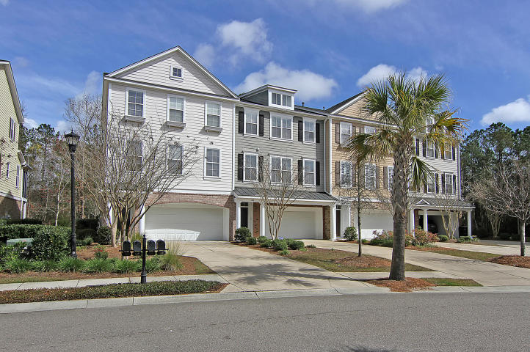
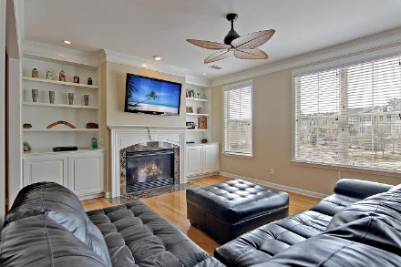
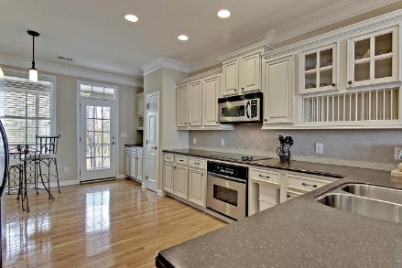
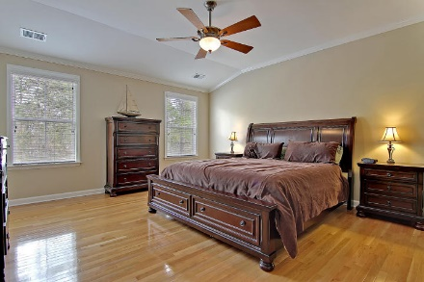
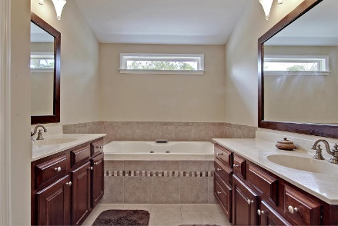
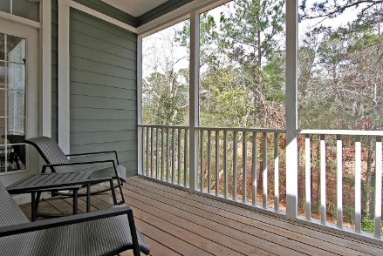
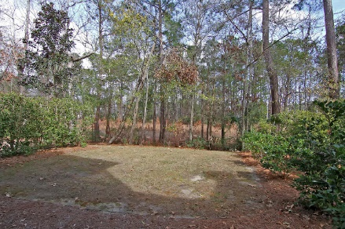
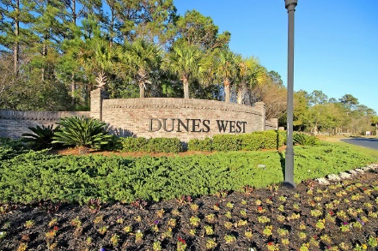
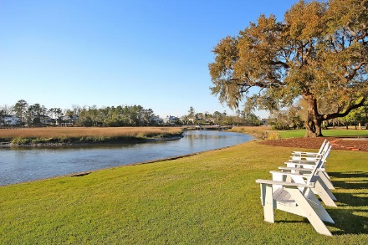
$2000 Buyer Agent Bonus
With An Acceptable Offer By August 1!
Reduced $200k!
120 Palm Cove Way
Dunes West ~ Mount Pleasant, SC 29466 ~ MLS# 17005392 ~ $379,999
Maintenance-free townhouse living awaits you at Dunes West with this three story beauty! The open floor plan on the main floor boasts hardwood floors, a cozy fireplace with built-ins on either side in the living room, columns in the dining room, crown molding, and a Corian kitchen with a breakfast bar, eat-in area and TONS of cabinet storage. A deck off of the kitchen looks out to the private, wooded backyard.
One great feature of this home is that each bedroom has an en-suite full bath making for very private accommodations. Between the bedrooms on the 3rd level is an office area with built-ins. The owner's retreat offers two walk-in closets and an amazing full bath. The ground level makes for a great man/bonus room with access to a half bath, the covered patio and two car garage.
Tyler Hawkins tyler@mattoneillteam.com (843) 908-2734

