Slide 1
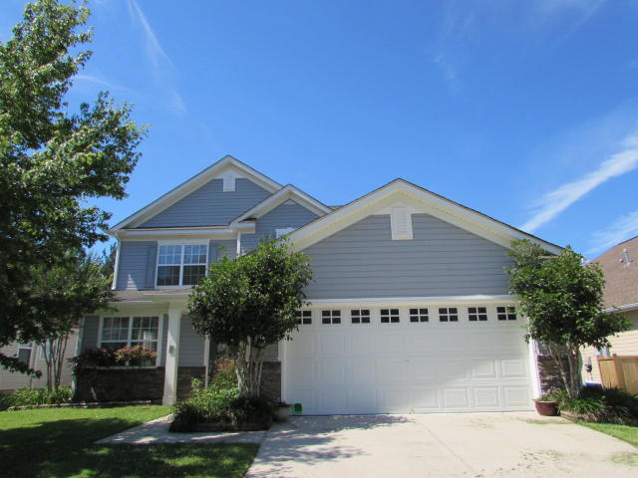
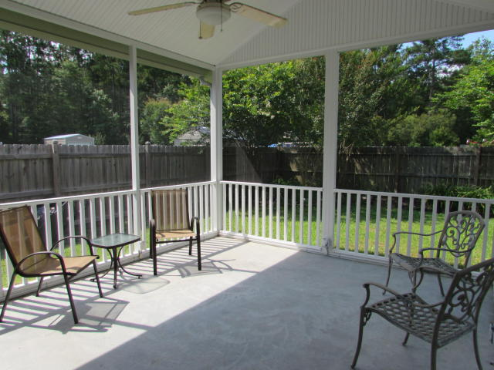
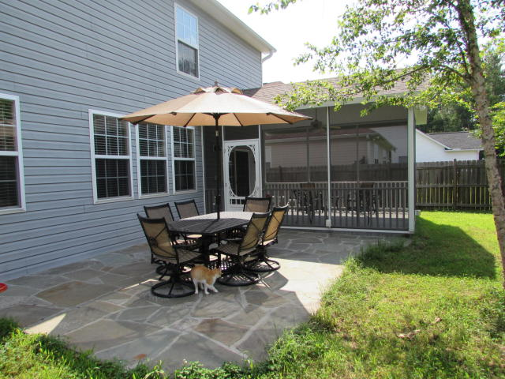
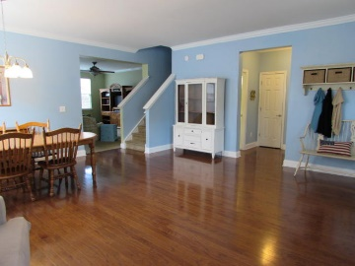
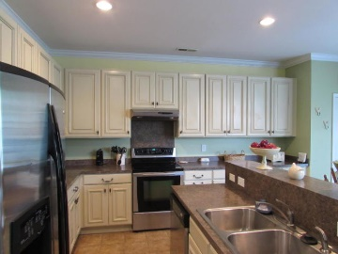
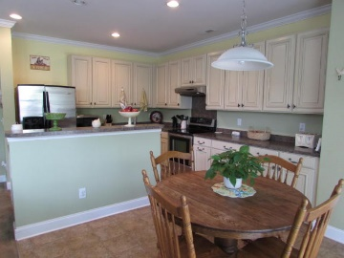
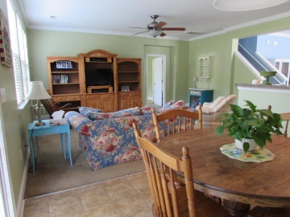
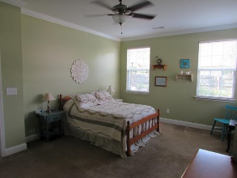
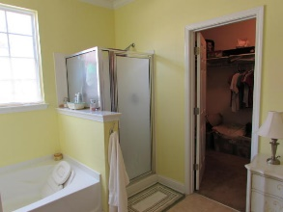
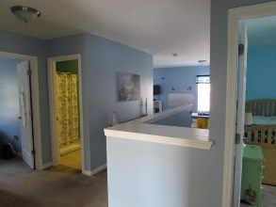
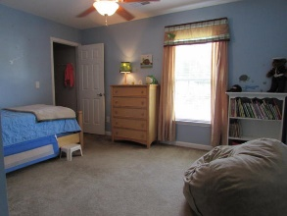
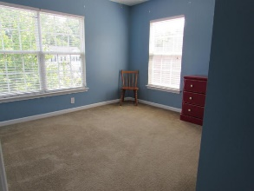


120 Salt Meadow Lane · Blackberry Creek · Summerville · MLS# 16015534 · $248,000 ·
55 and Better!
A Steal In Summerville
This lovely spacious home in Dorchester II school district boasts a large family room and living room, large upstairs loft w/its own closet, tons of storage space, a 13x16 screened in patio and a blue stone patio as well. Kitchen has beautiful antiqued white cabinets and lots of cabinet space. There are oak cabinets in the two car garage for hiding tools and such out of the way. Interior is painted in calming beach colors throughout. Price to sell quickly, property does come AS IS.
Heather Broadwell-Derexson
(843) 303-2065 – C heather.derexson@carolinaoneplus.com
www.Lowcountryhomesbyheather.com
Carolina One Real Estate
900 N Main St.
Summerville, SC 29483

