Slide 1
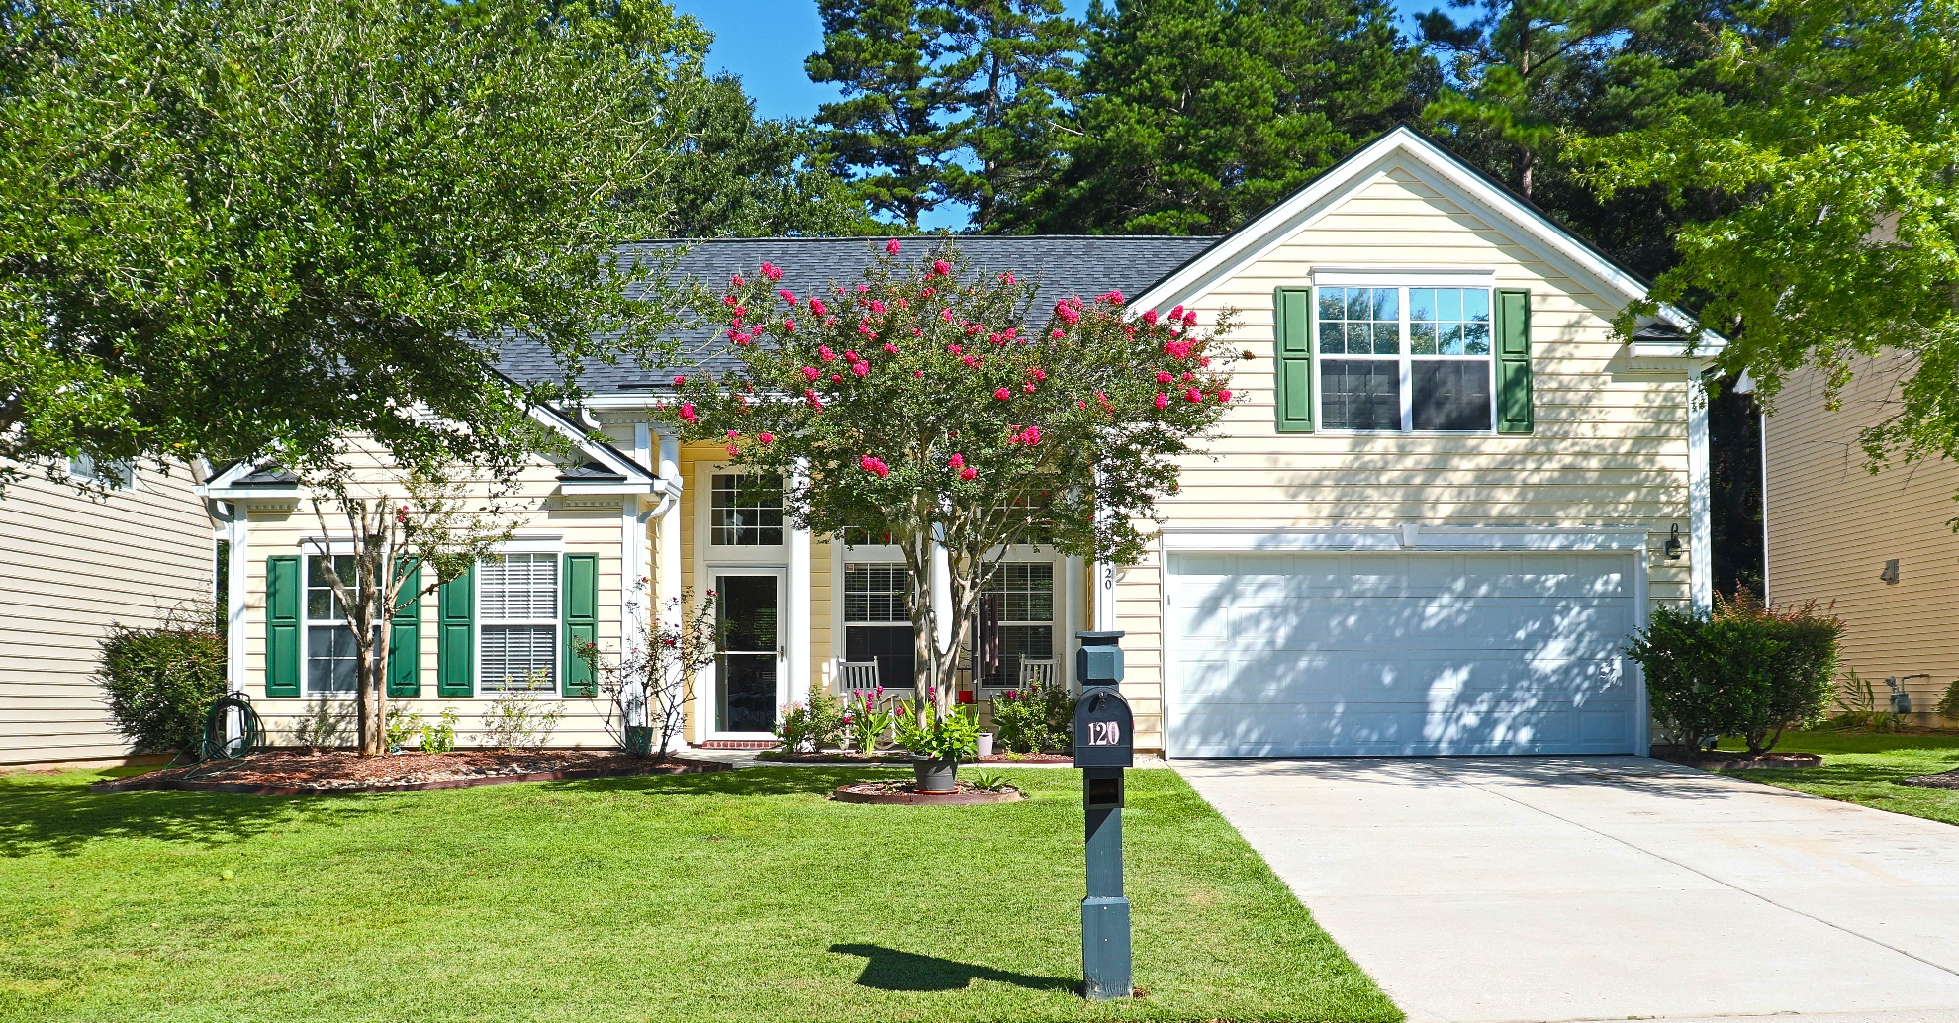
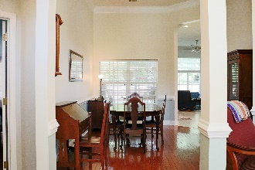
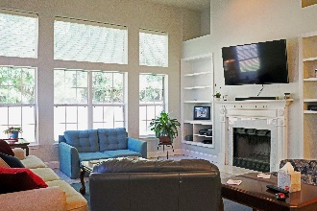
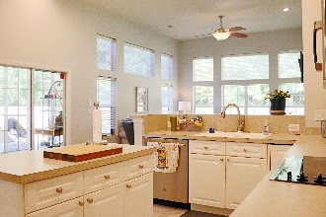
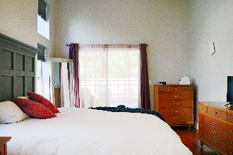
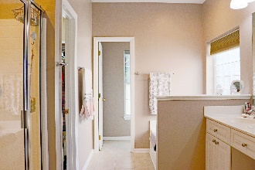
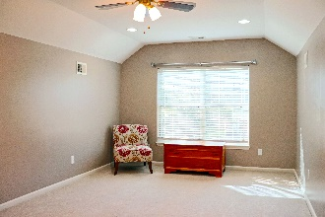
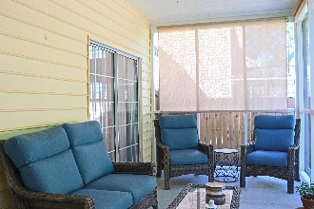
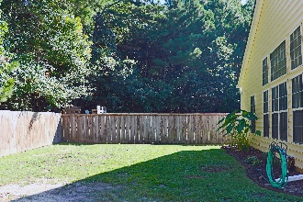


120 Carolinian Drive
Legend Oaks Plantation | Summerville, SC 29485
Beautiful Move-in Ready Home
Here is your chance to live in the desirable Legend Oaks Plantation! This move in ready home is nestled in the back of the subdivision on a quiet street. Upon entering you are met by tons of natural lighting and a semi-open floor plan. Your large master suite features a garden tub, walk-in closet, and separate access to the screened porch. It sits opposite the guest rooms for additional privacy. The large kitchen features a double oven, stainless steel appliances, and plenty of cabinet storage. In the living room, built ins encase the wood burning fireplace perfect for a cozy night at home. Upstairs, the FROG is perfect for an additional bedroom, office, or playroom!
Outside, just off the screened porch, a patio gives you plenty of room for entertaining outdoors! The privacy fence was completed 2 years ago. Roof replaced in March 2022. Hardwood and tile floors installed 2022. HVAC replaced 2018. Interior and ceilings painted 2 years ago.
Bonnie Dickson
864-219-1674
bonnie.dickson@gmail.com
AgentOwned Realty Co. Premier Group, Inc.
141 A N. Main Street
Summerville, SC 29483

