Slide 1
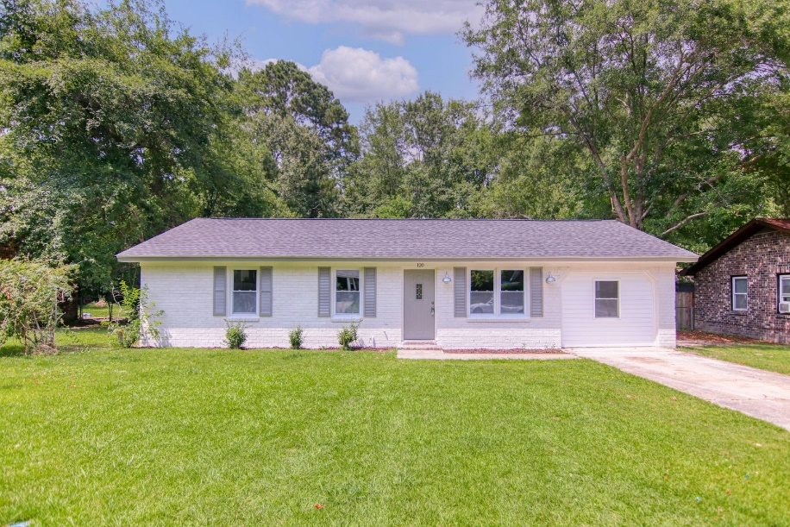
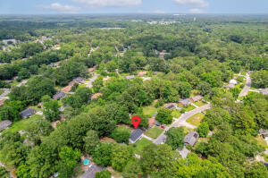
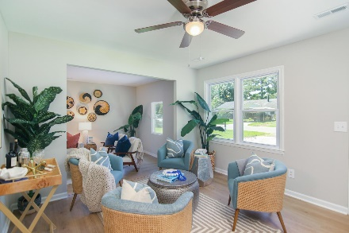
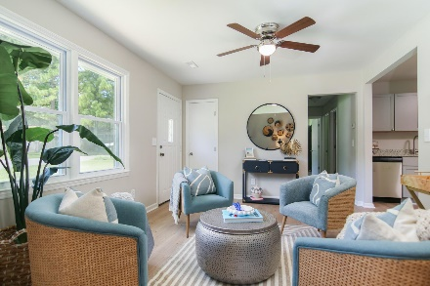
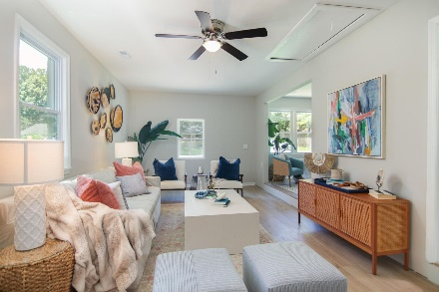
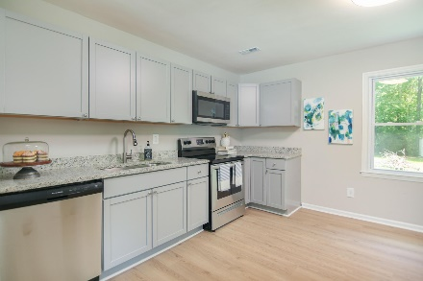
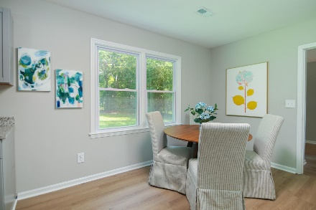
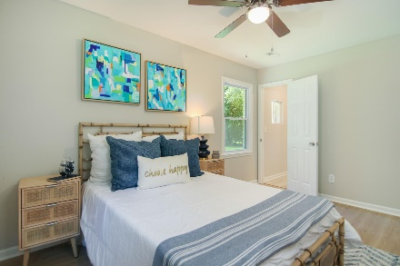
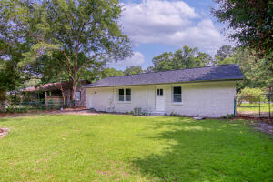
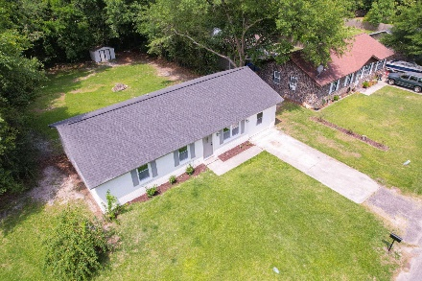
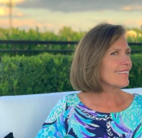


120 Lisa Drive Greenhurst ~ Summerville, SC 29485 MLS# 22016073 ~ $265,000
RECENTLY STAGED BEAUTIFULLY AND PRICED TO MOVE!
MULTIPLE FINANCING OPTIONS ARE AVAILABLE
ALL BRAND NEW RENOVATION!!!! Be within minutes of parks and downtown Summerville with this stylish, completely renovated house in a quiet but centrally located subdivision. Nice, large backyard to enjoy! In addition to new paint work, the house features a substantially large converted living room, large kitchen, brand new cabinets with granite countertops, NEW stainless steel appliances, NEW HVAC, NEW windows and a NEW roof! Attention was directed at improving natural light with expansion of living spaces as well as brand new laminate floors. Also features a NEW half bath in the master bedroom as well as NEW fixtures throughout the house. Thanks for your interest!
Susan Stanley
832-323-5573
susancstanley@gmail.com
Brand Name Real Estate
4 Carriage Lane Suite 106
Charleston, SC 29407

