Slide 1
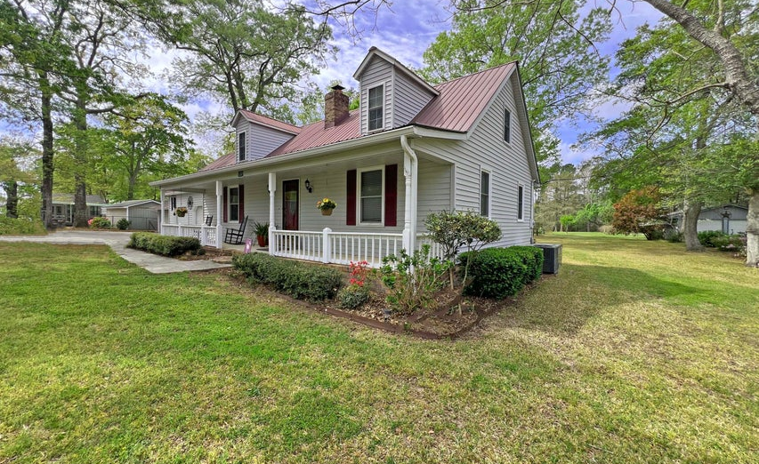
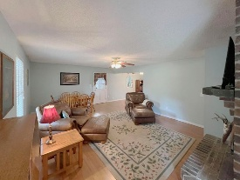
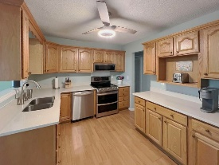
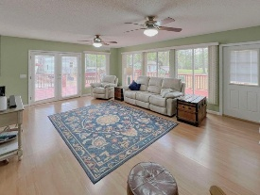
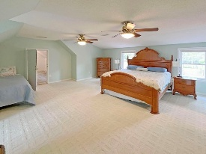
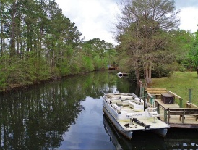
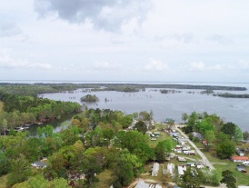


Waterfront Home on Lake Marion
CHARLESTON SINGLE STYLE HOME
4 BEDS/2.5 BATHS/LOFT
MASTER BEDROOM DOWN
YARD W/PRIVACY FENCE
HARDIPLANK SIDING
HOME ONLY 2 YEARS OLD
QUARTZ COUNTERTOPS
STAINLESS APPLIANCES
REFRIGERATOR INCLUDED
COVERED PORCH
PERFECT JOHNS ISLAND LOCATION
1 MILE FROM SEVERAL RESTAURANTS/SHOPS
BLINDS AND WASHER/DRYER INCLUDED
LESS THAN 10 MILES TO DOWNTOWN CHARLESTON
12 MILES TO KIAWAH OR FOLLY BEACH
120 Rutledge Drive
Eutawville, SC 29048 | MLS# 25008640 | $495,000
QUIET WATERFRONT 4 BEDROOM AND 2.5 BATH HOME WITH DOCK AND BOAT RAMP ON LAKE MARION. ENJOY LARGE LOT WITH GARDEN SPACE AND FRUIT TREES. WORKSHOP OR STORAGE SPACE ON PROPERTY. WALK FROM YOUR HOME TO YOUR BOAT AND OUT TO FISHING AND FUN!!! ENJOY GOLF CART RIDES AROUND THE NEIGHBORHOOD AND THE SURROUNDING AREA. OUTSIDE SPACE WITH A FRONT PORCH AS WELL AS A DECK ON THE WATER VIEW. SANTEE COOPER ANNUAL MARGINAL LEASE TO APPLY TO PORTION OF LOT. BUYER AND BUYER'S AGENT PLEASE VERIFY ALL INFORMATION OF IMPORTANCE.
Carla Davis
843-437-4873
gaweber@tds.net
Adler Realty
518 Parrot Point Dr
Charleston, SC 29412
www.adlerrealtychs.com

