Slide 1
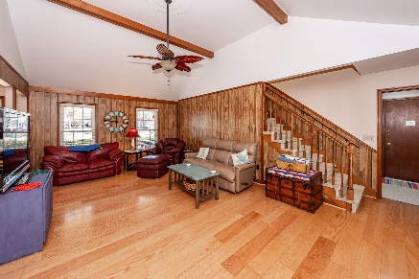
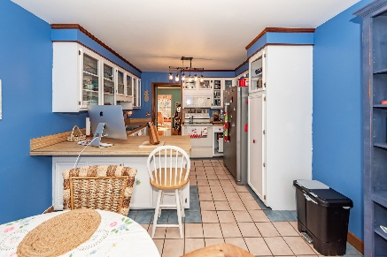
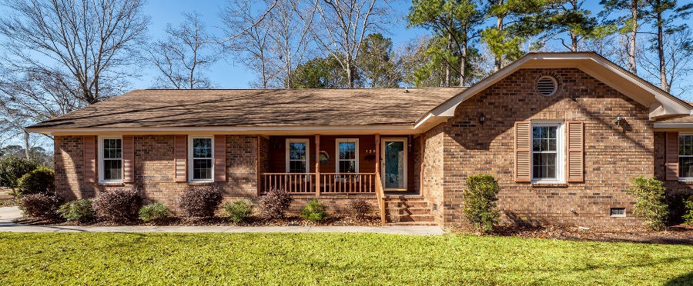
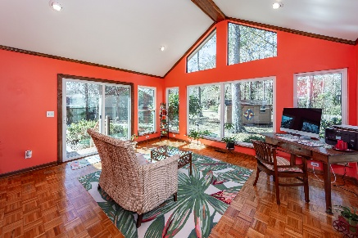
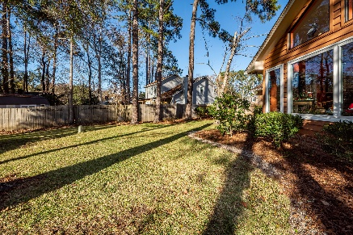

120 Savannah Round
Irongate | Summerville, SC 29485
3 Bedrooms | 2 Bathrooms
2,100 Square Feet
MLS# 25032463
Now Offering at $395,000
Beautiful brick veneer ranch style home on a large corner lot ,close to 4/10's of and acre. This beautiful home boast a large spacious family room, spacious sunroom, 3 spacious bedrooms, 2 full baths, large room over the garage which can also be 4th bedroom, home office, study, sewing room, etc.
Separate dining room as well as a eat in kitchen, 2 car garage with additional space for a work area and additional driveway space for multi vehicles.
Neighborhood playground as well as walking trails. Neighborhood pool membership available separately. Convenient to shopping, schools, restaurants, downtown Summerville. Might be best for you to schedule showing to see this great home!!!

