Slide 1
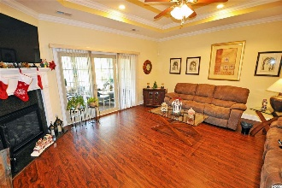
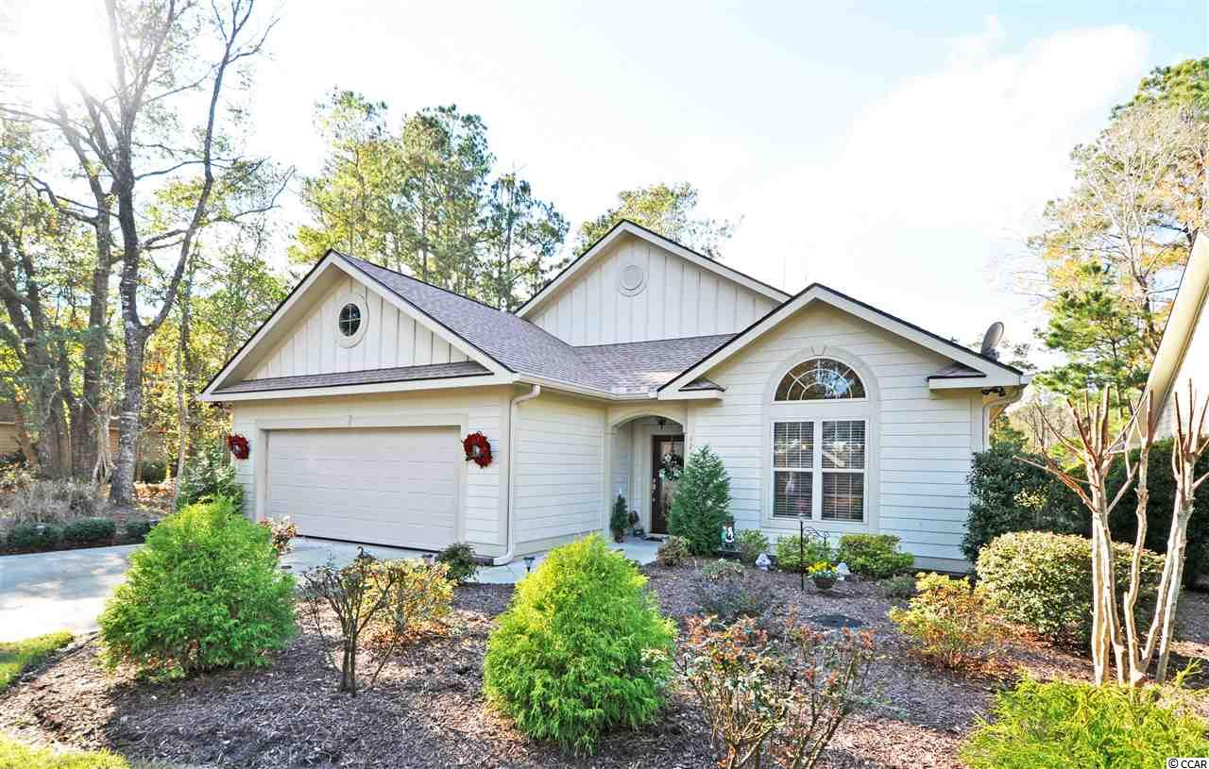
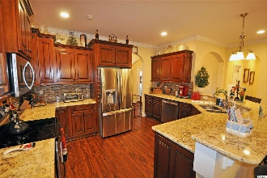
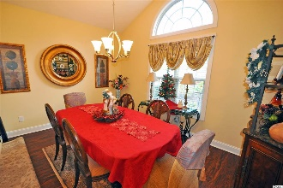
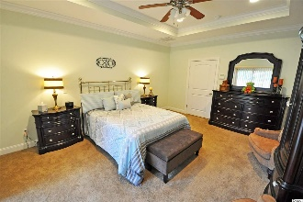
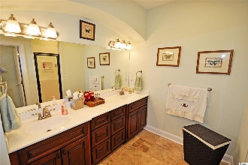
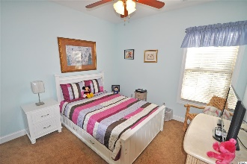
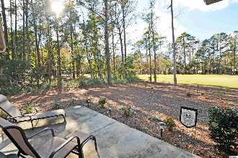
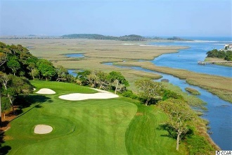
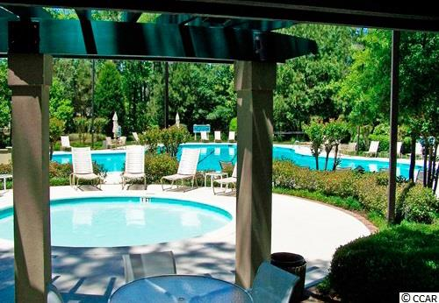
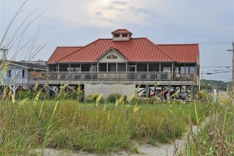


1210 Clipper Rd
Tidewater Plantation Resort ~ North Myrtle Beach
MLS# 1824513 ~ $375,900
This 3-year-old custom-built 3 bedroom, 2 bath one-owner home is too good to be true, but come in soon to see it for yourself, as it really is! There's the Tidewater Plantation secluded cul-de-sac location...on the world-class golf course, including 24-hour manned gated security; a private oceanfront beach cabana for owners on a wide, uncrowded stretch of the white-sand Cherry Grove Inlet Beach; and multiple pools, restaurants, events centers, tennis, fitness and so much more. It is a wonderful way of life, so live it to the fullest in this well-priced charming beach-house beauty. Enter from an inviting, nicely landscaped front entry or large double-car upscale garage with eye-catching epoxy-inspired flooring. Both bring you to a welcoming foyer adjoining a magnificent formal dining room which is gathering-sized, for the family or for gracious entertaining. From there, follow the Brazilian cherry-style high-tech manufactured flooring to the designer kitchen and show-stopper great room or to the right to the preferred and popular separate guest rooms wing. Architectural arches, neutral colors and custom trim adorn the convenient lay-out. The kitchen has tall custom and truly magnificent cherry wood cabinets, upgraded stainless steel appliances, granite, designer tile back splash, walk-in pantry, and breakfast nook and bar. It overlooks that great GREAT room with tray ceilings and ceiling fan, gas fireplace with mantel and an open view to the back screened porch/ lanai, good-sized yard and fairway. The lanai has custom window shades and is a perfect place to enjoy this pleasant, natural environment and golf-course location seasonally. There's much more to see inside, too! The master bedroom is spacious, accommodating a king-plus bed and big furniture, with likewise spacious customized walk-in closet and wonderful walk-in shower in the en suite bath, also featuring double-sink vanity and custom cabinets. The tray ceiling with ceiling fan nicely enhances this comfortable, luxury master retreat. The guest room section offers two bedrooms, again with custom closets; full bath with vessel sink and granite vanity & tub/shower; and the utility room with LG washer/dryer, sink and work space. This home has it all -- even a tank-less, gas hot water heater in the garage, an alarm system and a Hardy Plank exterior. Furniture is negotiable. And it's Tidewater... Amenity-rich Tidewater is on a tree-lined road to oceanfront Anne Tilghman Boyce Coastal Reserve, a nature conservancy, including Waties Island, with access for managed recreational use. Tidewater itself is on an elevated peninsula of live oaks and southern pines between the Intracoatal Waterway and the Cherry Grove Inlet to the Atlantic Ocean. The plantation also preserves the singular look of its own historic origins. It is minutes from the beach, shopping, medical services, entertainment and access to major highways. Rich amenities at low, low HOAs include that oceanfront beach cabana for owners' use with open/screened porches, bathrooms, showers and kitchen. Residents enjoy the use of several pools/hot tubs. Other amenities include a driving range, golf shop, clubhouse with bar/dining and event facilities overlooking the 18th hole, clay and hard surface tennis courts, pickle ball court, fitness center overlooking a pool, bocce courts and amenity center for public/private events. Tidewater has a gated storage yard for boats, jet skis, motorcycles & kayaks. Tidewater Plantation, with its full range of things to do and to enjoy, reflects a "way of life" in safe, affordable North Myrtle Beach. North Myrtle Beach enjoys the lowest tax millage of any such full-service city of its kind the Carolinas. Both Tidewater and North Myrtle Beach are well run and have healthy financial resources, along with those uncrowded, wide, white sand beaches. It is, after all, ALL about the BEACH!
Deborah Collins
843-424-9013
dctidewater@yahoo.com
Connie Ross-Karl
702-306-2643
conniesross@aol.com
NEW WAY PROPERTIES MYRTLE BEACH

