Slide 1
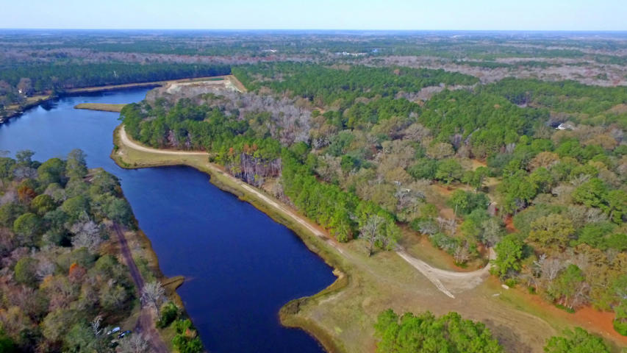
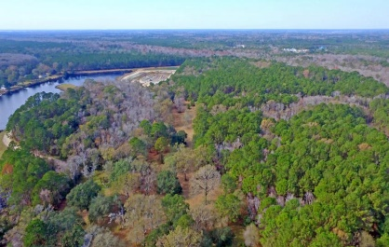
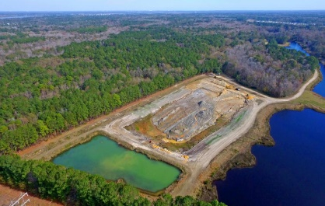
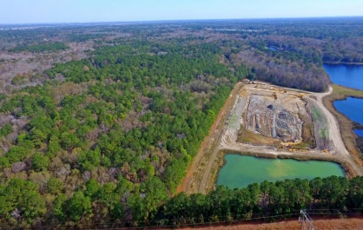
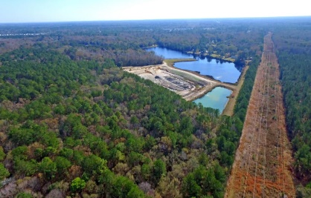
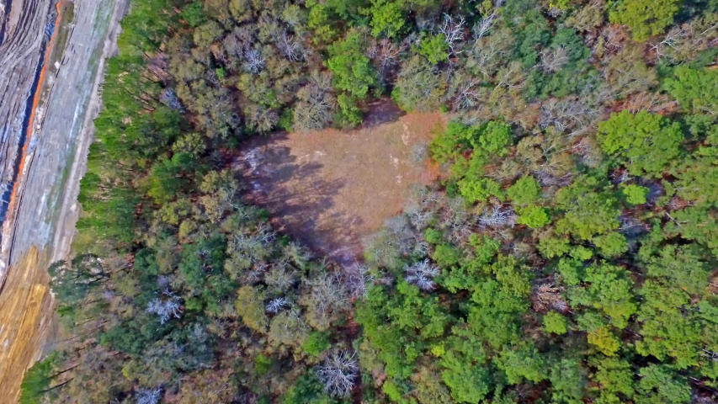

Price Reduced!
Price Reduced!
1210 Michelle Lane
Hickory Hill ~ Johns Island, SC 29455 ~ MLS# 17032821 ~ $499,999
Perfectly located between Main and River Roads, this serene 17+ acres on Johns Island has unlimited potential. Whether you are looking for the perfect hunting grounds, campgrounds, or are searching for the perfect place to built a family retreat, 1210 Michelle Lane has it all. The raw beauty and quiet that give John’s Island its charm are found throughout this wooded property. After driving through a tree canopy towards the end of the property, an opening reveals the perfect setting for a custom home to be built. The property contains two parcels that are being sold together. The Front Lot 3 is zoned residential with electric, one well, and septic. Back Lot 14, is zoned agricultural and has a well on the rear cleared area. A near by waterway is the perfect fishing hole just steps away!
Take a video tour here: www.charlestonrem.com/1210-michelle
Jeff Burda jeff@mattoneillteam.com 843-619-0405

