Slide 1
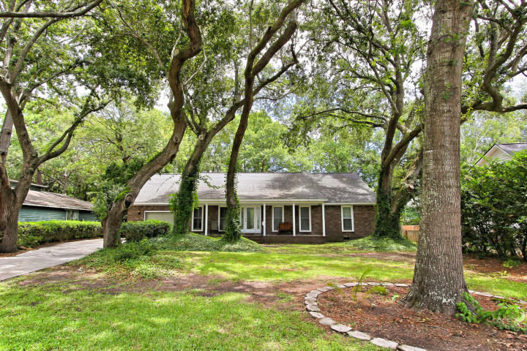
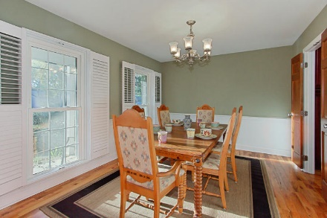
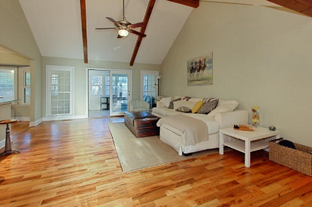
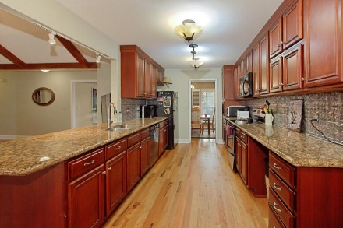
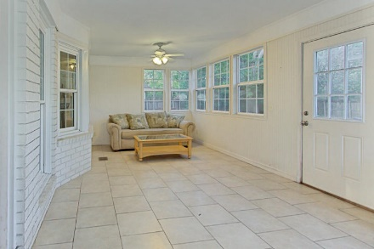
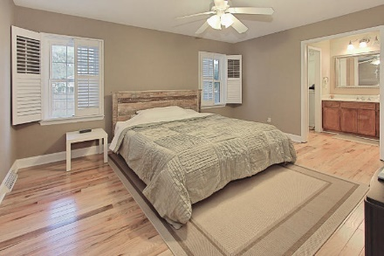
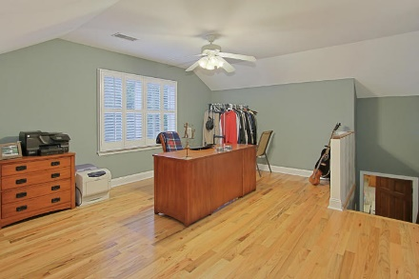
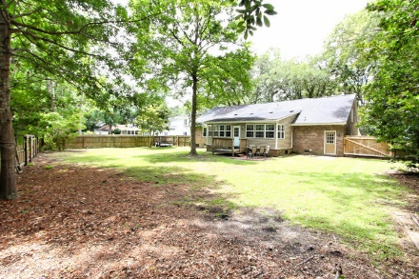


1210 Parkway Drive Mount Pleasant, SC 29464 MLS# 17020202 $494,000
Snee Farm Open House Sunday 11-2pm
Move in ready, renovated one story brick ranch in centrally located, Snee Farm. The home features mast down, open floor plan, beautiful hardwood floors in common living areas, and plantation shutters throughout.
In addition there is a finished room over the garage with separate HVAC - perfect for a playroom, media room guest room or office. Kitchen includes stainless steel appliances, granite countertops, and cherry cabinets which opens to the living room. Smooth ceilings throughout and updated vinyl insulated windows.
Mary Beth Bennett
(843) 367-1774
marybeth.bennett@agentownedrealty.com
www.chsarealiving.com
AgentOwned Preferred Group | 824 Johnnie Dodds Blvd | Mt Pleasant, SC 29464

