Slide 1
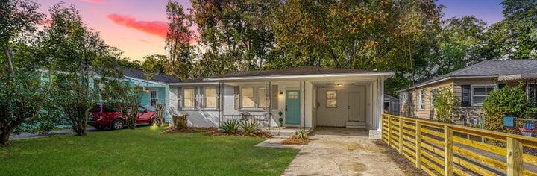
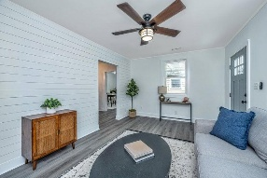
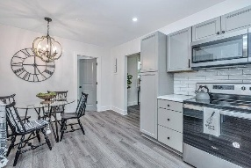
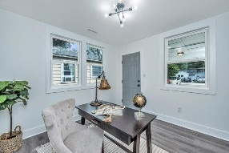
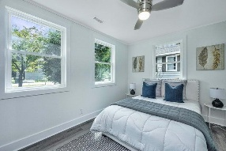
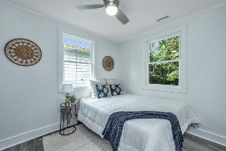
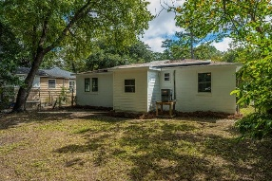

Priced 5k Below Appraisal!
No HOA! No Flood Insurance!
Michael Moseley
843-442-0959
michaelsmoseley@gmail.com
charlestonrealestateandgolf.com
1210 Pepper Street
Avalon In The Pines | Hanahan, SC 29410 | MLS# 25000815 | $299,900
Enjoy low electric bills with recently installed solar panels that provide efficient living at its best. Home is freshly painted and completely renovated in 2023/24 and features new roof, new solar panel brackets, new windows, new water heater, gleaming LVP flooring, renovated bathroom and kitchen with new appliances. Fridge, washer, and dryer convey with the sale of the property as a bonus. Termite bond in place with Palmetto Exterminators and don't forget about the excellent Hanahan schools, all located within 1 mile. Experience the best of both worlds with modern touches and efficiency seen in new construction together with an established neighborhood in Hanahan Proper that so many desire.
The towne centre, located just down the street, is currently being revitalized with new shops and restaurants. Hanahan is centrally located and minutes to downtown Charleston, Park Circle and the beaches. The only thing missing is YOU!!
Carolina Elite Real Estate | 1081 East Montague Ave | N Charleston, SC 29405

