Slide 1
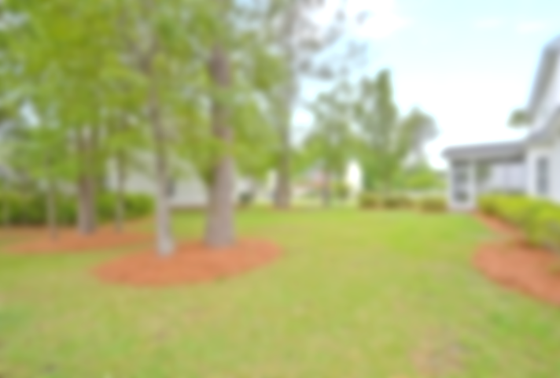
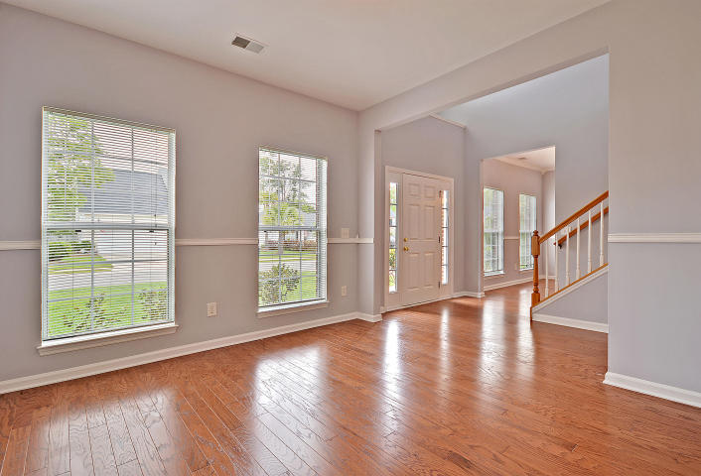
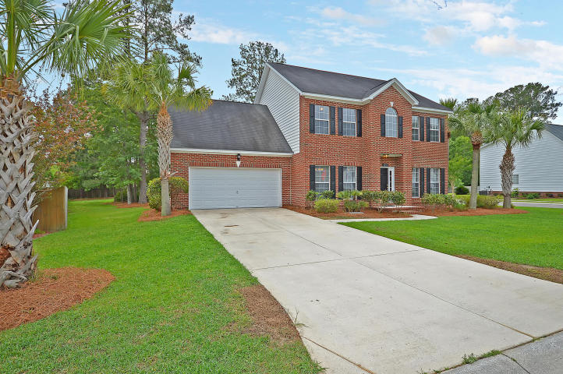
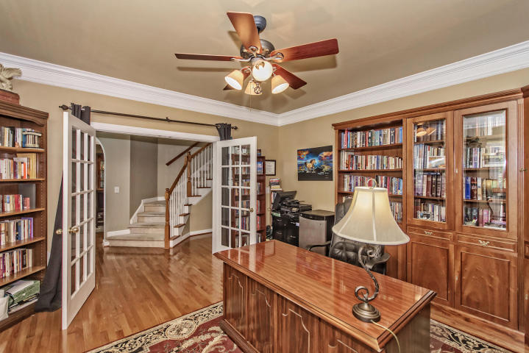
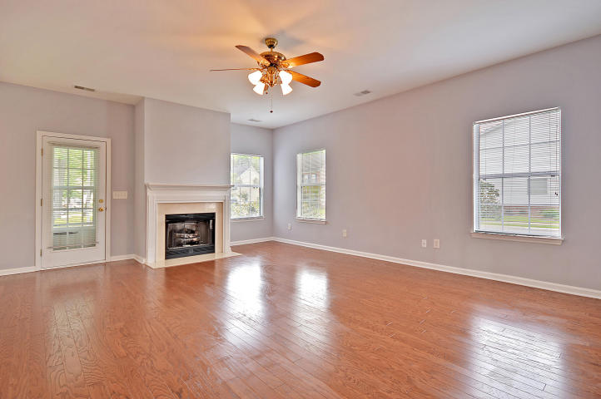
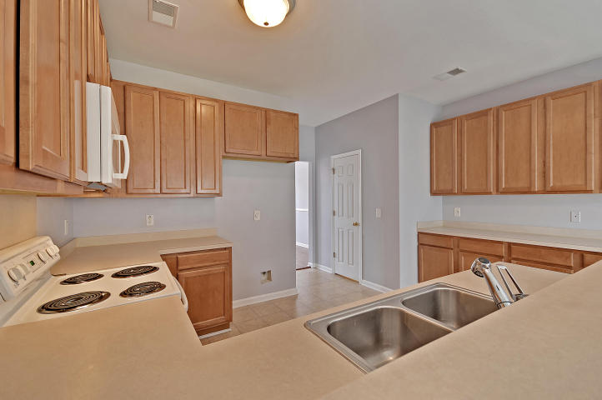
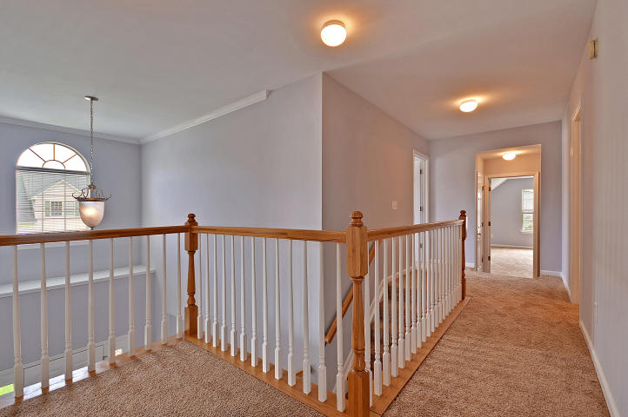
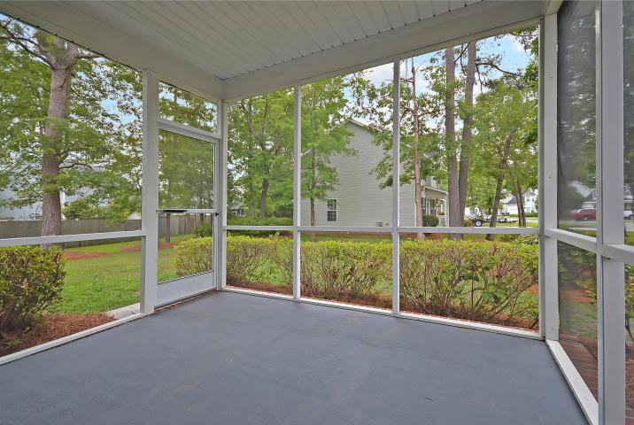
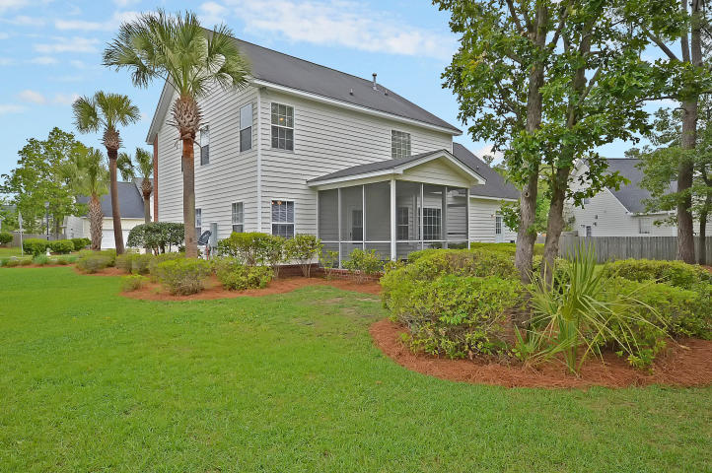

#1 BEST BARGAIN
IN HANAHAN!
1211 Creek Stone Way Tanner Plantation ~ Hanahan, SC 29410
MLS# 17011823 ~ $274,900
3 Bedrooms ~ 2½ Bathrooms
Absolute Bargain!
Unbelievable Price!
Priced low and firm for your pre-approved buyer who wants a great deal on the nicest house in Hanahan.
Hurry, it won’t last long at this low, low price.
Do your buyer a favor and submit a squeaky-clean full-priced offer today and save yourself all the fun of a full-priced counter offer.
Chip Walsh
843-822-4663
chipwalsh@gmail.com
The Boulevard Company, LLC 35 Broad Street Charleston, SC 29401
www.TeamWalshRealEstate.com

