Slide 1
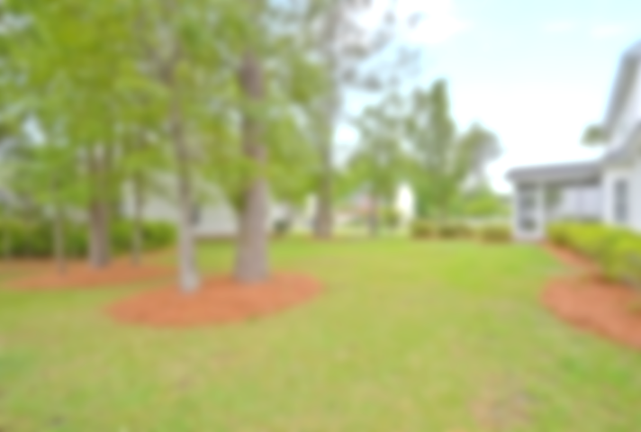
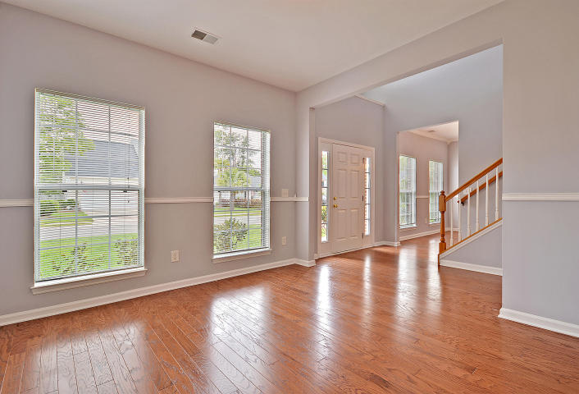
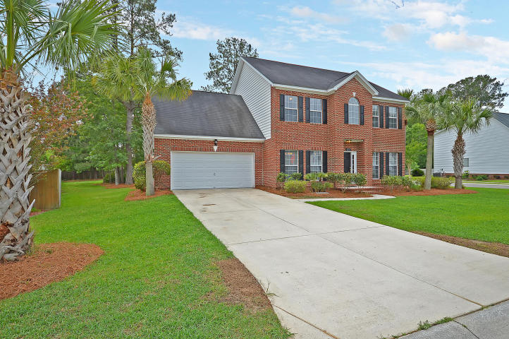
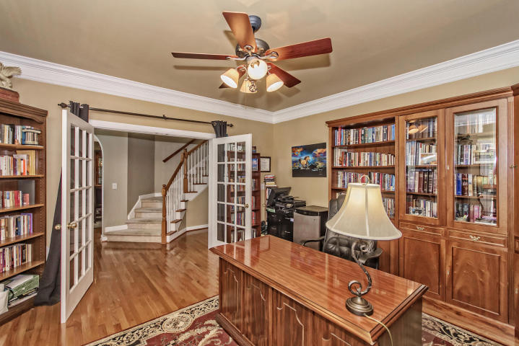
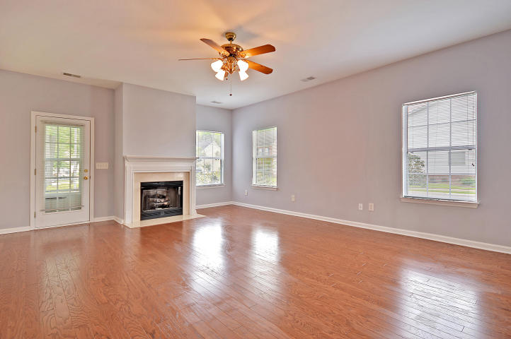
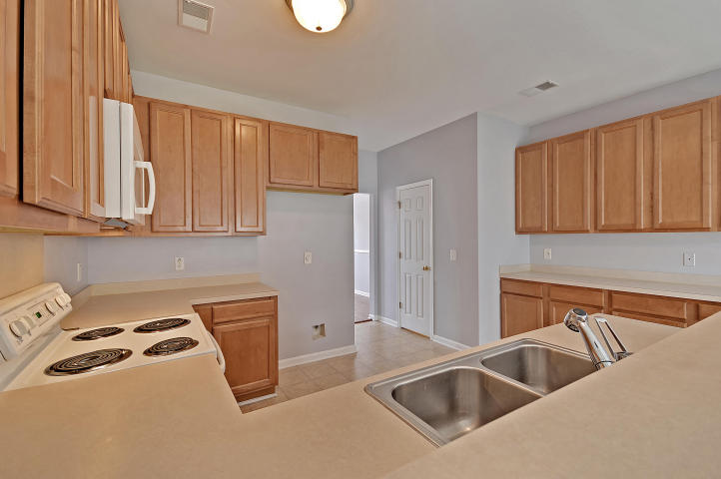
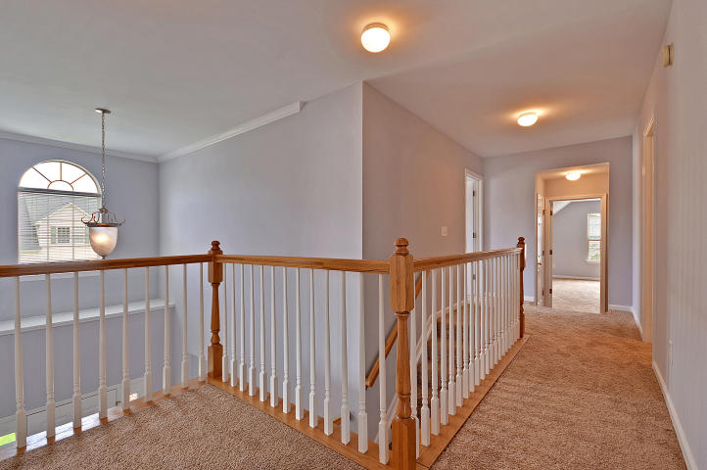
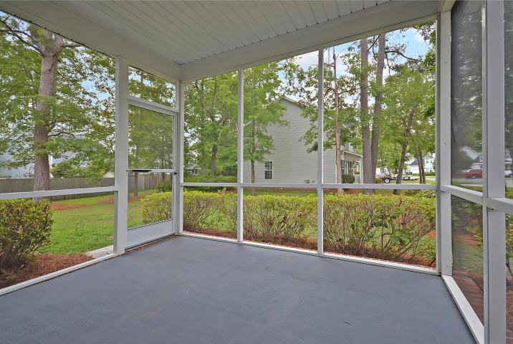
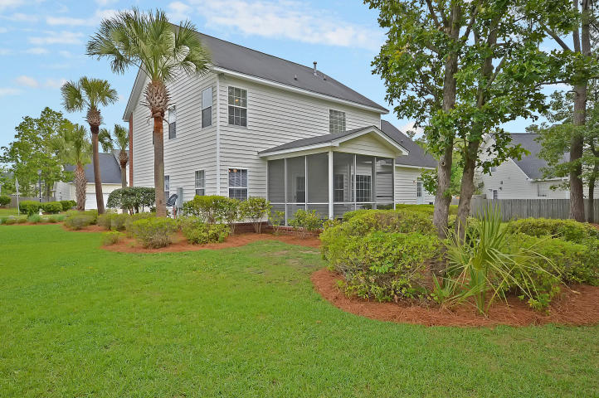

#1 BEST VALUE
IN HANAHAN!
1211 Creek Stone Way Tanner Plantation ~ Hanahan, SC 29410
MLS# 17011823 ~ $289,900
3 Bedrooms ~ 2½ Bathrooms
Pristine 3 bedroom, 2.5 bath home in Tanner Plantation at a super bargain price! Fresh paint, new carpet, brand new kitchen remodel! Kitchen has “White Ice” granite countertops, Glacial Ledger Tile Backsplash, BRAND NEW stainless steel sink with modern faucet, as well as new stainless steel appliances including a built-in microwave, smooth-top stove and dishwasher. This home has received a “face lift” worthy of a Beverly Hills plastic surgeon. Corner lot with screened-in back porch. Mega storage space and nearly 2,700 square feet of finished living space. Superb Hanahan schools and close proximity to the best of greater Charleston including the airport, historic downtown Charleston, our world-class beaches as well as Boeing, Volvo and Mercedes. Hurry! Will not last long!
Chip Walsh
843-822-4663
chipwalsh@gmail.com
The Boulevard Company, LLC 35 Broad Street Charleston, SC 29401
www.TeamWalshRealEstate.com

