Slide 1
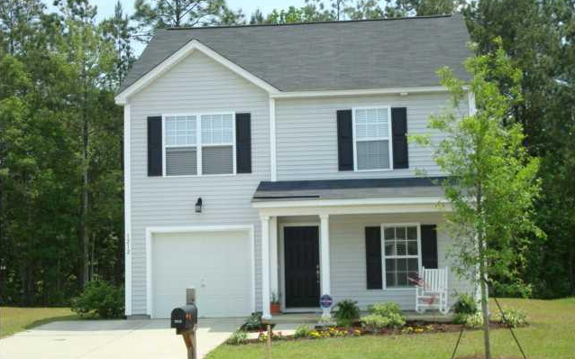
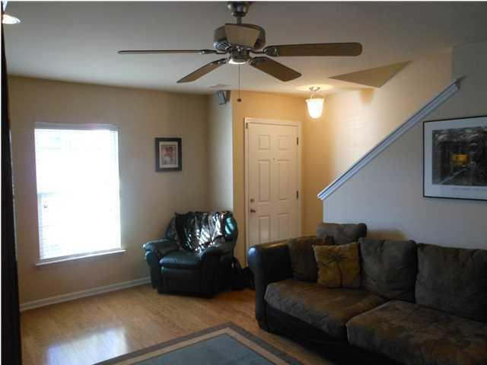
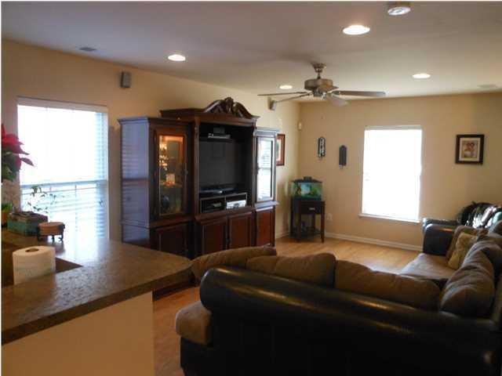
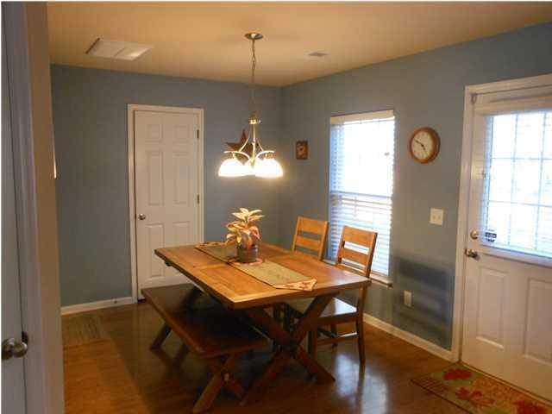
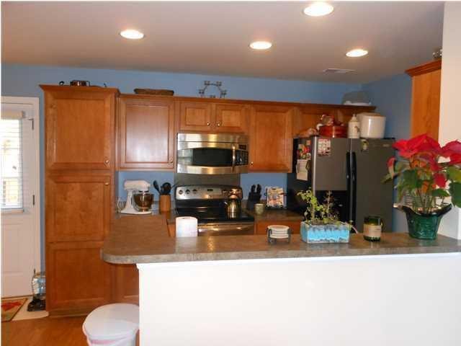
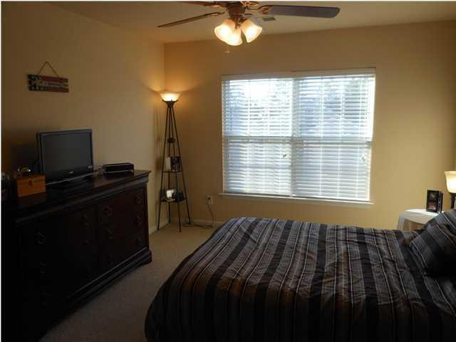
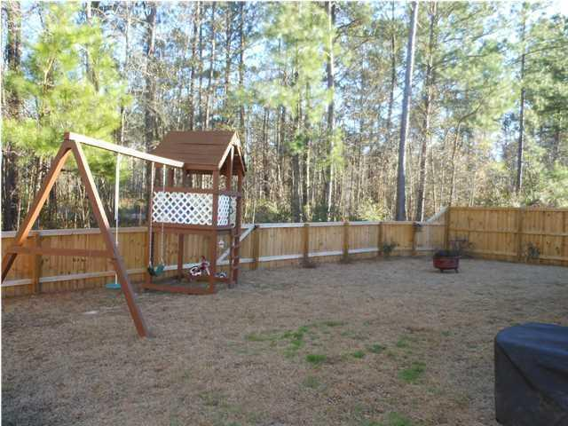

1212 Wild Goose Trail Drakesborough Summerville, SC 29483 MLS# 16021528 $159,900 3 Bedrooms | 2½ Baths
Dorchester District 2!
Tastefully decorated, 3 Bedrooms, 2.5 baths with lots of upgrades. Entire first floor has wood floors in family room, kitchen and dining area. The kitchen has upgraded kitchen cabinets, stainless/black appliances and raised counter for breakfast bar overlooking the family room. There is also a half bath and an exit to the fenced backyard with children's playset. The second floor has 3 bedrooms, one being the master suite with private bath and walk-in closet. There is also a large laundry/utility room upstairs plus another guest bath. The home features 2'' window blinds thru out, upgraded lighting, a surround sound system, and double driveway. The owners have done a lot of landscaping and the rear of the property borders a 60' wide buffer area for lots of privacy. Home has been freshly painted, carpets shampooed and is ready for a quick close. It has also been pre-wired for an external generator. Located in a great sub-division in the award winning Dorchester 2 school district, this home is an outstanding value providing a very competitive price with lots of upgrades. This is a HUD designated community and provides an opportunity for 100% financing to qualified buyers.
Bill Milo
843-412-0052
bill@weichertrealtorspc.com www.charlestonareahomesforsale.net
Weichert Palmetto Coast
1035 Johnnie Dodds, Ste B2
Mt. Pleasant, SC 29464

