Slide 1
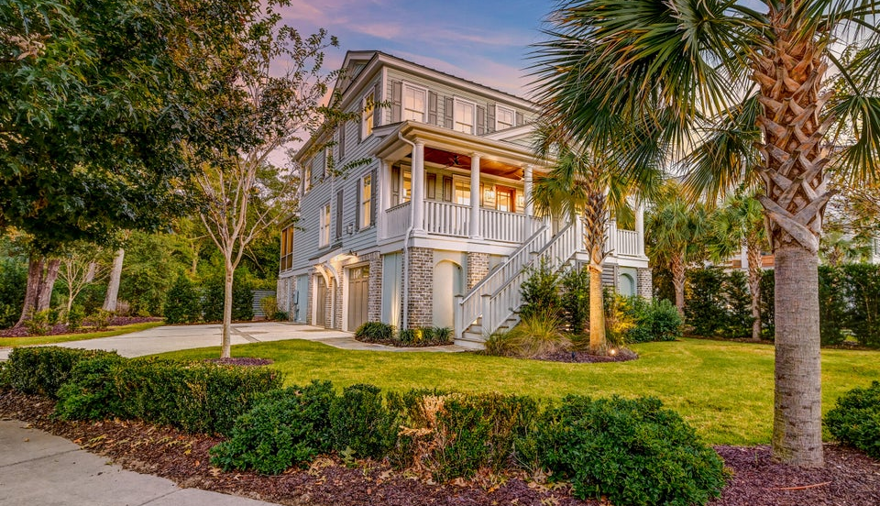

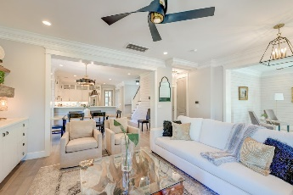
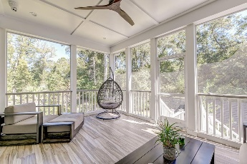
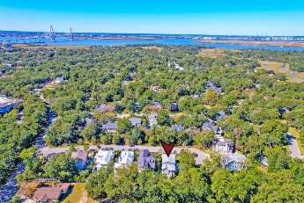
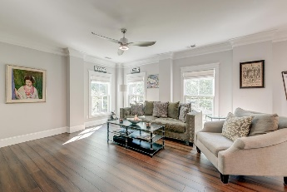
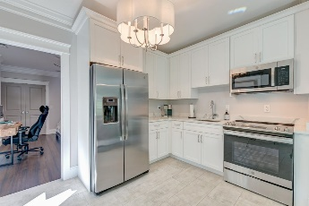
Custom Home with Potential Rental Opportunity
New Improved Price
1212 Clonmel Place
Mathis Ferry Court ~ Mount Pleasant, SC 29464 ~ MLS# 24027040 ~ $2,495,900
This stunning property highlights the latest trend in luxury living- spacious DUAL primary bedroom suites! Nestled on a splendid cul-de-sac lot in a picturesque luxury community in Mt. Pleasant, this home features two primary bedroom suites AND a separate two-bedroom apartment/office space or in-law suite. From the moment you arrive, you'll be captivated by the beautifully landscaped yard, a welcoming facade, an expansive driveway, and a grand front porch. As you step inside, you're greeted by an open floor plan with true craftsmanship and design, attractive flooring, extensive molding, and shiplap throughout. The family room has a cozy fireplace, built-in cabinetry, and provides a sun-drenched atmosphere. The adjacent dining room flows effortlessly into the gourmet kitchen, complete with white cabinetry, stainless steel appliances, a six-burner gas range with integrated hood vent, elegant countertops, a stylish backsplash, a pantry, and a large island with ample storage.
The main level features a luxurious primary suite with a vaulted ceiling and a modern ensuite bath, boasting an extended dual-sink vanity, a freestanding soaking tub, a tiled step-in shower with a rain shower head and detachable shower head, and an expansive custom walk-in closet. The laundry room has built-in cabinetry, countertops, and a sink and is located just off the kitchen. The upstairs loft space offers additional living or recreational options.
The second-level primary suite is light-filled with two separate closets, a en suite bath and soaking tub, a dual-sink vanity, and a tiled step-in shower. Two more generously sized bedrooms, each with its own en suite bathroom, complete the upper level. The ground floor also holds a hidden gem: a spacious in-law suite with two bedrooms, a full bathroom, a living room, a fully equipped kitchen, a laundry room, and a separate outdoor entrance. Ideal for extended family or guests, this space offers privacy and comfort. There may also be the potential of adding a swimming pool to the backyard.*
Verna Bunao-Weeks verna@mattoneillteam.com 843-364-2447

