Slide 1
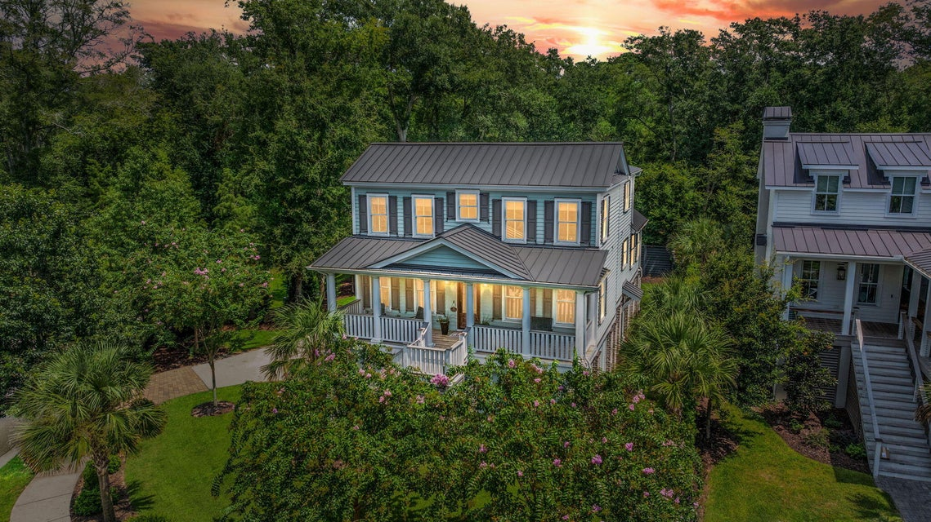
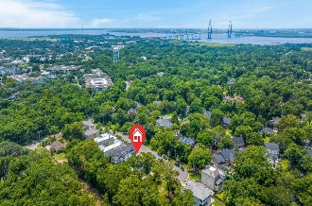
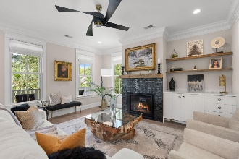
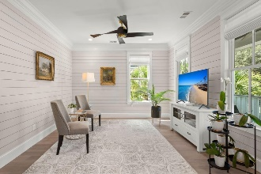
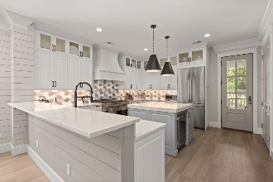
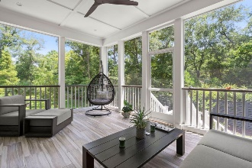

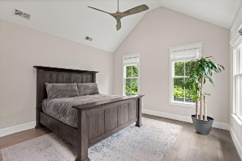
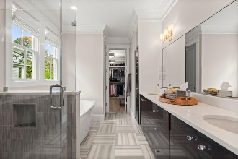
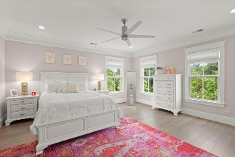
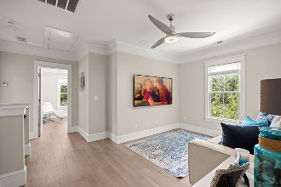
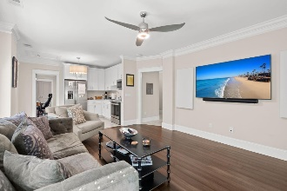


Just Listed in S Mount Pleasant
1212 Clonmel Place
Mathis Ferry Court | Mt Pleasant | MLS# 24021289 | $2,995,000
Welcome to this extraordinary property located in the heart of South Mount Pleasant, offering proximity to the stunning beaches, downtown Charleston, vibrant shopping districts, picturesque Shem Creek, and prestigious golf courses. Situated just a short drive over the iconic Ravenel Bridge, this location is simply perfect. Upon arrival, you'll immediately notice the exclusivity of this small community, with only one street leading to the cul-de-sac where this remarkable home is nestled. The meticulous attention to detail is evident from the outset, with a metal roof, cement plank boarding, and a charming full front porch that exudes the quintessential Southern style synonymous with the low country.
Don't miss the opportunity to call this exceptional property your own, where every detail has been thoughtfully considered to create the perfect blend of luxury, comfort, and modern living.
VIDEO TOUR
Marina Shaw
The Maddox Team
843-849-4511
marinalyonshaw@gmail.com
The Boulevard Company, LLC | 06 Johnnie Dodds Blvd Ste 100 | Mount Pleasant, SC 29464

