Slide 1



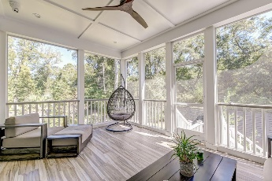
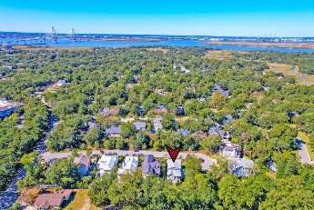
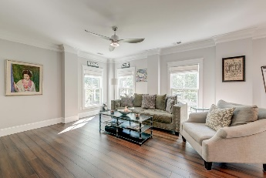
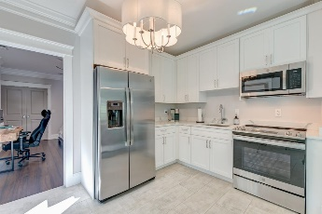
Custom Home with Potential Rental Opportunity
1212 Clonmel Place
Mathis Ferry Court ~ Mount Pleasant, SC 29464 ~ MLS# 24027040 ~ $2,840,000
Nestled on a stunning cul-de-sac lot in a picturesque 8-home luxury community near the base of the Ravenel Bridge, this gorgeous home offers exceptional living in one of Charleston's most desirable locations. From the moment you arrive, you'll be captivated by the beautifully landscaped yard, the welcoming façade, the expansive driveway, and the full front porch, perfect for enjoying the Lowcountry breeze. As you step inside, you'll be greeted by an impressive blend of craftsmanship and design, with beautiful flooring, extensive moldings, and shiplap throughout. The bright, open floor plan offers endless charm and functionality. To the right of the entry, you'll find a formal living room or office space, while to the left, the family room beckons with its cozy fireplace, built-in cabinets and shelves, and sun-drenched atmosphere. The adjacent dining room flows effortlessly into the gourmet kitchen, complete with modern white cabinetry, stainless steel appliances, a six-burner gas range with an integrated hood vent, elegant countertops, a stylish backsplash, a pantry, and a large island with ample storage. Just off the kitchen, the screened porch offers a wonderful space to enjoy views of gorgeous, groomed backyard.
The main level also features a luxurious primary suite with a vaulted ceiling and a spa-like en suite bath, boasting an extended dual-sink vanity, a freestanding soaking tub, a tiled step-in shower with a rain showerhead and detachable showerhead, and an expansive custom walk-in closet. A convenient laundry room with built-in cabinetry, countertops, and a sink is located just off the kitchen for easy access.
The ground floor also holds a hidden gem: a spacious in-law suite with two bedrooms, a full bathroom, a living room, a fully equipped kitchen, a laundry room, and a separate outdoor entrance. Ideal for extended family or guests, this space offers privacy and comfort.
Verna Bunao-Weeks verna@mattoneillteam.com 843-364-2447

