Slide 1

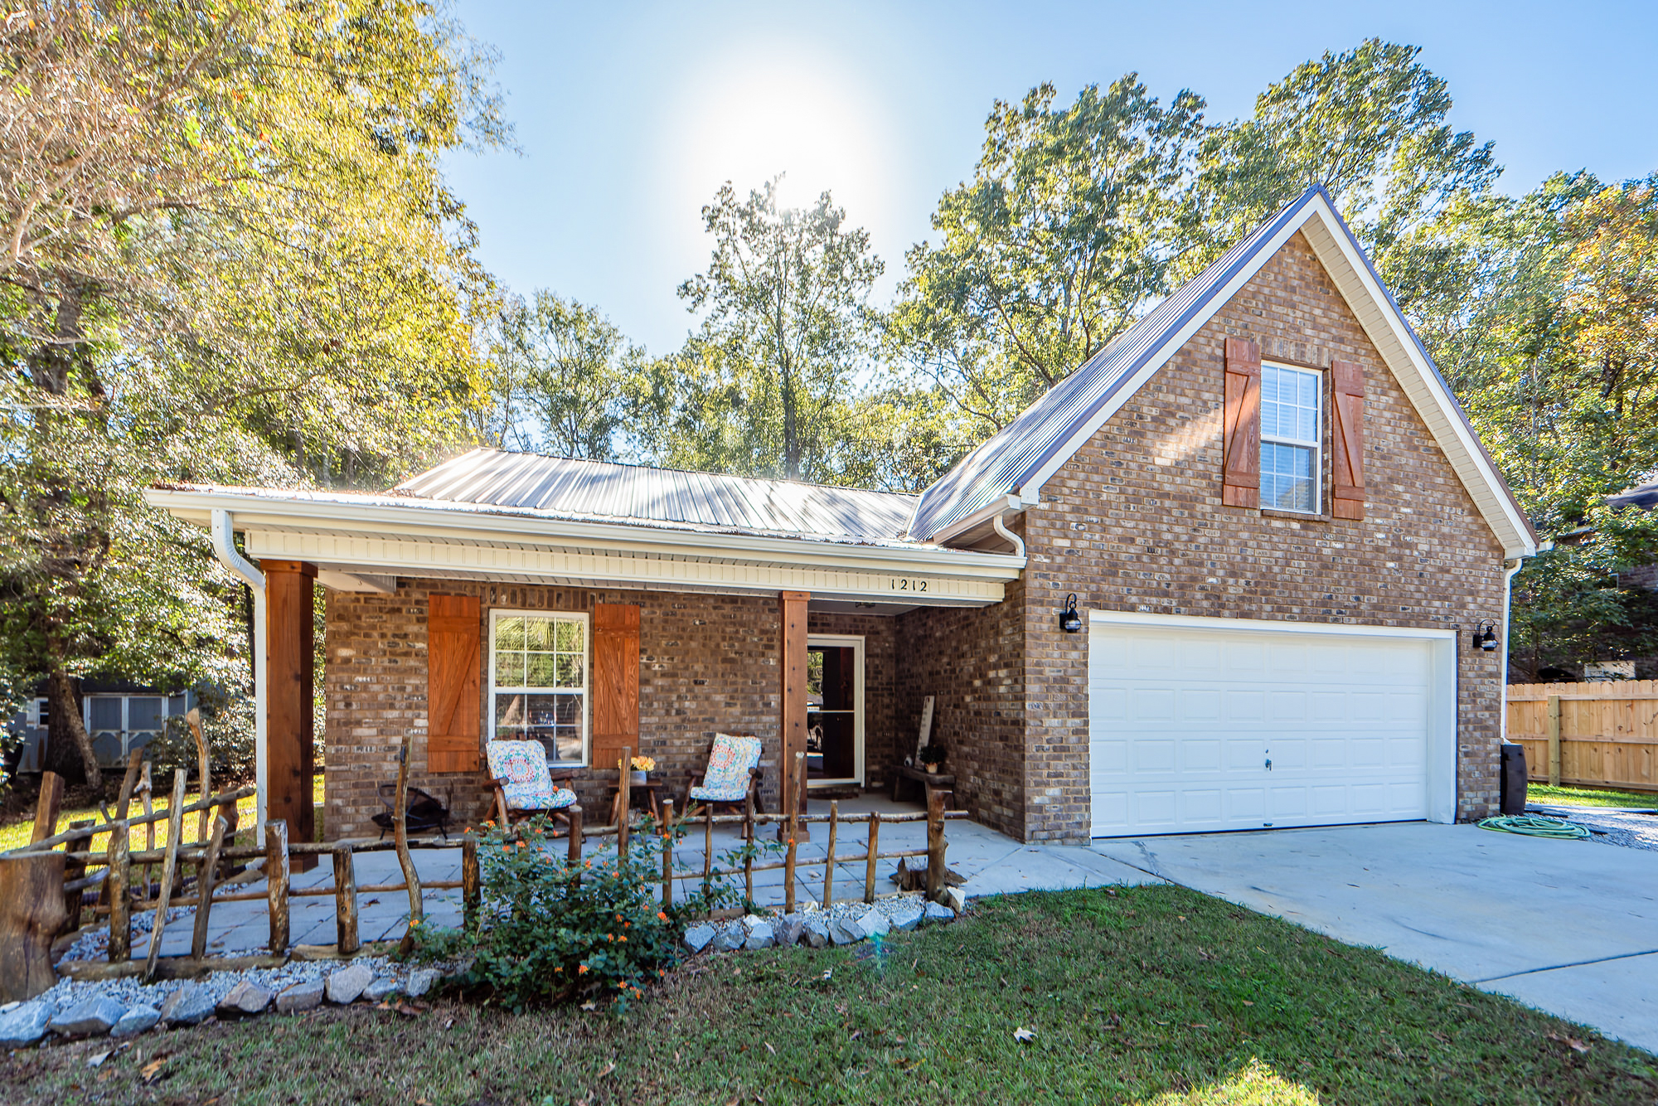
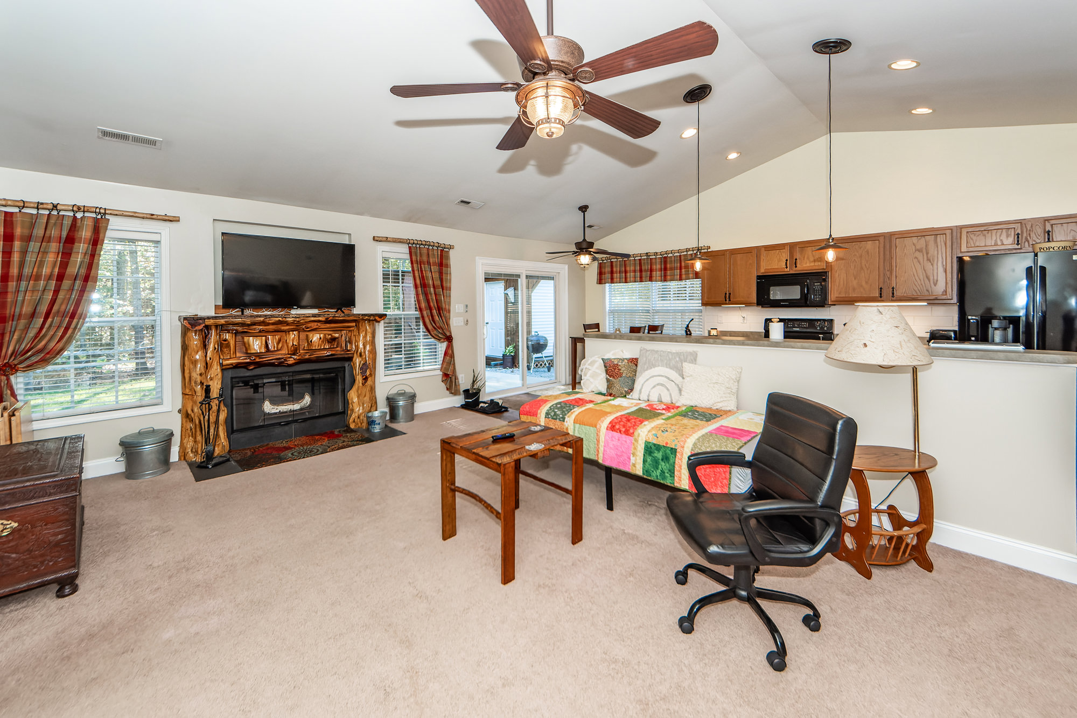
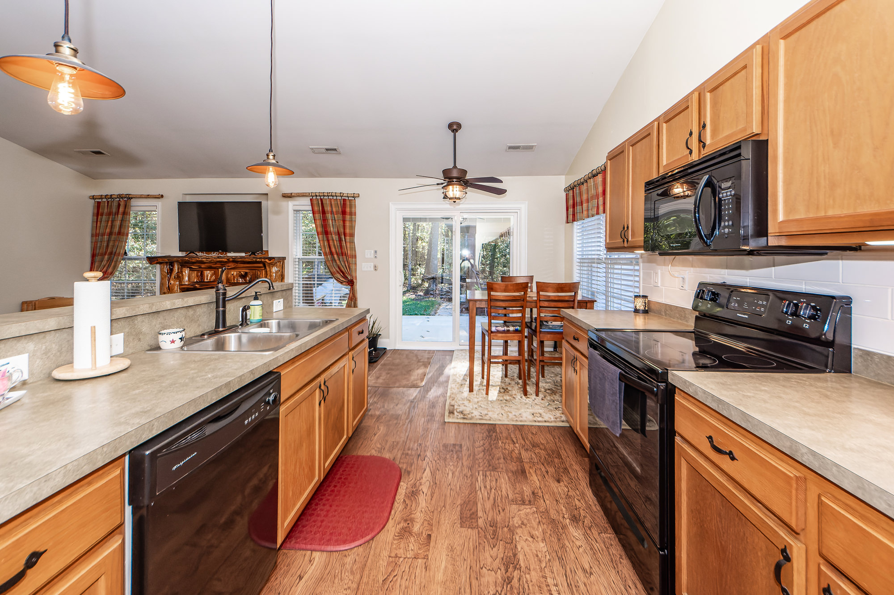


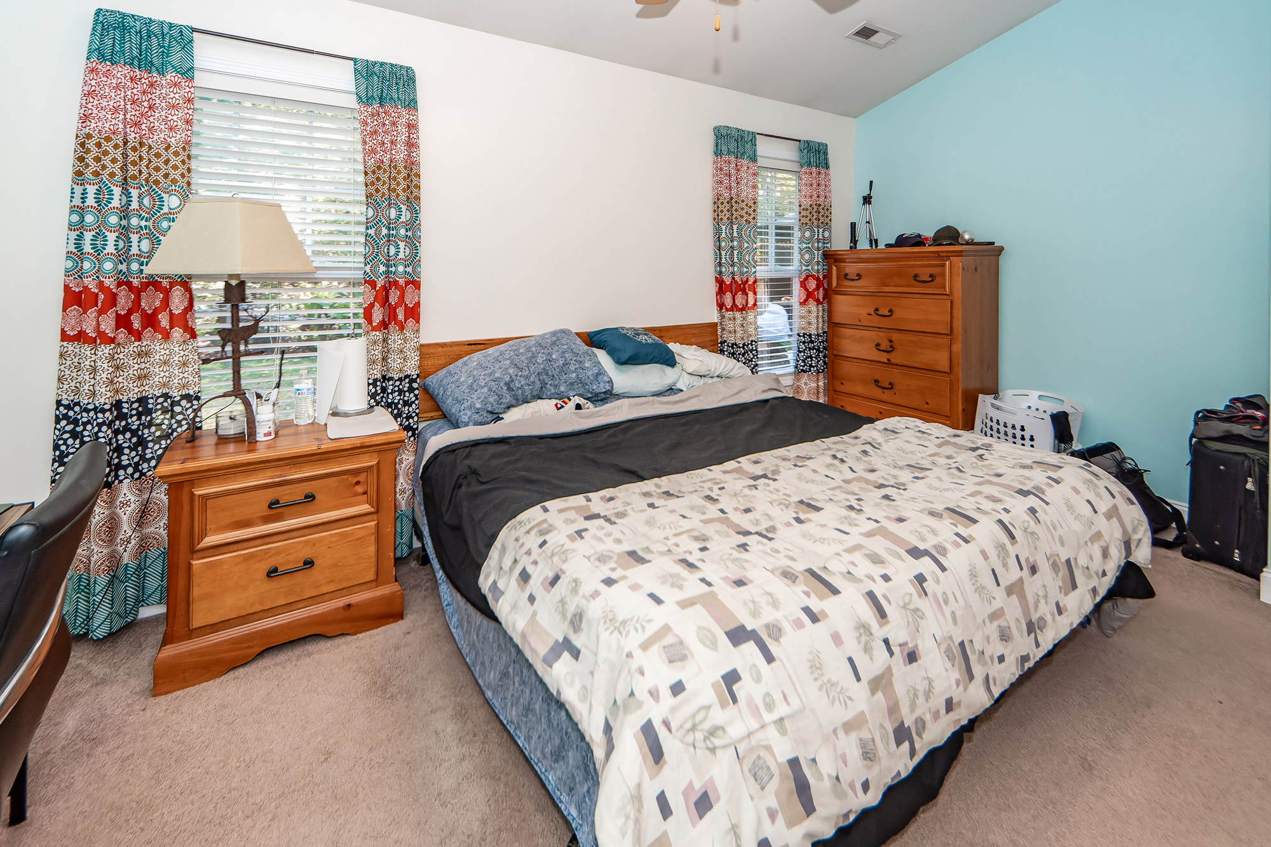
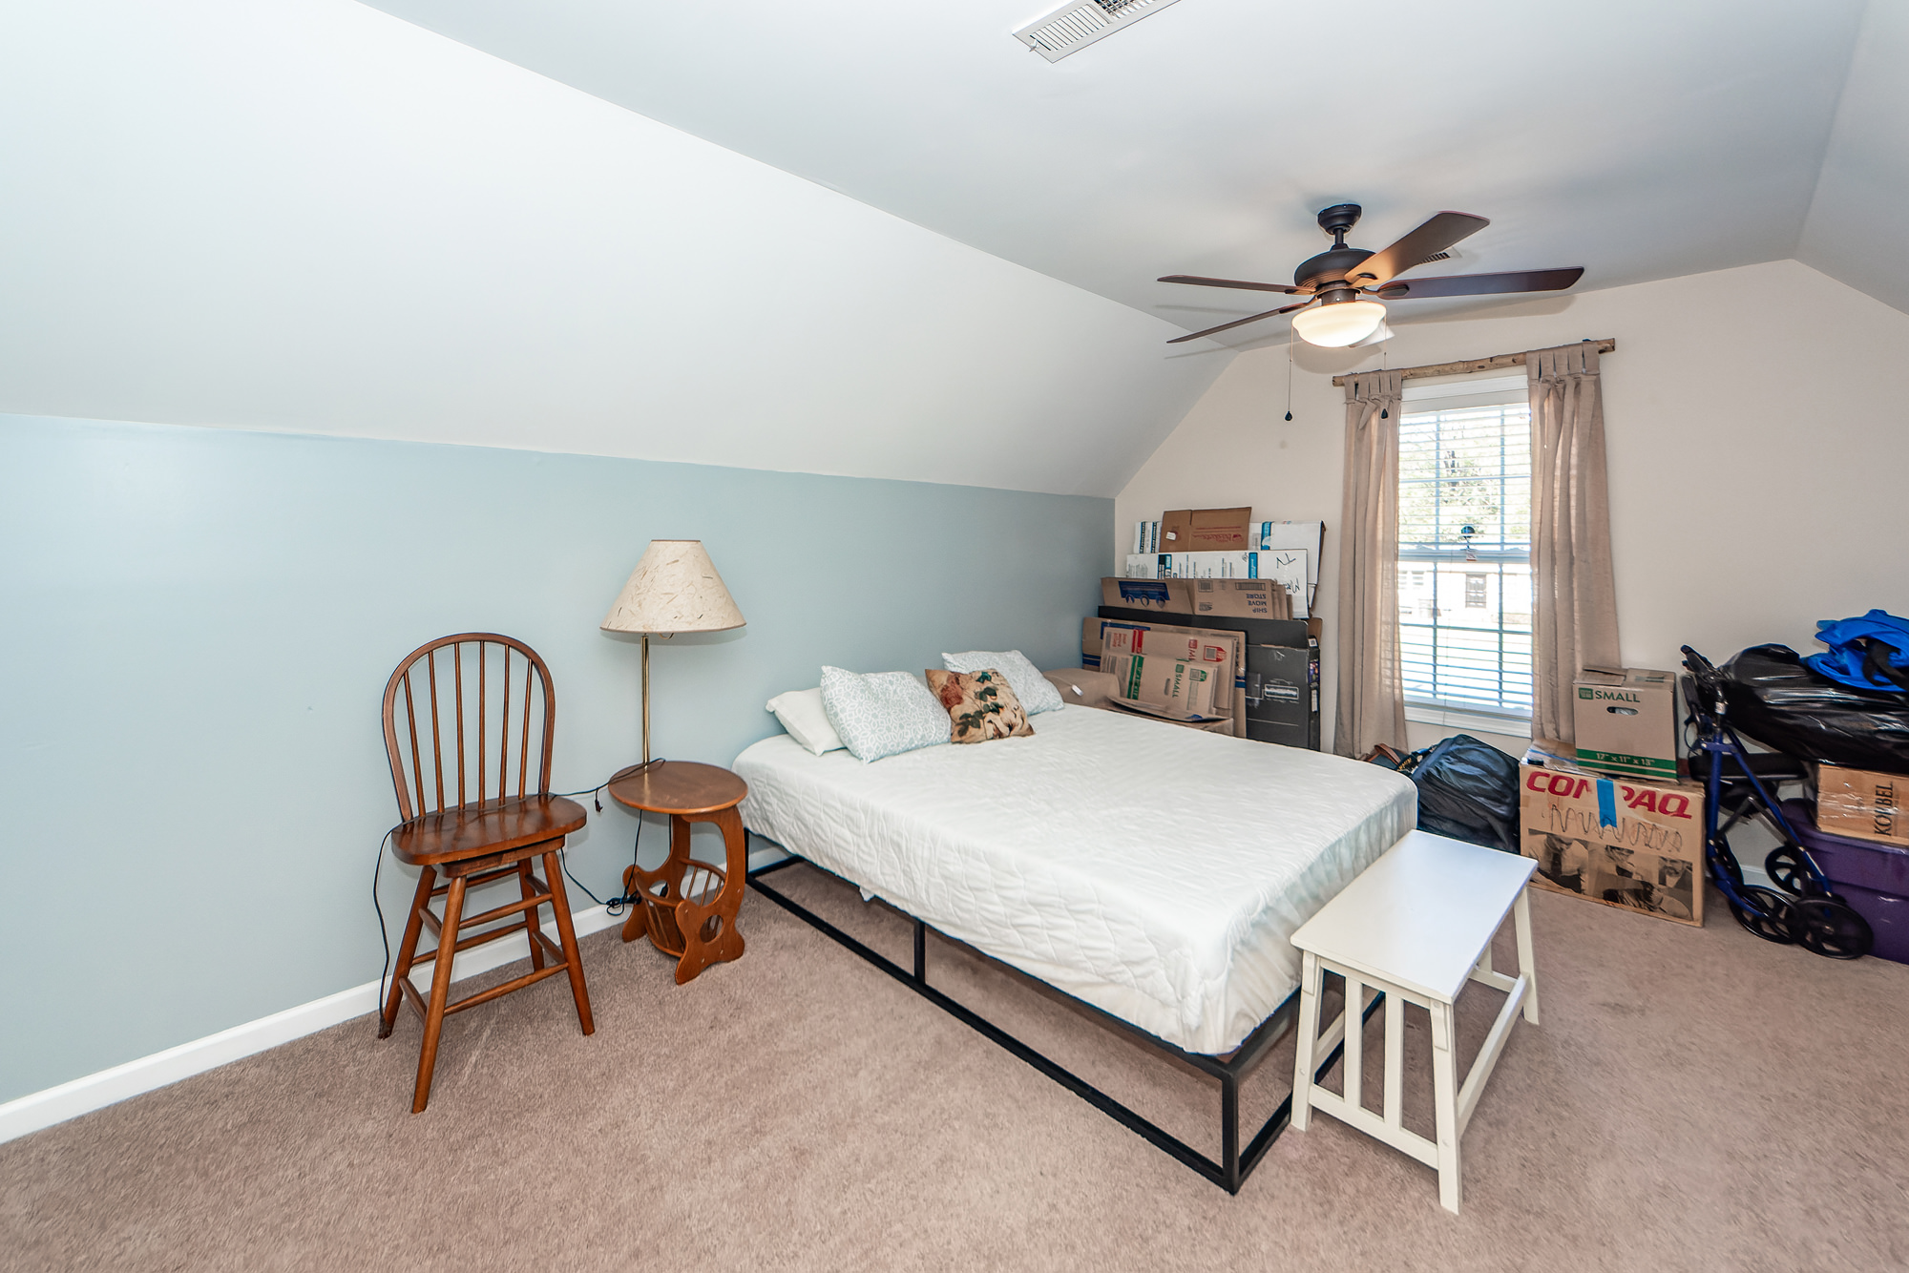



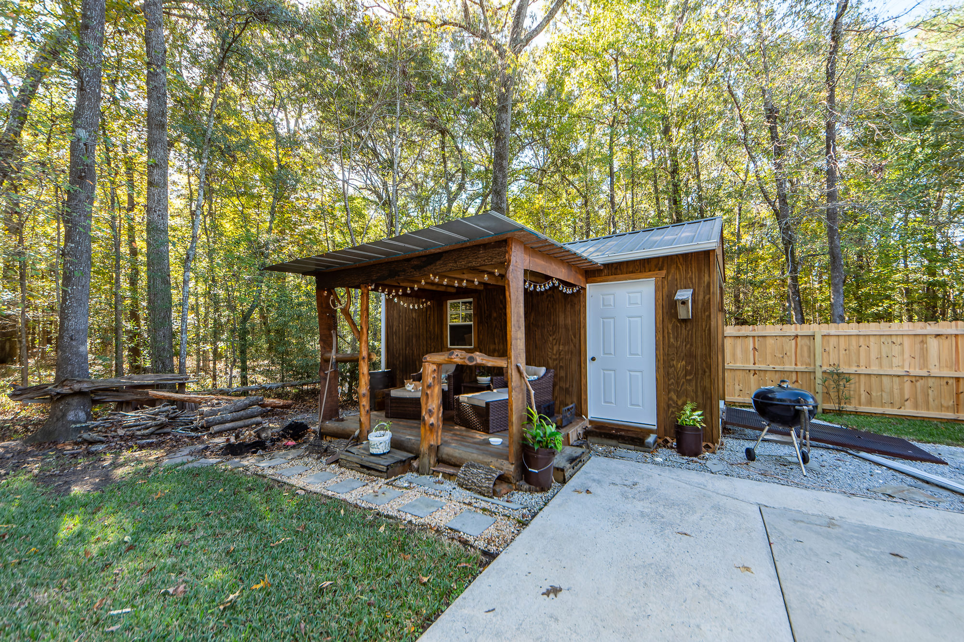
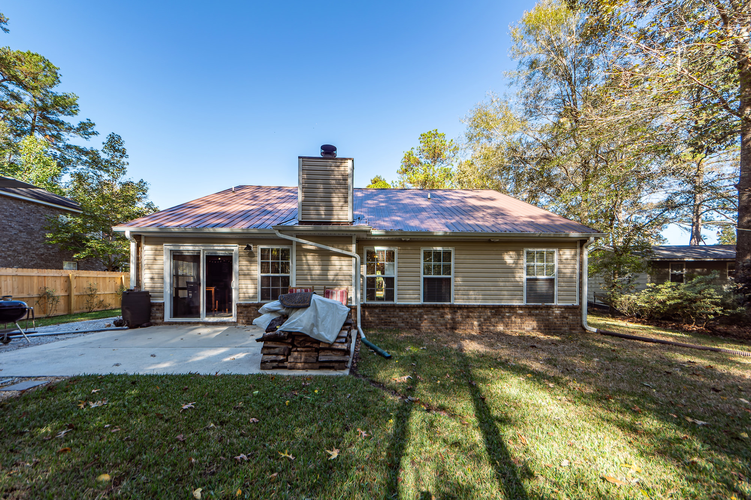

Closing
Assistance Available
1212 O T Wallace Boulevard
Berkeley Country Club | Moncks Corner, SC 29461 | MLS# 24028553 | $359,900
Welcome to the Berkeley Country Club & No HOA! Your opportunity to own a stunning custom-built ranch home. This well-maintained home showcases open concept, cathedral living room ceiling and spacious kitchen with breakfast bar. Enjoy one level living with the master bedroom located downstairs with separate tub and shower and 2 additional bedrooms with full bath. Bonus room/fourth bedroom is located upstairs and the current owner converted the walk-in closet to a full bath. Perfect space for guest, mother-in-law suite, man cave, or office. New Roof & New HVAC 3 years. Outdoor shed has a covered sitting area to enjoy the lush back yard. Berkeley Country Club offers golf, & easy access to the river to fish and summer fun. This home is a must see and must own.
We are offering up to $10,000 in down payment assistance and up to $7,500 in closing cost assistance. Buyers do not need to be first-time home buyers although we do require the home to be a primary residence. These are not traditional grant programs and do not need to be re-paid. Robert Vinton Bank of America 843-882-4191
4 Bedroom
3 Bath
1,811 sf
Virtual Tour
Connie White, Broker
843-532-3356
connie@conniewhiteteam.com
conniewhiterealestate.com
Connie White Real Estate & Design, LLC
102 Six Point Court
Goose Creek, SC 29445

