Slide 1
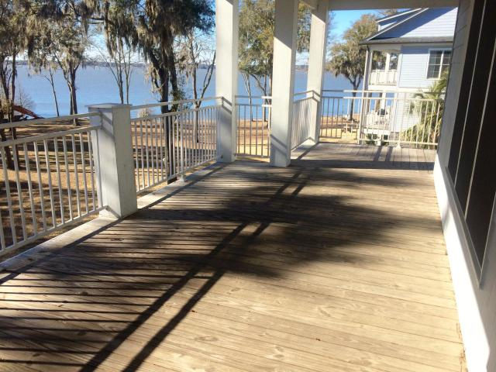
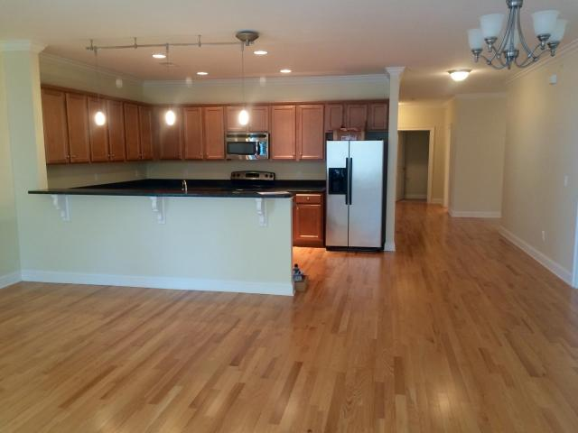
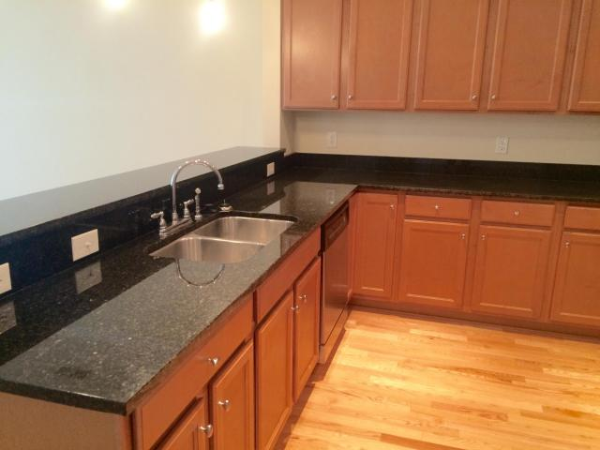
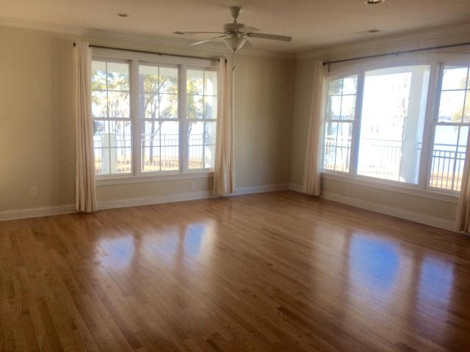
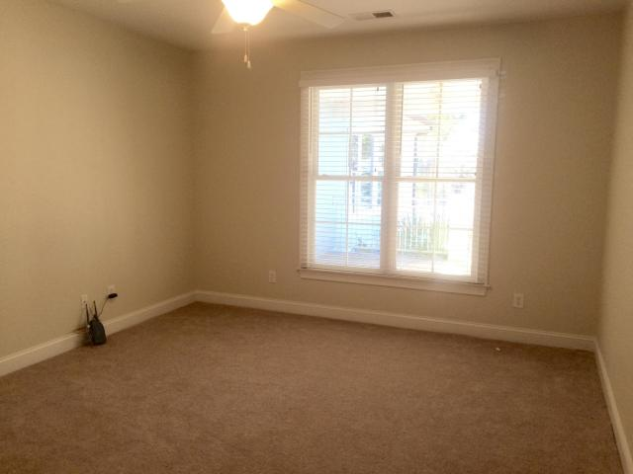
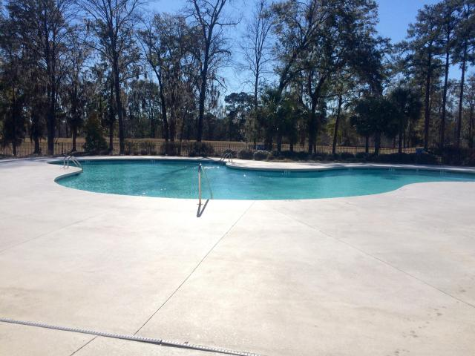
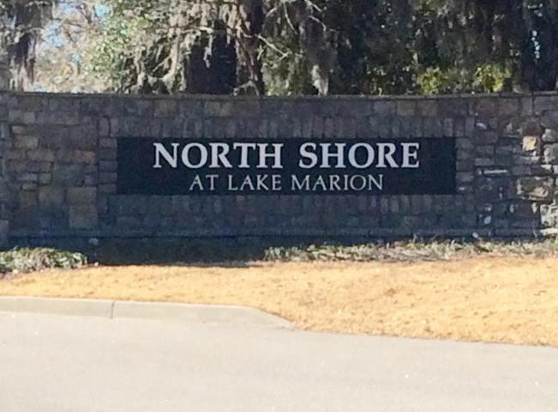

1213 Bridgeview Ln
F301
Summerton, SC
MLS# 15007676 $1,750
2,353 Sq Ft - 3 Bedroom - 4 Bath
Carefree Living
on Lake Marion
This spacious condo with an open living area and hardwood floors has fabulous views of Lake Marion.
You can relax on the large wraparound porch this summer while enjoying the lake. It has three nice size bedrooms with carpet and four bathrooms with ceramic tile.
There is an extra room that can be used as an office or den. Lots of wood cabinets and stainless appliances in the Kitchen.
It also comes with an open foyer with tile and a separate laundry room with washer and dryer. This building has an elevator for your convenience.
You will also have access to the pool, clubhouse and dock.
Barbara Limehouse
Mobile: 843-870-8291
barbara@southernshoresre.com
Southern Shores Real Estate
107 S. Main St
Summerville, SC 29483

