Slide 1
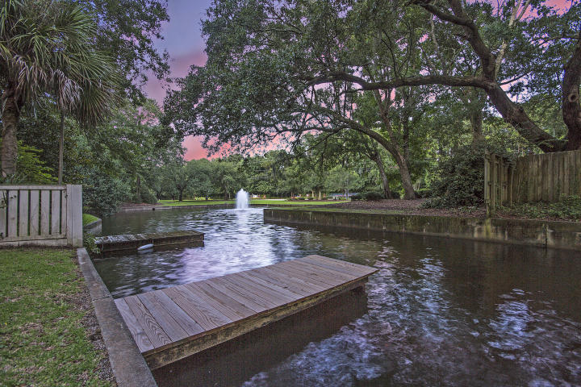
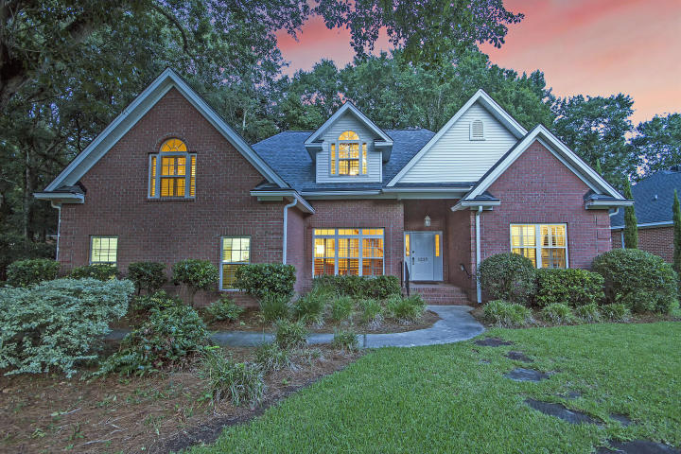
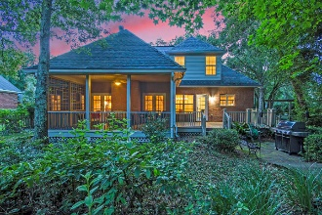
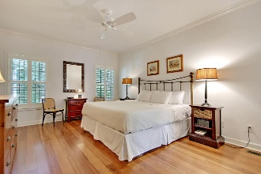
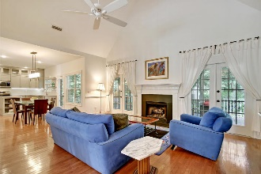
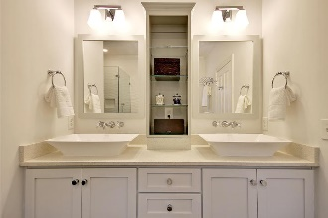
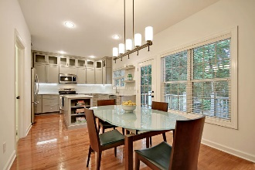
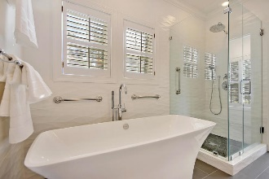
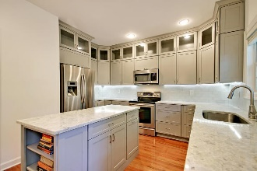
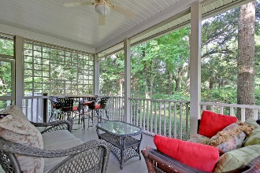

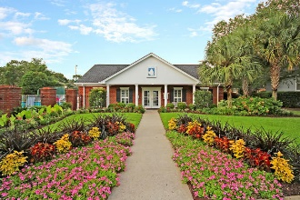
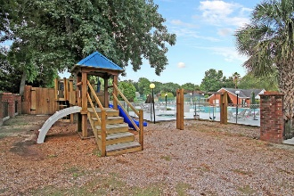
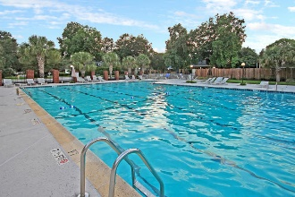
MAJOR Price Drop!!
Canal-Front &
Fully-Updated!
1213 Hidden Lakes Drive
Hidden Lakes ~ Mount Pleasant, SC 29464 ~ MLS# 18022251 ~ $674,900
Truly a gem in the heart of Mt. Pleasant, just minutes from Isle of Palms beach & Mt. Pleasant Towne Centre, this fully-renovated brick home on a picturesque canal w/ a private dock in Hidden Lakes is waiting to be discovered. Shaded by live oaks, this energy efficient home feat. a master down, open-concept living space, new bathrooms & kitchen, an encapsulated crawl, a screened porch & back deck, a flagstone patio, & a peaceful yard overlooking the water. Plantation shutters, quartz counters, soft-close cabinetry, SS appliances, & remote-controlled under-cabinet lighting are just a few details that stand out. Paddle your kayak down the canals to the neighborhood 50-acre lake, soak up the sun at the beach, or walk to nearby shopping & restaurants – it doesn't get more convenient than this!
Additional details include:
Modern open floor plan features a living/dining area, a family room with a vaulted ceiling and access to the screened-in porch, a breakfast area open to the kitchen and family room with a walk-out to the back deck, a gorgeous fully-updated kitchen, and a fully-renovated master suite. The second floor features a second master suite complete with an ensuite bath and a large walk-in closet, a 3rd bedroom, a 3rd full bath, and a 4th bedroom/FROG/media room/play room (now used as an office) with access to extra attic storage.
Stunning new kitchen features quartz counters, shaker-style ceiling-high cabinetry with custom storage solutions that provide ample room for all your kitchen items, glass tile backsplash, a center island with extra storage cabinets and a bookcase, soft-close drawers, pull-out drawers in cabinets, brand new Samsung stainless steel appliances, wood flooring, recessed lighting, a breakfast area that walks out to the back deck, and remote-controlled under-cabinet lighting with multiple color choices for you to select the color to suit your mood.
Downstairs master suite features durable bamboo flooring, a large walk-in closet, a free-standing Victoria + Albert tub w/ handheld sprayer, a large frameless shower with stone flooring and tile surround, his and her vanities and Victoria + Alberts sinks, tile flooring, and polished chrome Moen fixtures.
Lush, low-maintenance yard features 14 live oaks, a fig tree, tons of azaleas, camelias, and gardenias.
Highly energy-efficient home averages less than $150/mo. for power bills and around $45/mo. for water/sewer.
Transferable termite bond in place with Palmetto Exterminators Inc.
Hidden Lakes community features a system of canals connecting to three lakes, including the big 50-acre lake with a gazebo in the center for picnicking (pond is stocked with fish); a pool; a clubhouse; tennis courts; a basketball court; a play park; boat storage; and convenience to Isle of Palms and Sullivan's Island beaches, downtown Charleston, Mt. Pleasant Towne Centre, Seaside Farms Shopping Center, and everything else Mt. Pleasant has to offer.
Updates include a fully-renovated kitchen in 2018; fully-renovated master bath and upstairs bathrooms in last couple of years; new bamboo flooring in master bedroom; new carpeting upstairs; plantation shutters added; crawl space encapsulated (enclosed and conditioned) in 2017; PEX plumbing installed in crawl space and first floor in 2017; Carrier 2-stage, 2-zone HVAC with dehumidifiers installed in 2010 (under warranty until 2020); roof replaced in 2013 with Owens Corning Tru-Def Shingle rated for winds up to 130 mph (offers home insurance deduction); new bathroom fans and smoke detectors added in 2018; a kid-safe, insulated garage door with silent motor and quiet rollers installed; and extremely quiet Emerson Eco Avant DC motor ceiling fans installed downstairs (all pre-wired for lights).
Over $140,000 in renovations include a fully-updated kitchen in 2018; fully-updated master bath and upstairs bathrooms in last couple of years; new bamboo flooring in master bedroom; new carpeting upstairs; plantation shutters added; crawl space encapsulated (enclosed and conditioned) in 2017; PEX plumbing installed in crawl space and first floor in 2017; Carrier 2-stage, 2-zone HVAC with dehumidifiers installed in 2010 (under warranty until 2020); roof replaced in 2013 with Owens Corning Tru-Def Shingle rated for winds up to 130 mph (offers home insurance deduction); new bathroom fans and smoke detectors added in 2018; a kid-safe, insulated garage door with silent motor and quiet rollers installed; and extremely quiet Emerson Eco Avant DC motor ceiling fans installed downstairs (all pre-wired for lights).
Julie Nims julie@mattoneillteam.com 843-580-6310

