Slide 1
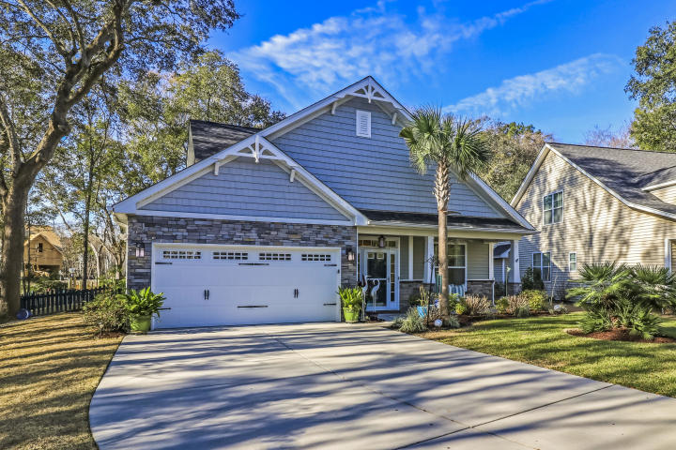
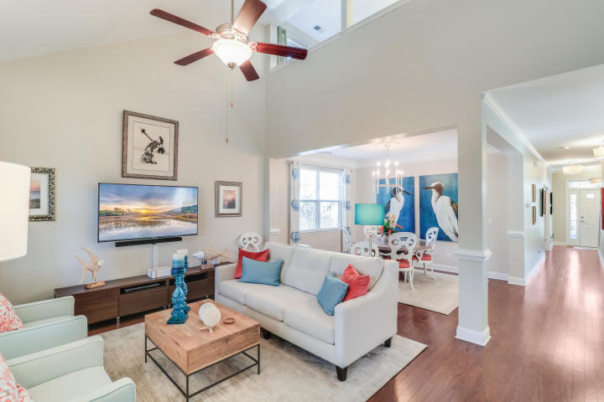
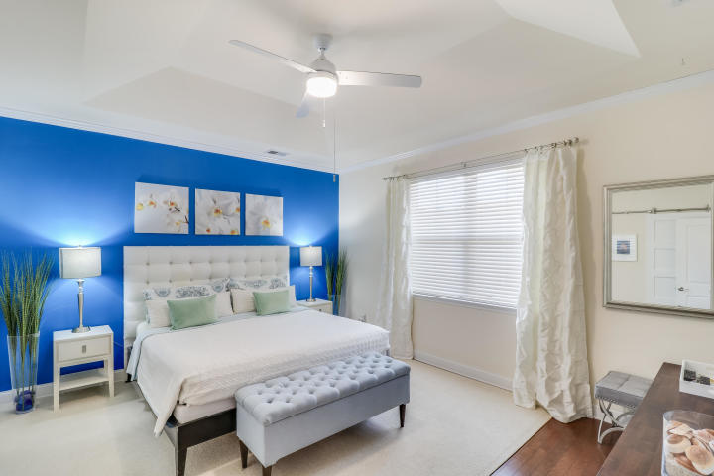
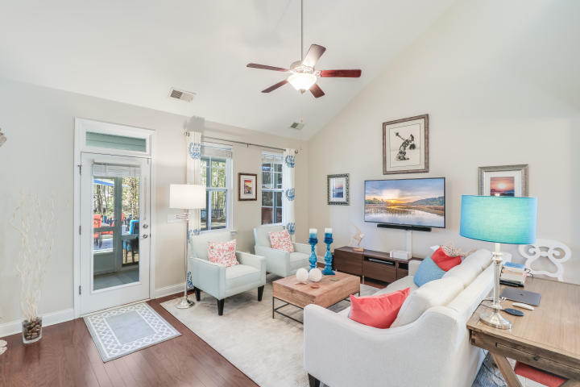
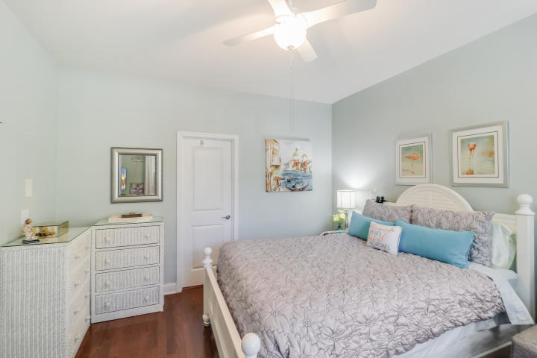
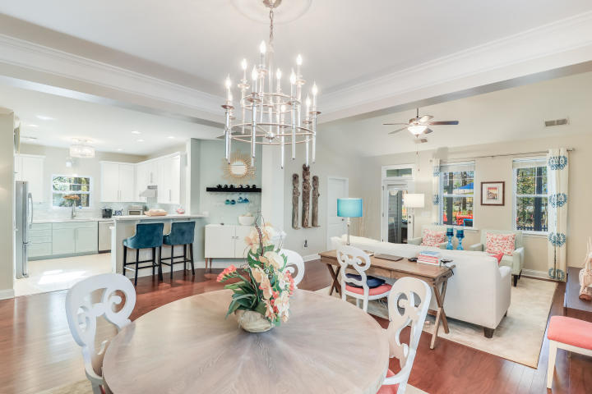
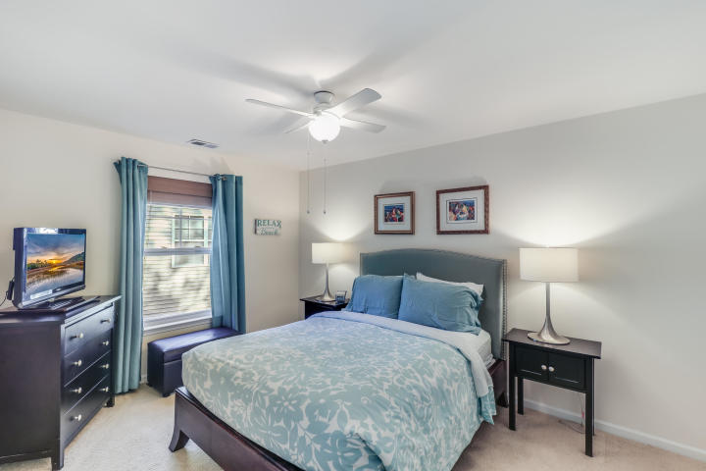
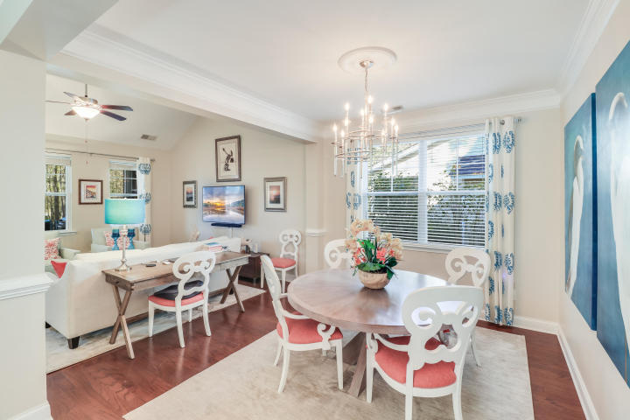
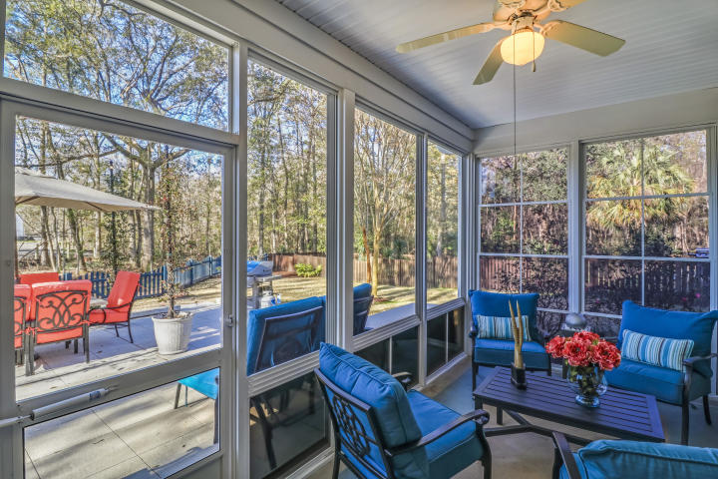
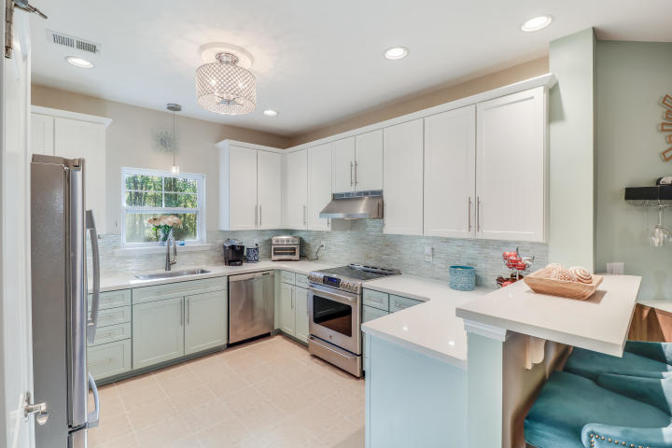
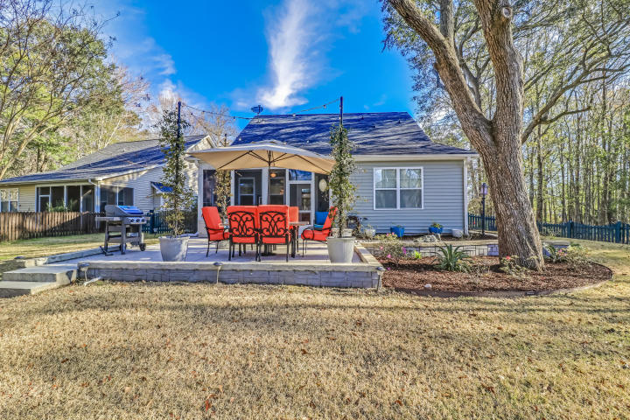


Just Listed!
1213 Shingleback Drive
Linnen Place ~ Mount Pleasant, SC 29466
MLS# 20003998 ~ $465,000
Beautifully designed home with a downstairs over-sized master bedroom with an additional downstairs bedroom. As you enter the foyer, the 9' ceilings open up to the kitchen and dining area. The beautifully designed, elegant kitchen flows to the dining and living area with cathedral ceilings. The flowing open floor plan concept creates an inviting environment great for entertaining friends or just enjoying a beautiful Charleston day at the end of the cul-de-sac home viewing low country wetlands. The over-sized downstairs master bedroom comes with tray ceilings and a spa like master bathroom. Two bedrooms, a bathroom and a great loft area are on the second floor. Truly one of the best floor downstairs master floor plans on the market. The many upgrades are listed in a pdf format.
Jason Newhauser
(843) 534-6564
jasonsellscharleston@gmail.com
www.jasonnewhauser.com
Coldwell Banker Residential Brokerage
1127 Queensborough Blvd. 103
Mt Pleasant, SC 29464

