Slide 1
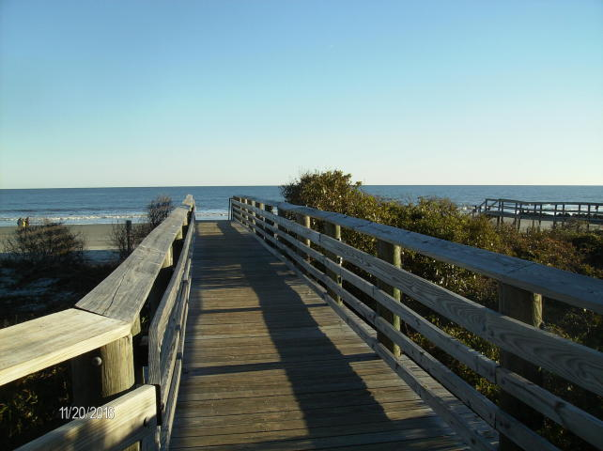
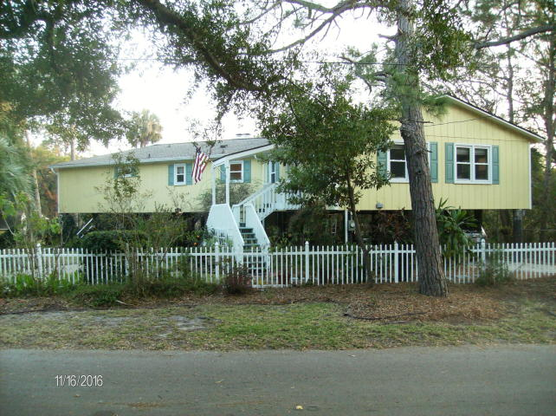
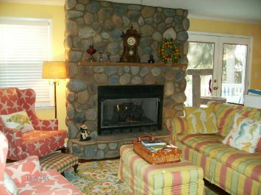
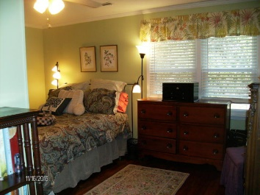
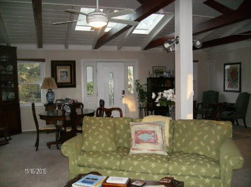
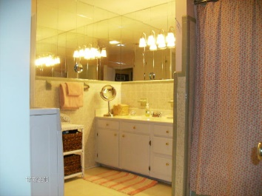
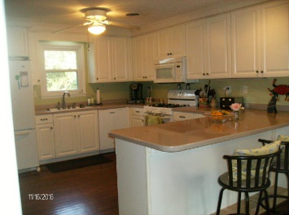
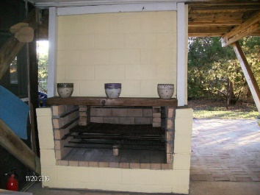
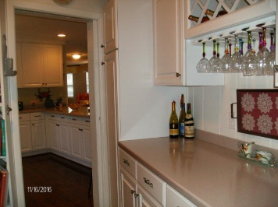
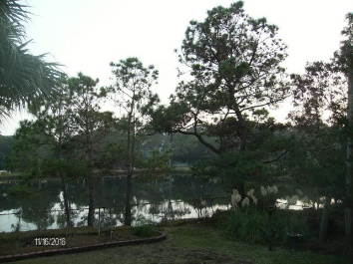



1213 Tabby Drive
Tabby Island | Folly Beach
Turn Left off East Ashley Avenue At 13th St
MLS# 16029795
$625,000
3 Bed | 2 Baths
2,192 Sq Ft
Open House TODAY from 12-2
~ Food And Drink Provided ~
Bring Business Card To Enter Drawing For Several Gift Cards.
Located on quiet side street (both ends are dead ends), 1 block to beach, yet close to restaurants & shops. Unique 3 bedroom, 2 bath home offers lots of space for entertaining, large kitchen overlooking dining area & living room with gas log fireplace, large great room with beamed cathedral ceiling with sky lights, some hardwood floors, huge outside deck accessible from dining area or bedroom. Beneath raised home is fireplace; huge screened-in area for dining, ping pong, etc.; Large workshop; shower; & parking. Detached storage shed. 1/3 acre lot backs up to neighbor's saltwater pond with great views of birds & wildlife. Beautifully landscaped with oaks, palms, flowers, fruit trees & has irrigation system. HVAC 2009, roof 2010, windows 2012, water heater 2012
Linda Spell Ashley
REALTOR
(843) 991-5745
linda.ashley@agentownedrealty.com
AgentOwned Realty Co. Premier Group, Inc. | 141 A N. Main Street | Summerville, SC 29483

