Slide 1
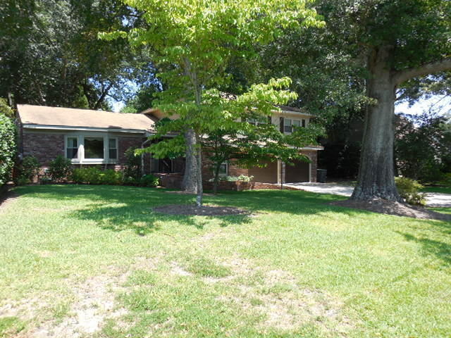
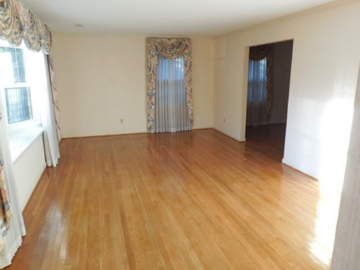
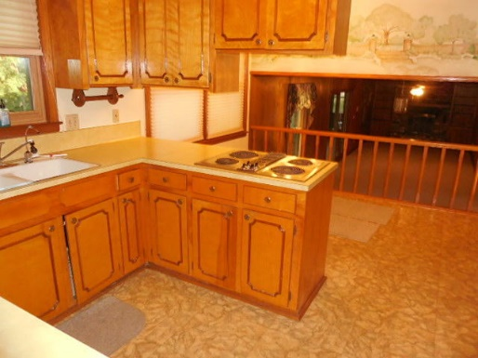
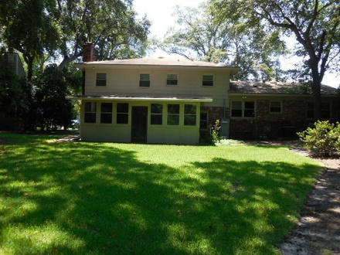
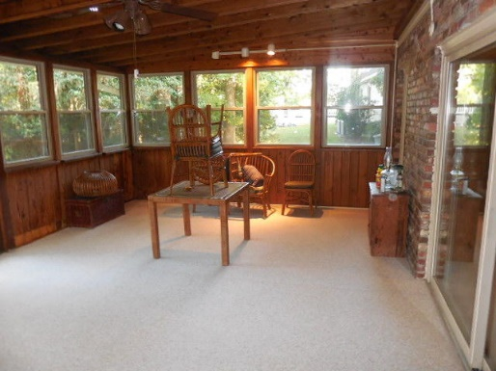

William S. Smith, Broker Hartnett Realty Co., Inc. 1041 Johnnie Dodds Blvd, 14-C Mt. Pleasant, SC 29464 wssmith@hartnettrealty.com (843) 723-7222
Price Slashed! From $397,000 Down To $350,000!
1214 Durham Place
Sandhurst - Charleston, SC 29407 - MLS# 15029656 - $350,000 Extremely well-built 1963 period house ten minutes from downtown. Property includes .27 acre on which house sits and .78 acre (TMS# 352-03-00-121) marshlands buffer . Wood-paneled 38' den with gas fireplace. California cedar enclosed porch with separate a/c unit. All windows double-paned reducing heat, a/c costs and noise. In-ground water sprinklers. House painted three years ago and guaranteed for life. All inside water runs through a purification system.

